Slide 1

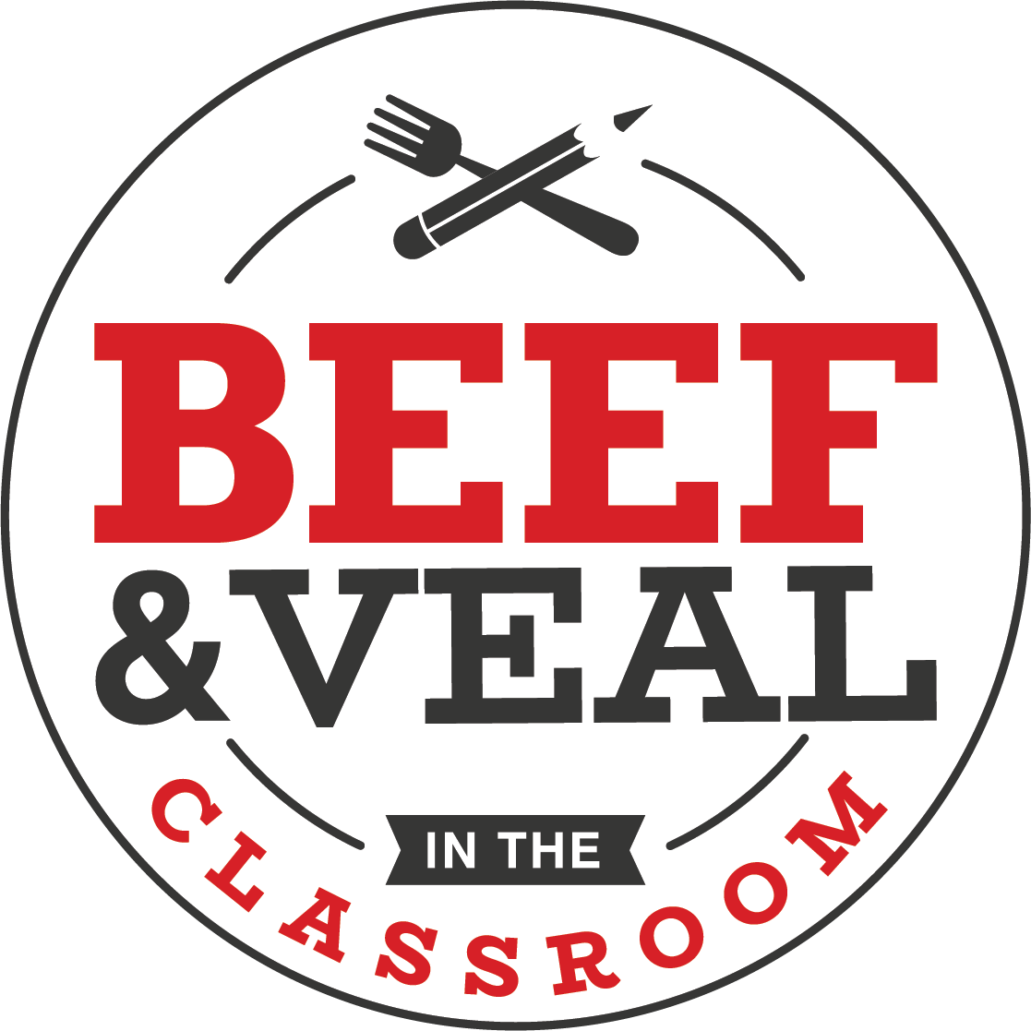
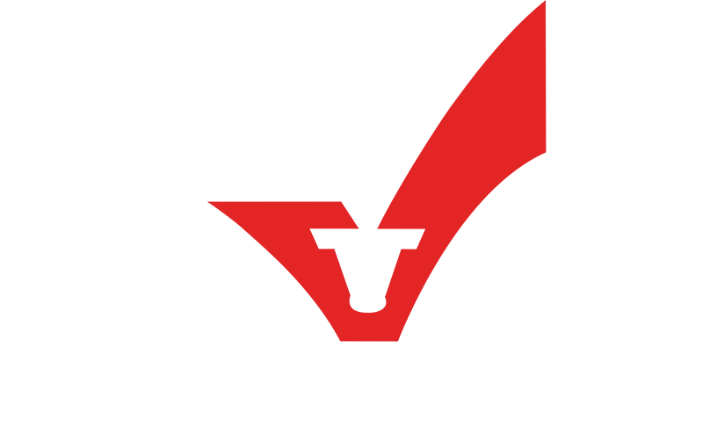
Beef in the classroom
Veal in the classroom
New Oxford High School
Presented in Partnership with the Wisconsin Beef Council
Kaitlyn Carey – PA Beef Council
Notes:
Good Morning/Afternoon Students! Today we will be going through a comprehensive lesson on veal – a high quality, nutrient-dense protein source! Our school has been fortunate enough to receive a grant through the Wisconsin Beef Council to supply the fresh veal product that we will use during our lab/cooking demo/etc. as part of this lesson.
First let’s learn a little bit about the Wisconsin Beef Council and the work they do…

Slide 2
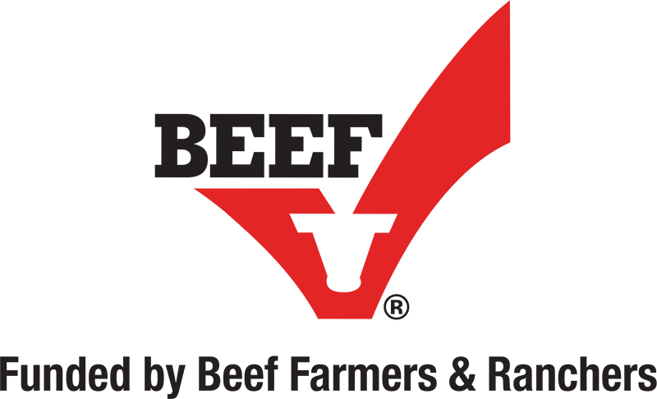

The Beef Checkoff Program
Non-profit organization
Working on behalf of Wisconsin’s beef and dairy farmers
Work in cooperation with the National Beef Checkoff Program
Mission Statement: To build beef demand that is sustainable for future generations.
Notes:
Some background information on the Beef Checkoff Program – to help guide the discussion:
The Beef Checkoff Program is a producer-funded (funded by beef, dairy and veal producers) marketing and research program designed to increase domestic and/or international demand for beef. This is done through promotion, research and new product development, and a variety of other marketing tools.
The Cattlemen’s Beef Board and USDA oversee the collection and spending of checkoff funds.
Checkoff dollars cannot be used for government lobbying efforts or anything policy-oriented.
As any checkoff program it is designed as a “self-help” program – farmers and ranchers are busy producing food for the world, they often don’t have time to promote their products and their livelihoods, this is where the checkoff comes into play
Wisconsin Beef Council specifics:
The Wisconsin Beef Council is a non-profit organization working on behalf of 25,000 beef, dairy and veal. Wisconsin’s 69,754 farm families continue to be the stewards of more than 14.3 million acres of farmland. With $10.7 billion in cash receipts annually from production agriculture, Wisconsin farmers and agribusinesses are the leading economic driver in our state.
The Wisconsin Beef Council’s Mission Statement is: Be a unified voice for our beef & veal partners by sharing their legacy of commitment with the families enjoying dinner with us.
Beef, dairy and veal producers are busy taking care of and raising their animals – we serve as “boots on the ground” to share their story and promote their products on their behalf.
Please direct any questions on the Beef Checkoff Program to Brooke Roberts - broberts@beeftips.com or 608-833-9944.

Slide 3
Today’s Lesson Goals
Brief Overview of the Veal Industry
  Today’s Veal Video
  Veal Production
  Group Housing
  Veal Nutrition
  Veal Quality Assurance
  Veal Resources
  Questions?
Notes:
You can customize this slide to reflect the goals for your specific lesson.
First, it’s important to understand the overall importance of Animal Agriculture. Let’s learn more on the next slide.

Slide 4
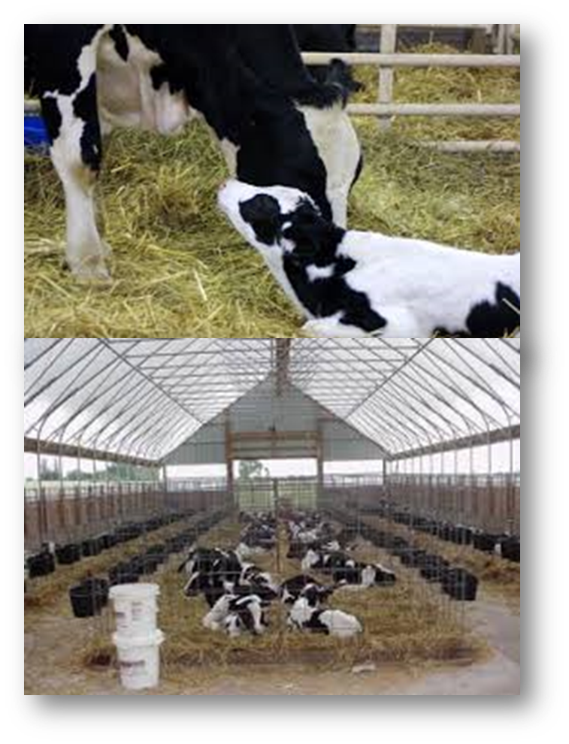
Importance of Animal Agriculture
Affordable food
One farmer feeds 155 people
97% of United States farms are family-owned and operated
2.5 million jobs
Notes:
Animal Agriculture is extremely important to our every day lives.
Here are some fun facts to keep in mind when you think of the people who produce meat, milk and eggs:
Due to efficient agriculture management and production practices, United States consumers spend only ~10% of their disposable income on food.
The average American can earn enough income in 40 days to pay for food for an entire year.
The average U.S. farmer raises enough food to feed 155 people.
In 1940, that number was 19.
About 2 percent of America's farms and ranches are owned by non-family corporations. The other 97-98 percent are owned by individuals, family partnerships or family corporations.
Animal agriculture in the United States accounted for more than $16 billion in income and sales tax and employs more than 2.5 million Americans.
While agriculture is the bedrock of a rural community’s economic foundation, farmers realize their obligation goes well beyond dollar and cents. Agricultural producers realize their ability to operate in a local community is a privilege, not a right.
It used to be enough for producers to just do the right thing for their animals and the environment. Now they know they must demonstrate for an increasingly curious public that they are doing the right thing.
On the next slide we will be watching a short video about Today’s Veal – what it is, who’s involved, etc.

Slide 5
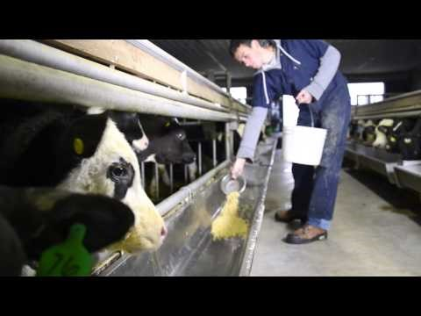
Today’s Veal
Notes:
Today we are starting off the veal lesson by showing a short video on what veal is and how it is raised. https://www.youtube.com/watch?v=mc9k5MURZ88
Play 2 minute video for background on Veal.
Video touches on:
What a veal calf is
What calves eat- milk fed
Housing needs
Questions to ask following the video:
Where do veal calves come from? A dairy farm
True or False: Veal calves are raised indoors. True
Veal calves died is primarily “x-based”. Milk-Based
How old are veal calves prior to harvest? 22 weeks old and approximately 500 pounds

Slide 6
The Basics
Veal: Nutrient-rich meat that is produced from the male offspring of dairy cows
Calf: Young bovine, either male or female
“Milk-fed” Veal: veal calves that are fed nutritionally-balanced milk-based diets
  This is how the majority of veal calves are raised
Where are most veal calves raised?
  In states with large concentrations of dairy farms, like Wisconsin
How big is a veal calf?
  Farmers purchase their calves when they are approximately 100 pounds and raise them for 20-22 weeks, until they weigh 475-500 pounds
How many calves does the average farm have?
  200 calves – all veal farms are small family farms
Notes:
This slide is designed to re-emphasize the concepts introduced in the short video. Review each term and definition with your students.
Emphasize that dairy cows give birth once a year in order to continue producing milk. Female offspring, or heifers, will stay on the dairy farm and enter the herd as replacement heifers in the milking cow herd. The male calves are either sold to veal farmers where they are fed to approximately 500 pounds and marketed as veal or these calves can be fed up to approximately 1200 pounds and marketed as beef.

Slide 7
Veal Production
Indiana, New York, Ohio, Pennsylvania and Wisconsin are the primary veal-producing states
Veal farmers purchase male Holstein calves, at about 100 pounds live weight and raise them for approximately 18-20 weeks or 475-500 pounds
The typical farm has 200 calves
Veal farmers contribute $350 million to the dairy industry through purchase of dairy by-products (used for feeding the calves) and male calves
Notes:
Many consumers are unaware of the important role veal plays in animal agriculture and in our rural communities. Veal farmers are important partners to the dairy industry and are generally located in states with a large dairy cow population, like Wisconsin. On dairy farms the female cow will have a calf once a year. The female calves called, heifers are kept on the farm to grow into milk producing cows. Bull calves are usually sold to a veal farmer to be raised for meat. Bull calves do not have a purpose on dairies which is why veal farms are so important to dairy farmers.
While our farms in WI may be smaller than many modern livestock farms, we provide a valuable economic contribution to the diary industry through the purchase of by-products and male dairy calves. Indeed, this partnership is viewed as both beneficial and sustainable for veal and diary producers as well as the communities in which these farms are located.
Learn more at: http://www.vealfarm.com/

Slide 8
Veal Production
How long does a veal calf stay with the dairy cow? When and why are they separated?
  Both male and female calves are separated from the cows within three days of giving birth
  Allows the dairy cow to return to the herd and produce milk for human consumption
  Calves receive colostrum, or first milk, from their mother’s
Notes:
There are a lot of questions within the dairy and veal industry surrounding the separation of the calf from it’s mother. This slide reviews how long the calf stays with their mom and then explains when and why the calves are separated.
It is important to emphasize that both male and female calves are separated from the cows within three days of giving birth, this allows the dairy cow to return to the milking herd and produce milk for human consumption. The calves stay with their mother’s to ensure that they receive colostrum.
Emphasize the importance of colostrum – “first milk” from their mama. It is full an antibodies and essential nutrients. It gives the calves’ immune system a healthy boost.

Slide 9
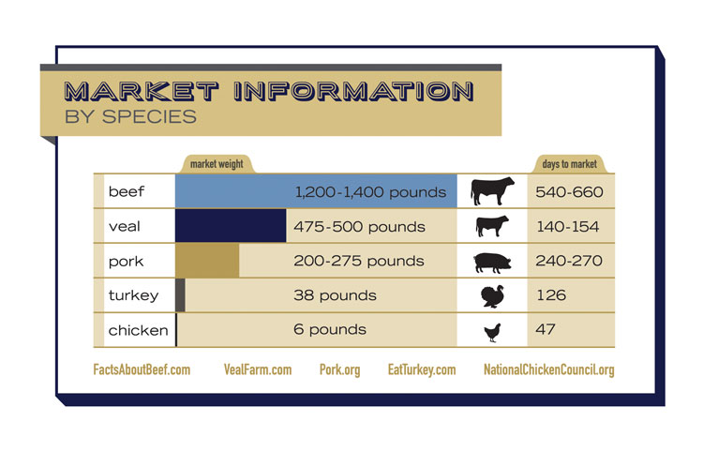
Veal Production
How big is a veal calf?
  Veal farmers buy their dairy bull calves when they weigh approximately 100 pounds
  Raise the calves for 20-22 weeks, until they weigh 475-500 pounds
Notes:
There is a lot of misinformation and perceptions held by consumers that all veal calves are very young and small (in size and weight) when they are harvested. The majority of veal calves are special-fed on veal farms and raised for 20-22 weeks, until they reach 475-500 pounds!
The infographic shows the market information by species for commonly consumed protein sources. It shows the market weight that the given animal is raised to, as well as the number of days it takes to raise that animal to market weight. Make the comparison between chicken and veal. It only takes 47 days (~7 weeks) to raise chickens to a market weight of 6 pounds compared to the 140-154 days (20-22 weeks) it takes to raise a veal calf to a market weight of 475-500 pounds.

Slide 10
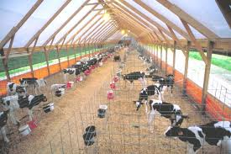
Responsible Veal Production – Housing
Housed in barns to protect their health and welfare
Easier for farmers to care for both healthy and sick animals
Protection from predators, disease and weather extremes
Barns are well-ventilated, temperature-controlled, well-lighted, clean and scientifically designed
Notes:
It is easy to generalize today’s animal agriculture industry. Agriculture has changed so dramatically over the last several years, therefore most people have limited knowledge of how these systems work and why the change has occurred.
There are some common myths that have become associated with today’s animal agriculture, one of those being housing.
Most food animals are housed in barns in order to provide a clean and healthy atmosphere. In addition to protecting the animals from predators, weather extremes and the spread of disease from outside sources such as birds and rodents, protects young animals and makes it easier for farmers to provide care for both healthy and sick animals.
A hog barn wouldn't be used for calves, any more than an adult would sleep in a child's crib. Housing is designed to allow the farmer to provide the best animal care to the calves.

Slide 11
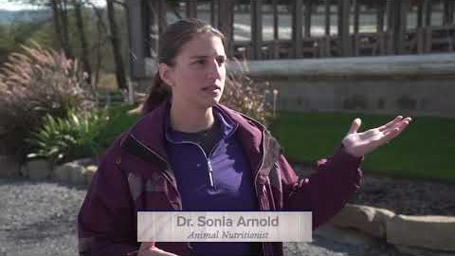
How veal calves are raised

Slide 12
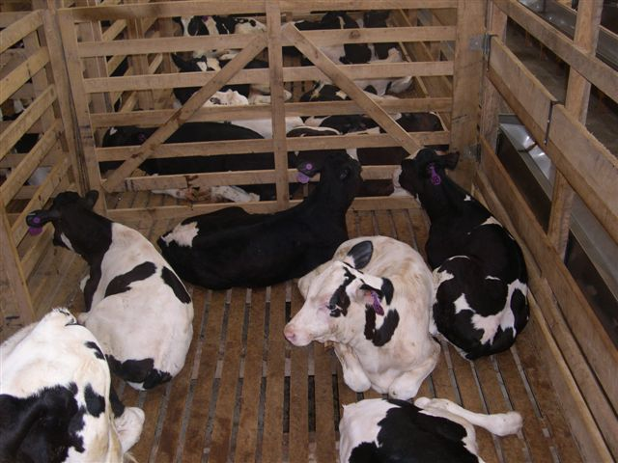
Group Housing Initiative
May 9, 2007— American Veal Association (AVA) Board of Directors unanimously adopts resolution calling for industry conversion to group housing
2012— AVA announces that 70% of member calves raised in group housing systems
December 31, 2017 – All U.S. Veal Producers will be converted to group housing
Notes:
In the video that played earlier you saw that the calves were housed in a group setting.
In 2007, the American Veal Association unanimously adopted a resolution calling for veal farmers to move to group housing. While science and farming experience tells us that calves can be provided quality care whether in a traditional or group setting.
The veal industry is very proud of the progress made by their producers. By December 31, 2017 all veal raised in the United States will be raised in group housing.
The main reasoning behind group housing was consumer demands. Consumers feel better knowing that calves are raised in a group setting.

Slide 13
Group Housing Initiative
Producers continue to experiment with group housing design
  Maintain individual care—meet consumer demands
  Minimize challenging calf behaviors—”bullying”
Research continues
  Better understand calf behavior
  Improve nutrition
  Refine various group housing systems to improve calf well-being
Notes:
Producers are continually working to improve the way that they raise calves in order to maintain individual care – this is directly linked to consumer demands. There are some challenges that farmers faced with group housing. Calves exhibit natural behaviors like bullying when together.
Research continues to constantly improve upon production methods.
For additional information regarding housing visit: http://www.vealfarm.com/housing/
For more information visit: http://www.vealfarm.com/housing/

Slide 14
Responsible Veal Production
To prevent illness and maintain calves health farmers take preventative measures – including the use of animal health products
These products are used judiciously with the guidance of a veterinarian
All animal health products are approved and regulated by the U.S. Food & Drug Administration (FDA) prior to be given to animals and very few antibiotics have been approved for use in veal calves
Notes:
To prevent illness and ensure that animals remain healthy, farmers take preventive measures -- including the use of animal health products. These products are given to the animal in a scientifically formulated feed best suited to the animal's needs. Before they can be used on the farm, all animal health products are approved and regulated by the U.S. Food & Drug Administration.
We will touch a bit more on antibiotics and what a withdrawal period are in a few slides.

Slide 15
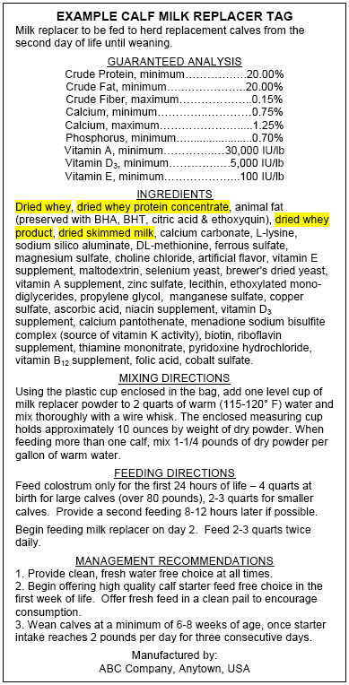
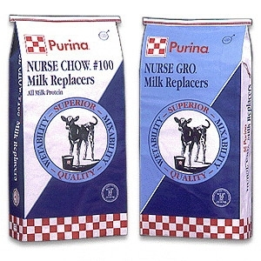
Responsible Veal Production
Veal calves receive diets designed to provide all of the 40 essential nutrients they need, including important amino acids, carbohydrates, fats, minerals and vitamins
In the formula-fed diet, research shows that calves must receive diets with iron to meet the animals' requirements for normal health and behavior
With a milk-based diet, formula-fed calves remain pre-ruminant. Once a calf is fed grain, the meat develops the strong flavor commonly associated with beef. Grain-fed calves are commonly known as "red-veal”
Notes:
Veal calves receive diets designed to provide all of the 40 essential nutrients they need, including important amino acids, carbohydrates, fats, minerals and vitamins.
In the formula-fed diet, research shows that calves must receive diets with iron to meet the animals' requirements for normal health and behavior.
With a milk-based diet, formula-fed calves remain pre-ruminant.
The video you just watched touched on milk fed calves. While all calves receive milk or milk replacer some farmers decide to feed a small amount of grain close to slaughter
Once a calf is fed grain, the meat develops the strong flavor commonly associated with beef. Grain-fed calves are commonly known as "red-veal."
Nutritional standards are established by a number of government agencies and professional organizations.
Fermentation in the rumen causes meat to change texture and flavor.

Slide 16
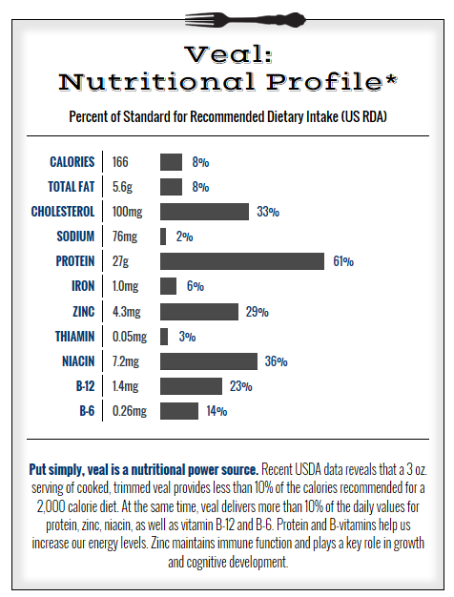
Veal – A Lean Meat
Cooked 3 oz. serving is about 166 Calories and 5.6 grams of fat
Excellent source of protein
Good source of Niacin, zinc, Vitamins B12 and B6
Leanest cuts include:
  Arm Steak
  Leg Cutlet
  Sirloin
  Rib Chop
  Loin Chop
  Top Round
Notes:
A Cooked 3 oz. serving is about 166 Calories and 5.6 grams of fat. Veal is a excellent source of protein and can be considered a good source of :
Niacin, zinc, Vitamins B12 and B6
Leanest cuts include:
Arm Steak
Leg Cutlet
Sirloin
Rib Chop
Loin Chop
Top Round
For more nutritional information and cooking information, visit www.vealmadeeasy.com

Slide 17
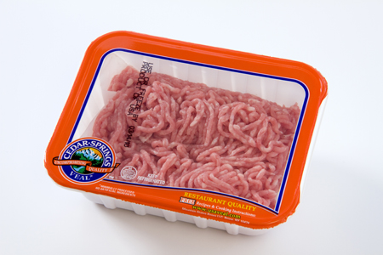
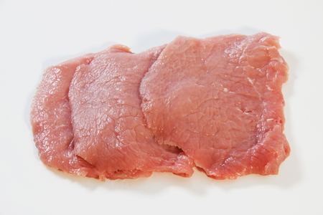
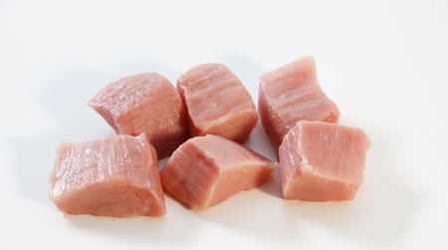
Veal – A Lean Meat
Why is veal meat light in color?
  The light meat results from the age of the calf
  The level of myoglobin (iron content) in the muscle
    Myoglobin produces a red pigment that affects the color of the meat
    The amount of iron the calves receive is controlled through their nutritionally-balanced milk-based diet
Notes:
When purchasing veal in the grocery store or from your local butcher it is very important to note that veal is much lighter in color than beef.
The reason that veal is a link pink color in comparison to the dark red color of beef is due to two factors: the age of the calf and the level of myoglobin found within the muscle.
Since the calf is younger, the meat is naturally lighter in color. Myoglobin is an iron and oxygen binding protein found within meat that produces the red pigment found within meats like beef and veal. The amount of iron found within a veal calf’s diet will directly affect the color of the meat, therefore the amount of iron contained within their diet is controlled through their nutritionally-balanced milk-based diet.
The calves iron level is checked periodically to ensure that they are not too low, to prevent anemia from occurring.

Slide 18
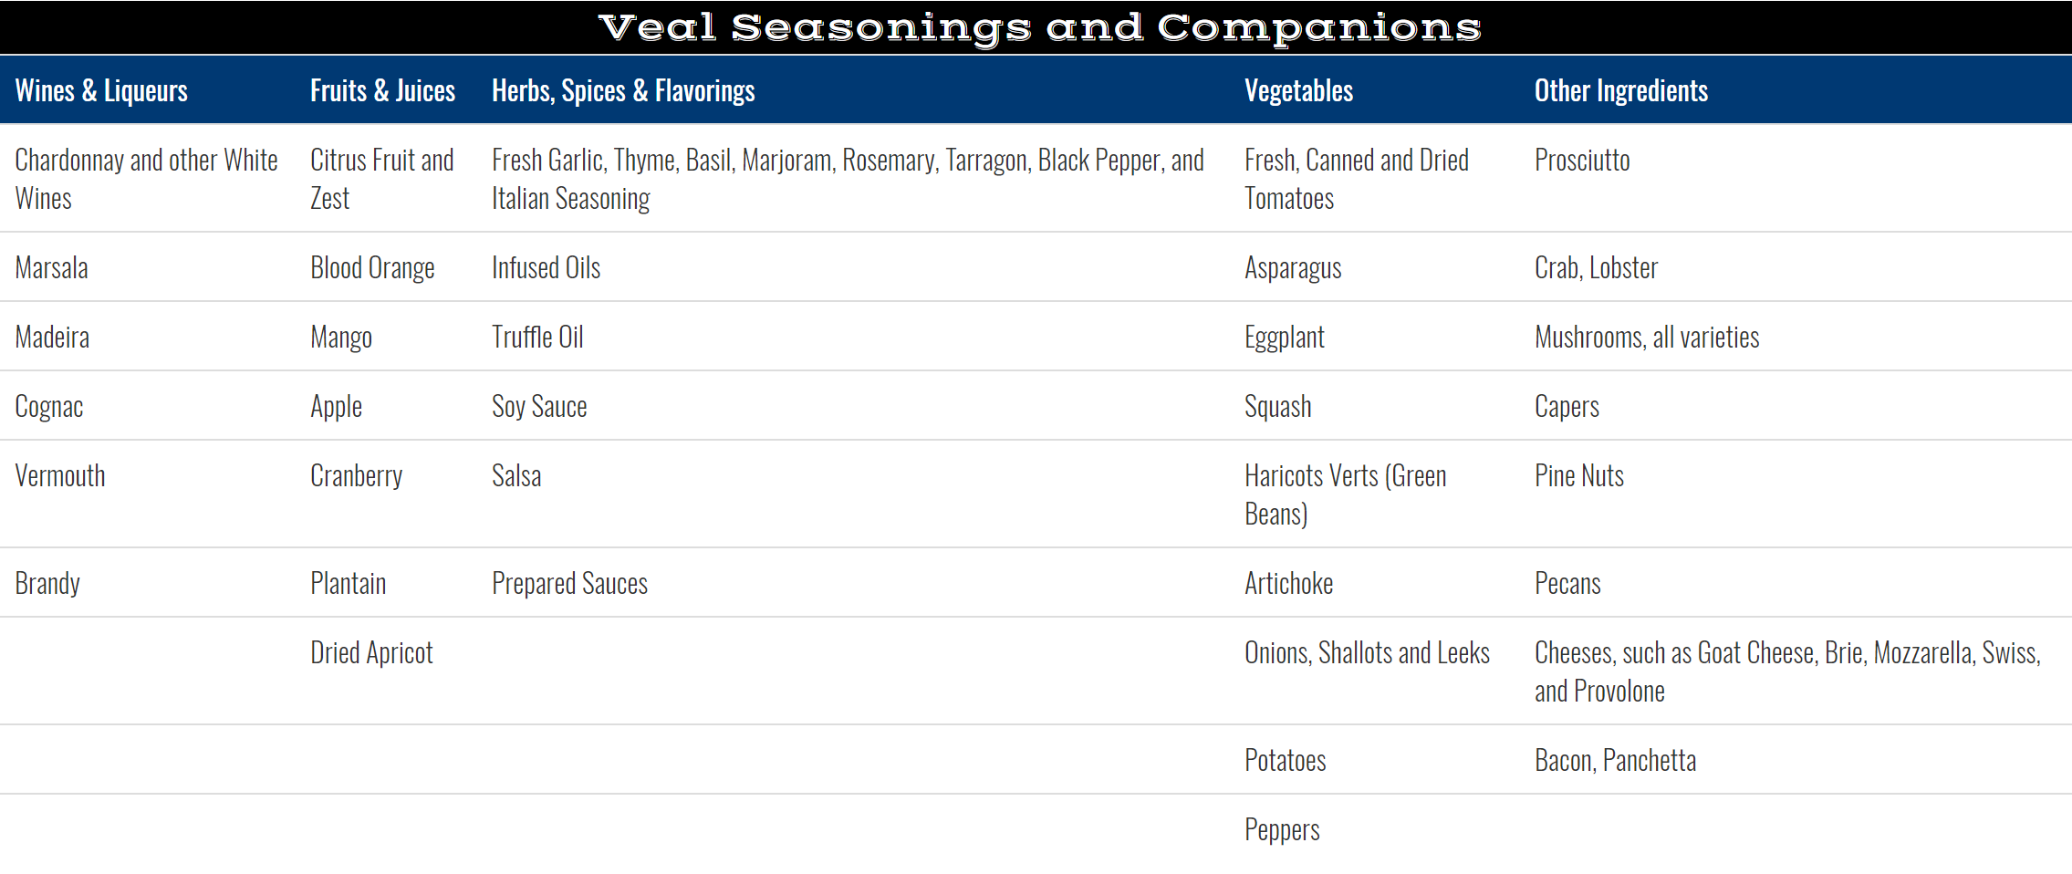
Cooking with Veal
Veal’s delicate flavor is compatible with a variety of seasonings
  Dry Rub
  Marinate
  Crust or Bread
  Sauce or Glaze
  Stuff
Variety of Cooking Methods
  Sautéing
  Stir-Frying
  Broiling
  Stewing
  Grilling
  Braising
For optimal flavor, juiciness and tenderness cook veal to medium (160 degrees F)
Notes:
Some basics surrounding cooking with veal.
Visit www.vealmadeeasy.com for more information and recipes!

Slide 19
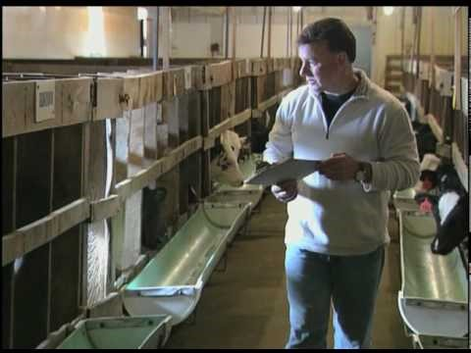
Tour a Wisconsin Veal Farm
Notes:
This is another video that showcases a small family-owned and operated veal farm in Wisconsin.
The video can be found here: https://www.youtube.com/watch?v=PYMkFNlXa_M

Slide 20
Veal Quality
Assurance
Production Standards and Best Practices for the U.S. Veal Industry
Notes:
Let’s spend a few minutes talking about what veal farmers are doing to care for and produce such a safe and wholesome food supply. To ensure quality care for their animals, safe food and consistent quality, veal farmers have created the Veal Quality Assurance program designed to ensure that farmers are using the best science and best practices necessary to produce veal.
Learn more here: http://www.vealfarm.com/certification-levels/

Slide 21

Veal Quality Assurance Program
Originally developed in 1988, as an education program—one of the first of its kind
Includes all segments of veal industry
Provides best management practices and animal care standards to ensure a safe, wholesome and consistent quality product
Two-year certification
Notes:
Recognizing the importance of assuring consumers of the importance of doing what’s right, veal farmers created the VQA in 1988. This program was one of the first of its kind. Farmers receive a 2-year certification after completing the education component and pledging to abide by the program.
There are additional quality assurance programs within the agricultural industry, including the beef quality assurance program.
This program enables veal producers to stay up-to-date with any changes occurring within the industry, including regulations, production practices, etc.

Slide 22
Veal Quality Assurance Program
VQA Program Committee includes: farmers, packers, veterinarians, animal nutritionists and other experts
Primary Components
  Education
  Best Practices
  Regulations/Laws
  Record-keeping
  Training
  Checklist/Self-Assessment
Notes:
The VQA was created and is managed by a variety of individuals with extensive education and experience in animal care. The VQA is very comprehensive and covers all areas necessary to ensure sound production practices. From education to ongoing self-assessment, veal farmers must continually update best practices.
Primary Components
Education- new research that has come out
Best Practices- for caring and keeping animals healthy
Regulations/laws that impact their operation
Record-keeping- Keeping up to date records is very important on any operation
Training- for new employees on the farm or to implement new practices
Checklist/self-assessment- on yourself and your operation

Slide 23
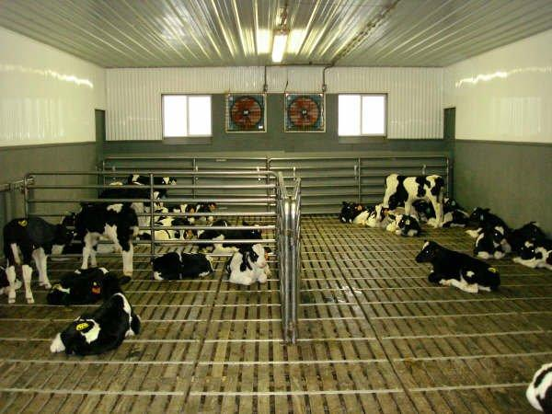
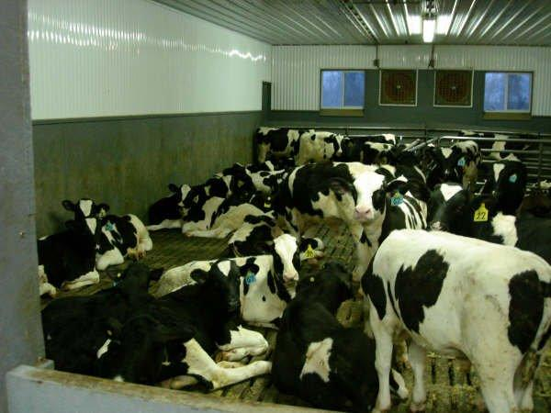
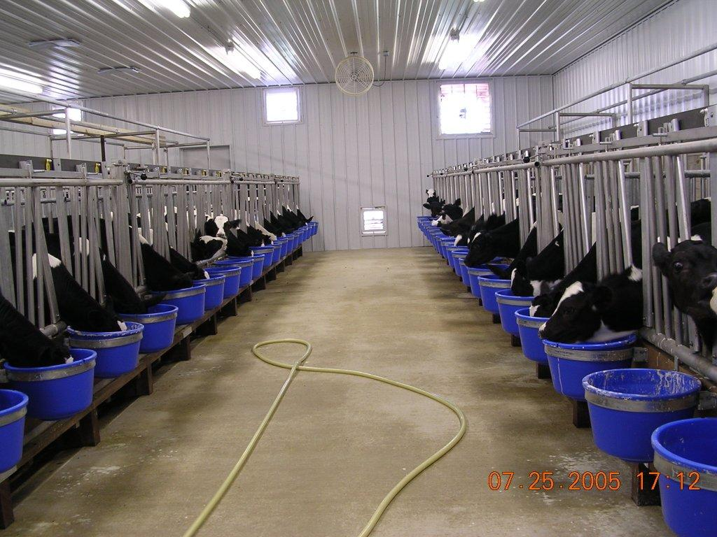
Notes:
Here are some photos of a modern veal production. Emphasize the group housing structure. The gates are set-up in the top right picture to allow the calves the option to get away from each other. Calves are very much like kids – they will find their familiar groups and then all go their own way and stay within those groups.
The bottom right picture shows how the calves are fed, with a hose line and buckets. The calves drink their milk replacer out of the buckets. Each calf has their own bucket.

Slide 24
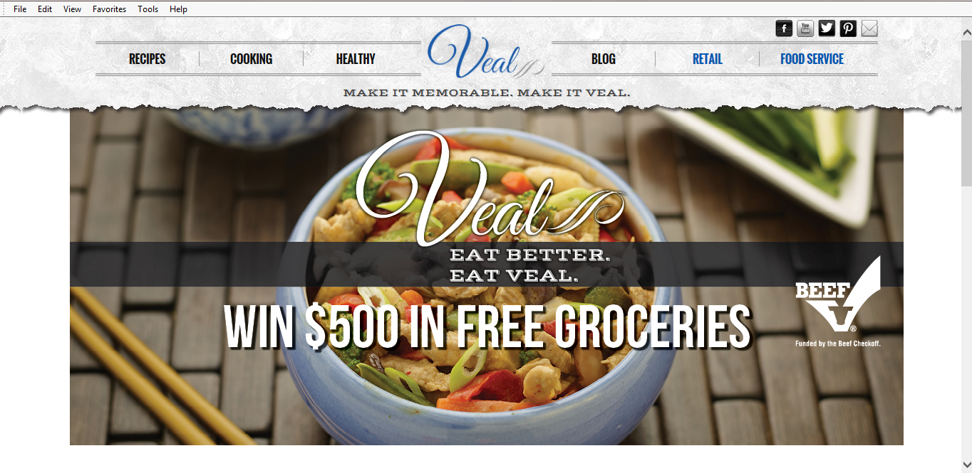
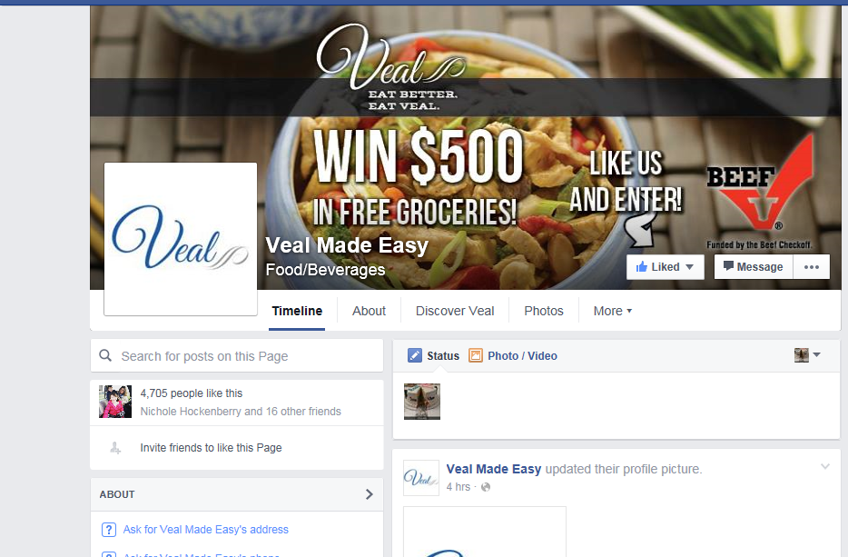
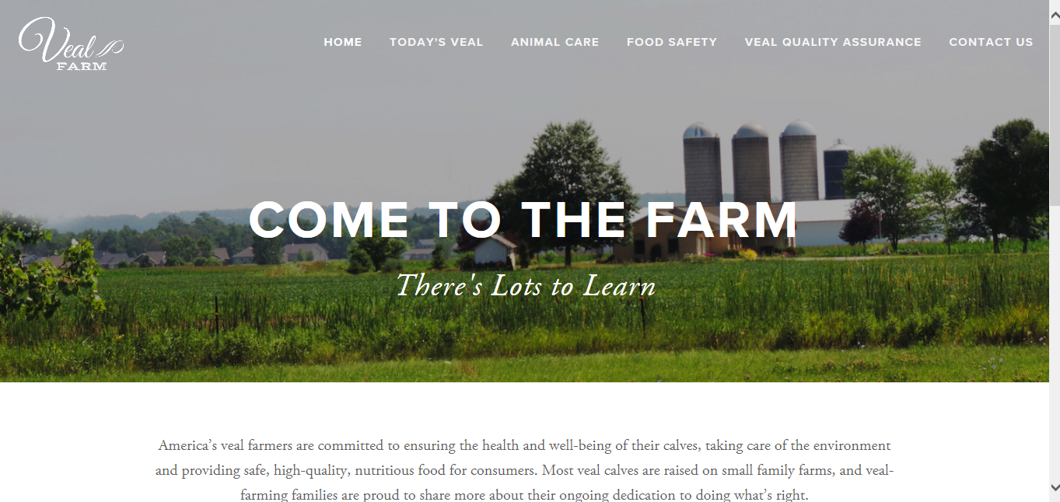
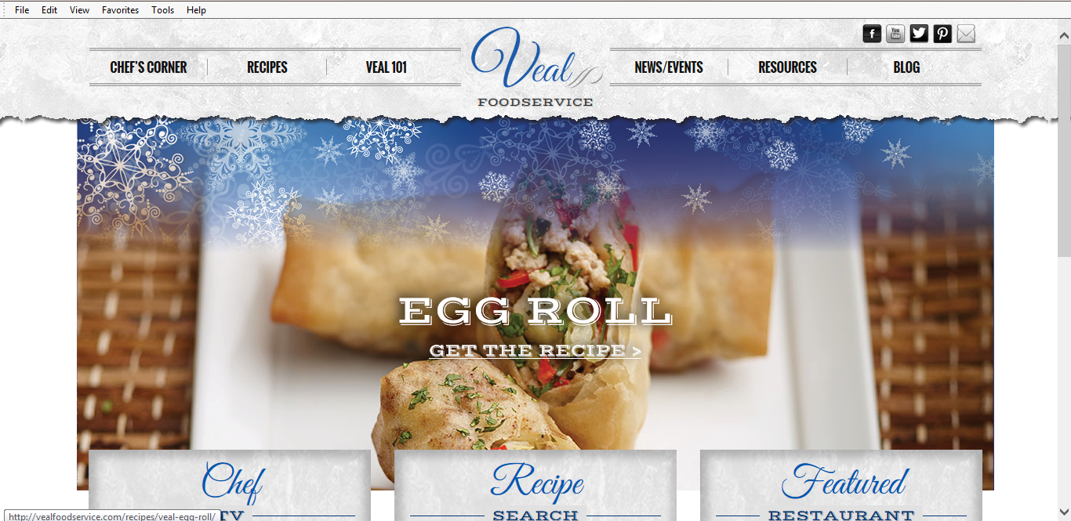
Veal Resources
Notes:
Find Veal Made Easy on social media and online at www.vealmadeeasy.com and on Facebook.

Slide 25
Veal-Specific Beef Checkoff Resources:
www.vealmadeeasy.com
www.vealfarm.com
Notes:
The go-to resource for everything veal is www.vealmadeeasy.com and www.vealfarm.com

Slide 26
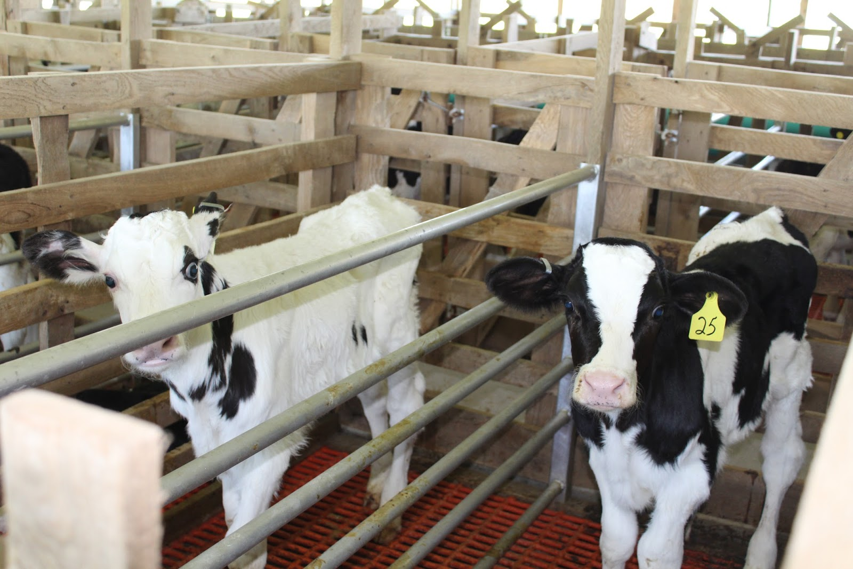
Questions?
???
Notes:
Any questions?
If any questions are asked by your students that you are uncomfortable answering in the moment, please feel free to direct their questions to me at broberts@beeftips.com or 608-833-9944.

