Slide 1




Raising Beef

Slide 2
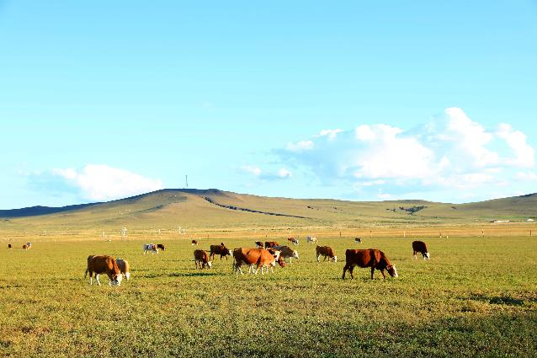
What You’ll Learn in This Lesson
Beef lifecycle from farm to fork
Beef Quality Assurance
Animal welfare
The beef community’s commitment to sustainable management practices
The partnership with veterinarians to provide safe, wholesome, and nutritious beef
How to talk to customers about beef production
Beef University
Notes:
Welcome to this Beef University lesson on Raising Beef where you’ll learn about how beef is raised in a responsible and sustainable way. We will share information on the beef lifecycle from farm to fork and our commitment to quality beef and animal welfare.
We will also share information on how the beef community conserves naturals resources while continuing to improve sustainable management practices. We will discuss our partnership with veterinarians and how, by working together, we keep cattle healthy to provide safe, wholesome and nutritious beef.
Finally, we will share strategies you can use to talk about beef productions.

Slide 3
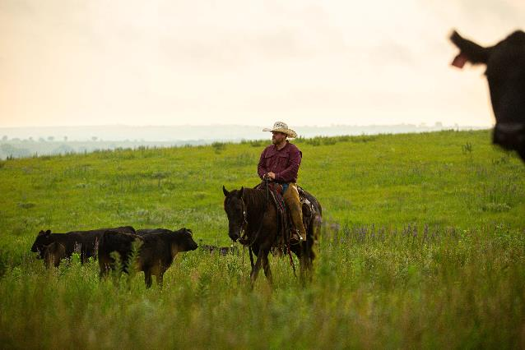
What Consumers Want
They want to know that:
Beef is responsibly raised
Animal welfare standards are maintained
Natural resources are conserved including:
  Soil
  Water
  Air
Beef University
Notes:
Foodservice and grocery retail operators know it’s not enough to just deliver a great eating experience. We conduct market research throughout the year to understand what beef customers are looking for, and it’s clear that customers want a great eating experience from food that was grown or raised responsibly. That is, with care for animals and for natural resources like soil, water and air.

Slide 4
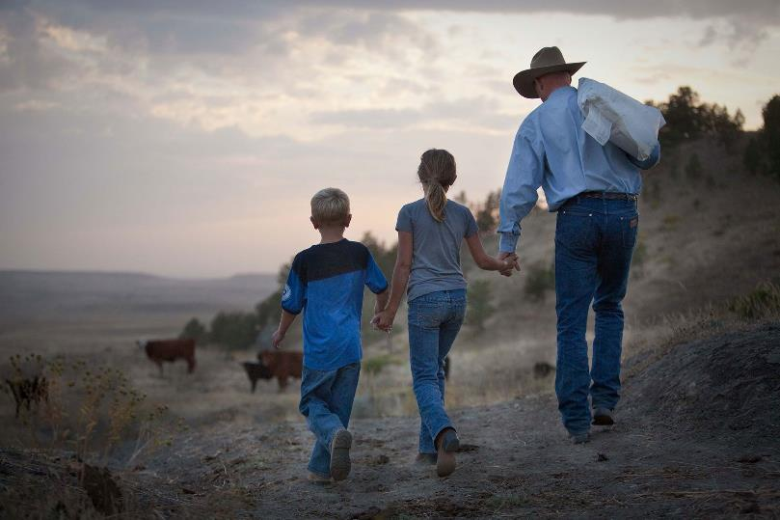
The Beef Community
Beef University
Notes:
For generations, cattle farmers and ranchers have been dedicated to raising beef responsibly and in a way that is sustainable. Their livelihood and the continued viability of their operation then, now and for future generations depends on it – and it is simply the right thing to do.
Let’s take a look at the community of people behind beef – our cattle farmers and ranchers.

Slide 5
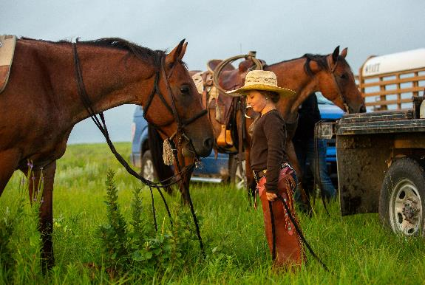
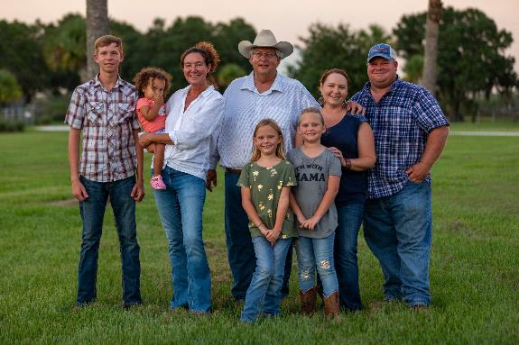
The Beef Community
Beef University
Notes:
America’s beef community is full of conscientious farmers and ranchers in all fifty states doing their very best to raise cattle in an environmentally and socially responsible way. Understanding more about the community that raises beef can bring clarity to misconceptions about the practices within the cattle industry.

Slide 6
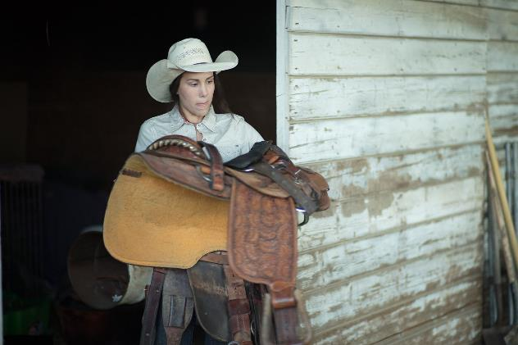
The Beef Community
91%
Farms and Ranches are Family Owned
80%
Feedyards
are
Family Owned
882K
Cattle Farms, Ranches, and Feedyards in the U.S. today
43.5
Head of Cattle
Average U.S.
Beef Herd
Size
Beef University
Notes:
For instance, ‘factory farm’ is a term you may have heard, but research shows the perception of a ‘factory farm’ is very different from reality. In reality, the vast majority of U.S. cattle farms and ranches and feedyards are family owned.
Many are also operated by women, as well as younger farmers and ranchers – a number that continues to grow as the face of American agriculture shifts. Today, there are hundreds of thousands of cattle farms, ranches and feedyards in the United States. And you may be surprised to know most are relatively small.

Slide 7
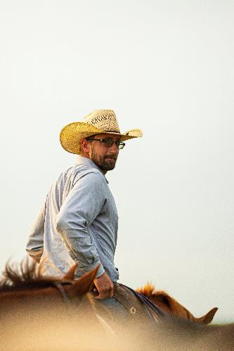
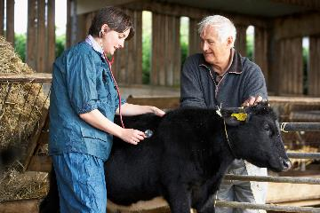
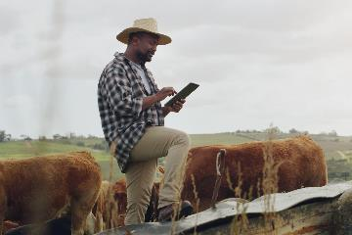
The Beef Community
Farmers and ranchers AND:
  Veterinarians
  Animal nutritionists
  Researchers
  Academia
Beef University
Notes:
While family farmers and ranchers make up the foundation of the beef community, there are many other people who work at every step of the journey to bring beef from farm to fork. These include veterinarians, animal nutritionists, and industry professionals who work with farm/ranch employees to provide quality care and nutrition for cattle every day. The beef community also includes the researchers, agricultural teachers and students who study ways to improve animal care, efficiencies in the life cycle and beef safety.

Slide 8
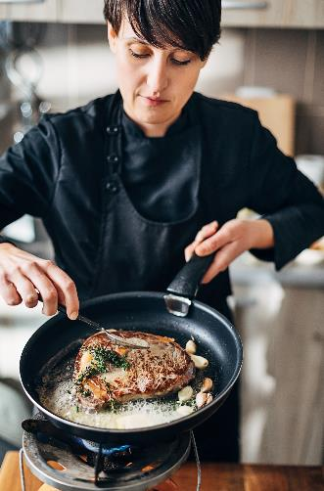
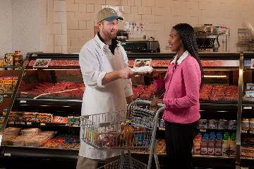
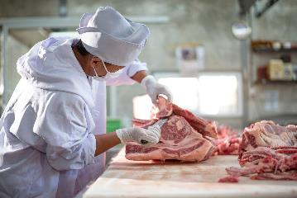
The Beef Community
Farm equipment suppliers
Processing plant employees
Retail associates
Restaurant and foodservice staff
Beef University
Notes:
Then there are the employees of the many large and small businesses that provide farm equipment and supplies, as well as those who work in the processing plants, and then people like you who work in grocery retail and foodservice who ultimately provide beef to consumers.

Slide 9
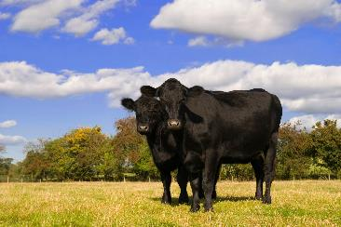
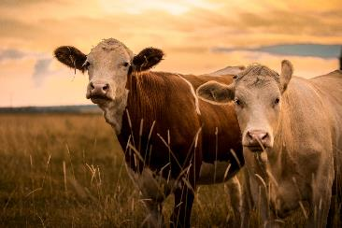
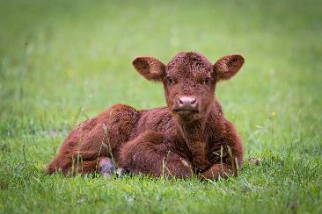
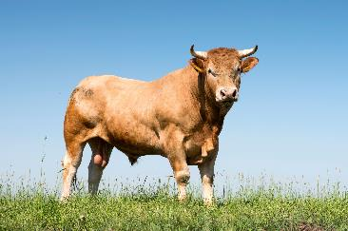
Cattle Definitions
Cow = Female who has given birth to a calf
Heifer = Female who hasn’t given birth to a calf
Bull = Intact male
Steer = Castrated male
Calf = Young cattle which have not been weaned
Beef University
Notes:
Before we get into the Beef Lifecycle, let’s talk about cattle. You’ve likely heard most cattle called “cows,” but since you’re in Beef University, let’s be technical: cows are only female cattle who have given birth.
One who hasn’t given birth is known as a heifer. And when it comes to males, bulls are intact adults and steers are castrated. And young cattle are called calves.

Slide 10
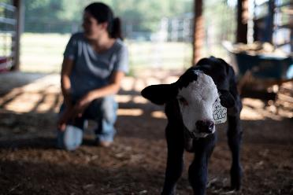
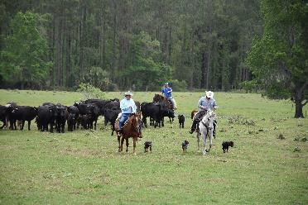
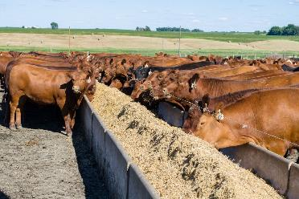

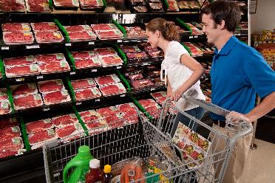

The Beef Lifecycle
Cow/Calf Operation
Stocker/Backgrounder
Feedyard
Packer/Processor
Grocery Retail
Foodservice Operator
Beef University
Notes:
Let’s take a closer look at the beef “lifecycle” – the journey beef takes from farm to fork – which demonstrates the breadth and depth of the beef community. Understanding the beef lifecycle also will help you answer one of the most basic questions we hear, which is “where does beef come from?”
The beef lifecycle is perhaps one of the most unique and complex lifecycles of any food. It takes anywhere from 2 to 3 years to bring beef from pasture to plate.

Slide 11
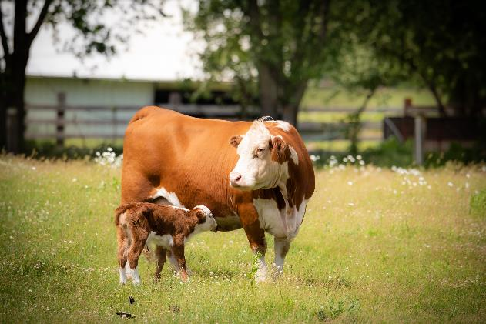
Cow-Calf Farms and Ranches
Female cattle are bred and give birth to a calf
Typically one calf per year
Gestation length is 9 months (approximately 285 days)
Calves weigh between 60 – 100 lbs.
Calves live off mother’s milk and graze on grass pastures
Beef University
Notes:
The beef lifecycle begins on cow-calf farms and ranches where cows, or female cattle, are bred and give birth to generally one calf each year. These are family farms and ranches like those you may see along highways and country roads.
Gestation is 9 months. When a calf is born, it typically weighs between sixty and one hundred pounds depending on the breed. Calves at this stage – whether traditionally raised, grass-fed or organic – live off their mother’s milk and graze on grass pastures.

Slide 12
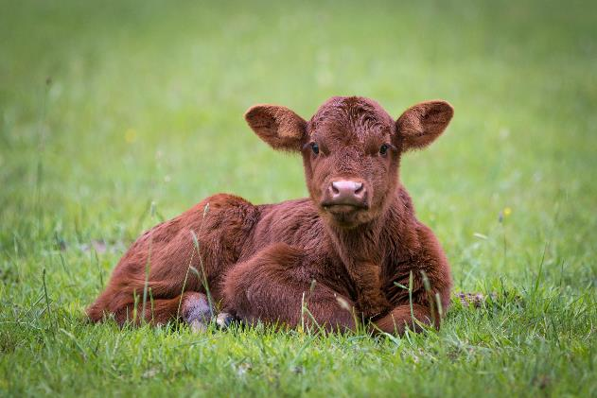
Cow-Calf Farms and Ranches
Weaned between 6 and 10 months of age
Weigh 450 - 700 lbs.
Most continue to graze on grass pasture
Almost all beef cattle spend the majority of their lives grazing on grass
Beef University
Notes:
Calves are weaned from their mother’s milk at 6 to 10 months of age when they weigh between 450 and 700 pounds. These calves may continue to graze on grass pasture.
In fact, nearly all beef cattle spend the majority of their lives grazing on grass. It is only during the finishing stage – which we will discuss later – that some beef cattle are given roughage and grain. Those that continue to be fed grass exclusively can be marketed as grass-finished or grass-fed beef.

Slide 13
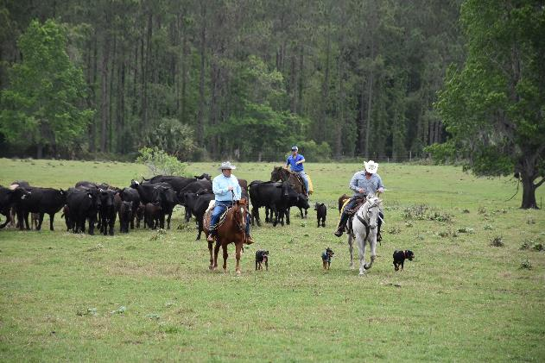
Stocker and Backgrounder Farms and Ranches
Cattle spend 4-6 months here
Cattle continue to graze on grass pastures and are given supplemental feed, including vitamins and minerals
35% of land in the U.S. is pasture and rangeland – too rocky, steep or arid to support crops
Cattle upcycle human-inedible grasses and plants to high-quality protein
Sources: USDA, Economic Research Service using data from the Major Land Use data series. Available at: https://www.ers.usda.gov/data-products/major-land-uses.aspx; National Academies of Sciences, Engineering, and Medicine. 2016. Nutrient Requirements of Beef Cattle: Eighth Revised Edition. Washington, DC: The National Academies Press. https://doi.org/10.17226/19014;
Council for Agricultural Science and Technology (CAST). 1999. Animal Agriculture and Global Food Supply. Task force report N. 135 July 1999, Department of Animal Science, University of California, Davis, CA, USA. Available at: http://agrienvarchive.ca/bioenergy/download/anag.pdf; Davies, KW, et al. Winter grazing can reduce wildfire size, intensity and behaviour in a shrub-grassland. International Journal of Wildland Fire 25(2) 191-199 https://doi.org/10.1071/WF15055
Beef University
Notes:
After weaning, calves may move to stocker or backgrounder farms and ranches for between four and six months, where supplemental feed is provided, including vitamins and minerals, to meet their changing nutritional needs as they grow.
Approximately 35 percent of the land in the contiguous U.S. is pasture and rangeland that is too rocky, steep, and/or arid to support cultivated agriculture – yet this land can support cattle, sheep and goats. Cattle graze in these areas, such as the sandhills of Nebraska or the arid land of Nevada. Cattle play a unique role in our food system by upcycling human-inedible grasses and plants to high-quality protein. And in shrub grassland areas, cattle even mitigate the risk of wildfire.
Before we move onto the feedyard, let’s reiterate that almost all beef is grass-fed, since cattle spend the majority of their lives on pasture. Grass-fed is a voluntary marketing claim that cattle farmers and ranchers may request the U.S. Department of Agriculture to verify in order to distinguish their beef products at a grocery store or restaurant.
It’s important to note that this is a marketing claim that pertains to the animal’s diet – it is not a nutrition nor animal welfare claim.
[USDA, Economic Research Service using data from the Major Land Use data series. Available at: https://www.ers.usda.gov/data-products/major-land-uses.aspx
National Academies of Sciences, Engineering, and Medicine. 2016. Nutrient Requirements of Beef Cattle: Eighth Revised Edition. Washington, DC: The National Academies Press. https://doi.org/10.17226/19014
Council for Agricultural Science and Technology (CAST). 1999. Animal Agriculture and Global Food Supply. Task force report N. 135 July 1999, Department of Animal Science, University of California, Davis, CA, USA. Available at: http://agrienvarchive.ca/bioenergy/download/anag.pdf
Davies, KW, et al. Winter grazing can reduce wildfire size, intensity and behaviour in a shrub-grassland. International Journal of Wildland Fire 25(2) 191-199 https://doi.org/10.1071/WF15055]

Slide 14
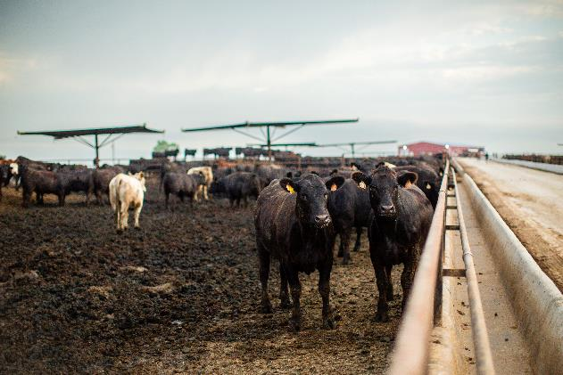
Feedyards
Majority of cattle go to a feedyard between 10 and 16 months of age
Stay between 4 – 6 months
Constant access to food and water
Balanced diet
  Roughage (grass + hay)
  Grain (corn, wheat)
  Crop + food byproducts (tops of sugar beet plants, potato peelings, distiller’s grains) - Upcycling
Beef University
Notes:
The majority of cattle in the United States are then sold or moved to a feedyard between ten and sixteen months of age, where they stay for an average of four to six months prior to harvest. Feedyards look different than cow-calf and backgrounding operations because cattle do not graze on pasture. Rather, they typically are separated into groups of 50 - 100 animals and live in pens with ample room to walk, run, play and lie down.
While at the feedyard, cattle have constant access to water and have free access to the feed bunks containing a carefully balanced diet of roughage (such as grass and hay), grain (such as corn and wheat) and other local renewable feed sources made from the byproducts of crops and food and beverage products made for humans, such as the tops of sugar beet plants, potato peelings, even citrus pulp or distillers grains generated by the beer and whiskey production process.
Ninety percent of what cattle eat is forage and plant leftovers that people can’t eat. Cattle play a role in a holistic and sustainable food system by eating these “plant waste” products and upcycling them into high quality protein, contributing to beef’s sustainability.

Slide 15
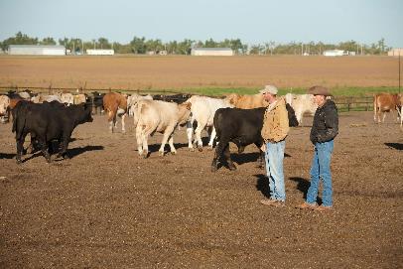
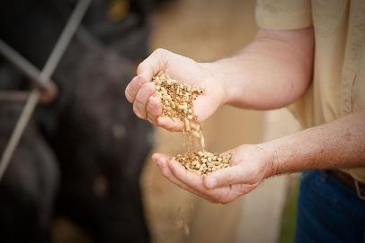
Feedyards
Team looks after the animals
  Veterinarians
  Nutritionists
  Pen riders
Efficient growth minimizes use of:
  Land
  Water
  Feed
  Other resources
Beef University
Notes:
Veterinarians, nutritionists and pen riders responsible for caring for the animals work together to look after each animal. Genetics, carefully designed diets and high-quality feed rations lead to efficient growth, which results in more meat per animal as well as a more uniform eating experience. Efficient growth minimizes the amount of land, water, feed and other resources needed to sustainably provide affordable beef for a rapidly growing population.
Beef cattle are a net source of protein to the human food supply, generating 19% more protein than they consume. Corn used to feed beef cattle represents only 10% of harvested corn grain in the U.S. By comparison, 37.5 percent of corn acreage in the U.S. is used for producing fuel ethanol.
[Council for Agricultural Science and Technology (CAST). 1999. Animal Agriculture and Global Food Supply. Task force report N. 135 July 1999, Department of Animal Science, University of California, Davis, CA, USA. Available at: http://agrienvarchive.ca/bioenergy/download/anag.pdf
CA Rotz, S Asem-Hiablie, S Place, G Thoma., 2018. Environmental footprints of beef cattle production in the United States. Agricultural Systems. Advance online publication. doi.org/10.1016/j.agsy.2018.11.005]

Slide 16
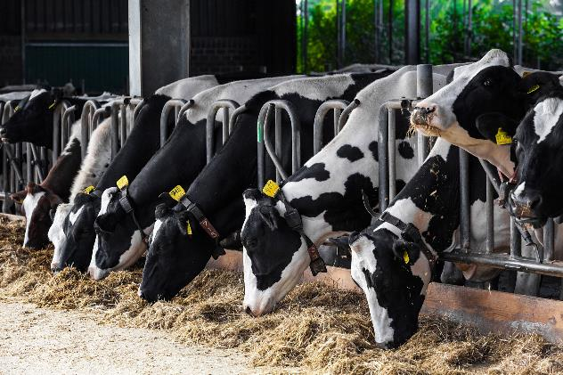
Dairy Cattle
Between 20% - 25% of the beef supply originates in the dairy industry
Dairy calves = high-quality beef
1/3rd of USDA Prime beef comes from dairy cattle
Beef University
Notes:
Another important segment of the beef supply chain is cattle originating from dairy farms. While the primary purpose of dairy cows is to produce milk, dairy cattle eventually become beef. Each year, between 20 and 25% of the beef supply originates in the dairy industry.
Dairies provide a consistent supply of calves into feedyards annually because dairy cow numbers in the U.S. fluctuate very little, with about 9 million cows being milked annually.
Dairy calves grow into adulthood in feedyards and provide high quality beef, making up about one third of the USDA Prime beef supply.

Slide 17
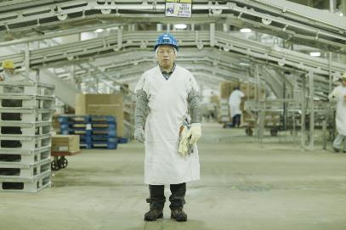
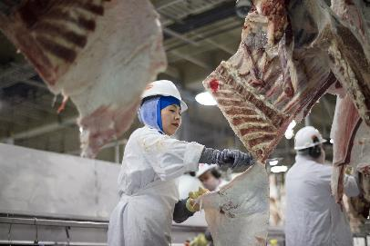
Packing Plant
Cattle reach market weight between 18 – 22 months
Market weight = 1,200 – 1,400 lbs.
Both grain-finished and grass-finished cattle are harvested in packing facilities
Beef University
Notes:
Once cattle reach market weight – typically at 1,200 to 1,400 pounds, which is when cattle are between 18 and 22 months of age – they are sent to a packing plant.
Both grass-finished and grain-finished beef cattle are harvested in modern processing facilities or packing plants where skilled workers break down beef carcasses into the popular beef cuts that you sell.

Slide 18
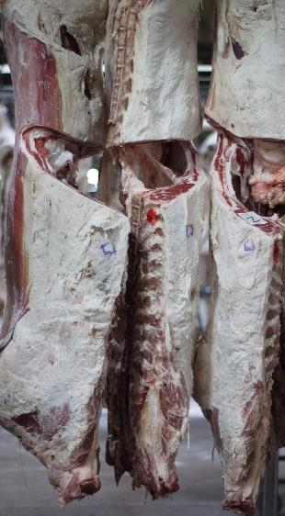
Packing Plant
Scientifically backed process ensures:
  Humane animal treatment
  Production of a safe food product
  Safety of employees
Beef University
Notes:
The harvest process is based on scientific research to ensure the humane treatment of every animal, the production of a safe food product and the safety of employees in the plant. When cattle arrive at packing plants, they are moved inside the plant in a quiet and orderly manner. There is little excess movement or unnecessary noise, so the cattle remain calm and move smoothly. Packing plant technicians then use a mechanical stunning device to quickly and effectively render each animal unconscious to begin the harvest process.

Slide 19
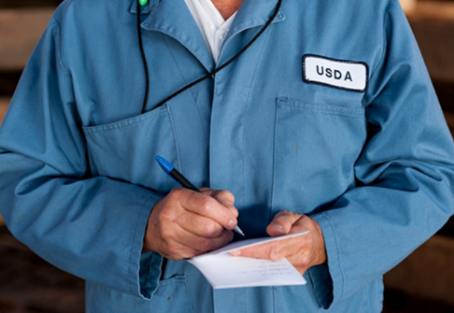
Packing Plant
USDA inspectors are stationed in all federally inspected plants
They oversee the entire process to ensure:
  Safety
  Animal welfare
  Quality standards
Beef University
Notes:
As we mentioned during the Beef Basics, Cuts and Preparation lesson, without a USDA inspector present, federally-inspected facilities cannot operate. State-inspected plants also receive inspection by state-employed inspectors. However, for Beef University we will focuses on beef from federally inspected processing facilities.
The Federal Meat Inspection Act requires USDA inspectors to provide inspection of all live animals before they enter the meat processing facility. The inspector evaluates animals to ensure they are healthy and fit for harvest. If animals appear sick or have an injury, the USDA inspector will deem the animal unfit for human consumption and the animal will not enter the food supply.
After animals are harvested, a USDA inspector will perform additional inspections to ensure the wholesomeness of the beef carcass. Once approved, the carcass is stamped with a non-toxic ink stamp to show that the animal has passed USDA inspection. If a carcass does not pass the USDA inspection it is condemned, stamped as such and does not enter the food supply.
All meat products are inspected by USDA inspectors before leaving the federally regulated facility. This process is mandatory and is paid for with tax dollars.

Slide 20
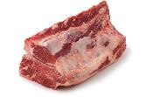
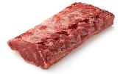
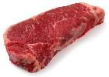
Packing Plant
Packing plants produce primals, subprimals, and trimmings for ground beef production
These products are sent to either:
  Additional plants that fabricate individual steaks and roasts, as well as ground beef
  Supermarkets/butchers/restaurants which fabricate individual steaks and roasts, as well as ground beef
PRIMALS
Loin Primal
SUBPRIMALS
Strip Loin
PORTION CUTS
Strip STEAK
Beef University
Notes:
When beef leaves the packing plant, it is in the form of large sections – either primals, like the chuck, rib and loin, or subprimals, which are still relatively large cuts of meat such as the bottom round, top round, eye of round and round tip. Some plants sell subprimals to meat processing facilities where workers skillfully fabricate them into individual steaks and roasts that are sent to supermarkets and restaurants worldwide.

Slide 21
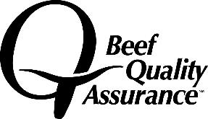
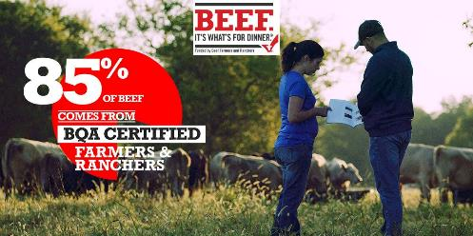
Beef Quality Assurance
Established more than 30 years ago
Voluntary program
Trains farmers and ranchers on best practices
Major beef suppliers source their cattle from BQA certified farmers and ranchers
More than 85% of beef in the US comes from BQA certified ranches
Source: National BQA Database
Beef University
Notes:
It’s important to note that all those involved in the beef community from the beginning to the end of the lifecycle are dedicated to raising and supplying safe, wholesome and nutritious beef. Just as important is the concern for the welfare of the animal and environmental stewardship.
This dedication is evident in the continuous effort to improve, exemplified by the beef checkoff funded Beef Quality Assurance, or BQA, program. For more than 30 years, the beef community has participated in the voluntary BQA program to ensure U.S. beef is produced under stringent animal care standards, resulting in high-quality" beef. The BQA program trains farmers and ranchers on best practices and cattle management techniques to ensure their animals and the environment are cared for within a standard set of guidelines across the U.S. beef industry.
Major beef suppliers source their cattle from BQA certified farmers and ranchers. Today, more than 85% of the beef in the United States comes from these farms and ranches.

Slide 22
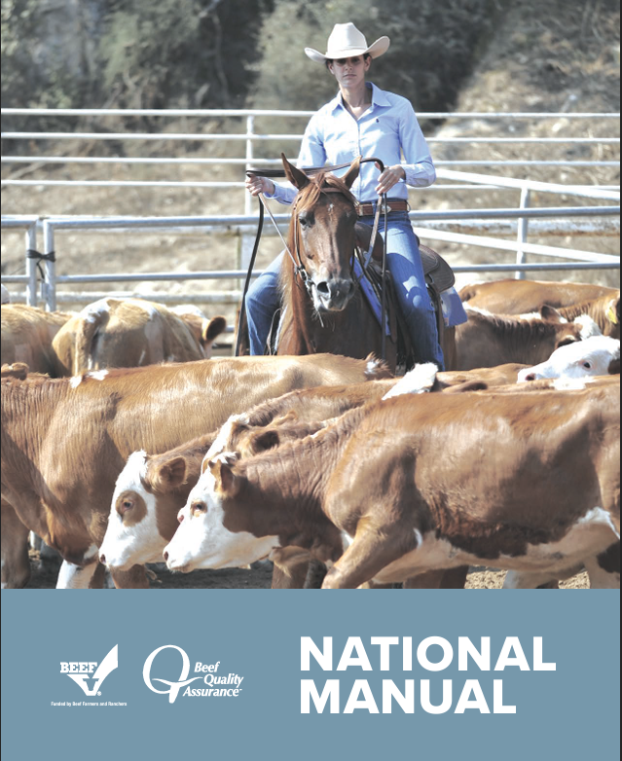
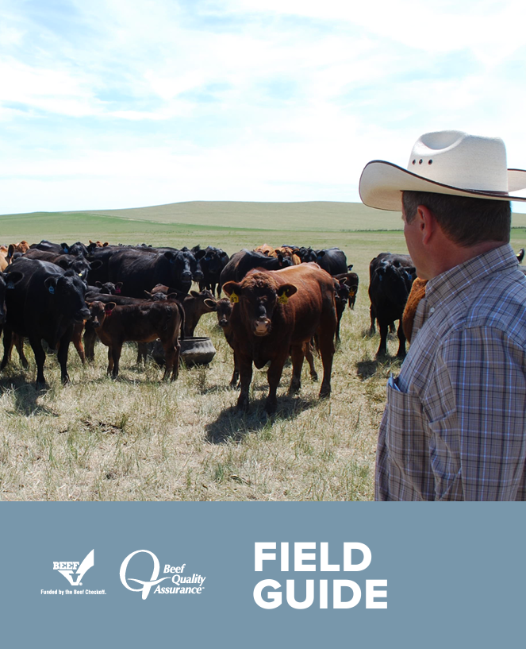
Beef Quality Assurance
Science-based educational resources promoting animal care
Cover areas such as:
  Cattle health
  Cattle handling
  Nutrition
  Transportation
  Worker safety
Source: National BQA Database
Beef University
Notes:
The foundation of BQA is a set of educational resources promoting animal care practices that are based in science and align with government regulations. They cover the areas of cattle health, handling, nutrition, transportation, worker safety, and much more. As an example, the program includes a 14-point antibiotic stewardship guideline, ensuring farmers and ranchers judiciously use animal health products. An advisory group consisting of farmers and ranchers, veterinarians, and animal scientists advise the ongoing development of educational materials to help beef producers stay abreast of the latest information.

Slide 23
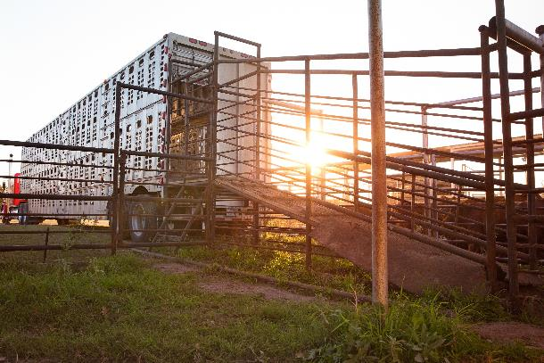
Beef Quality Assurance Transportation
BQA training extends to the semi-truck drivers who transport cattle
Covers
  Biosecurity
  Animal handling
  Loading/unloading cattle
  Weather
  Truck and trailer maintenance
Beef University
Notes:
Each segment of the beef community, including transportation, undergoes cattle industry specific training. Many semi-truck drivers who pick-up and deliver cattle to and from feedyards and packing plants have completed Beef Quality Assurance Transportation, or BQAT, which is a program designed to provide training in the areas of biosecurity, animal handling, unloading and loading cattle, weather and truck and trailer maintenance. BQA and BQAT are prime examples of the beef community’s commitment to proper animal care at all stages of the beef lifecycle.

Slide 24
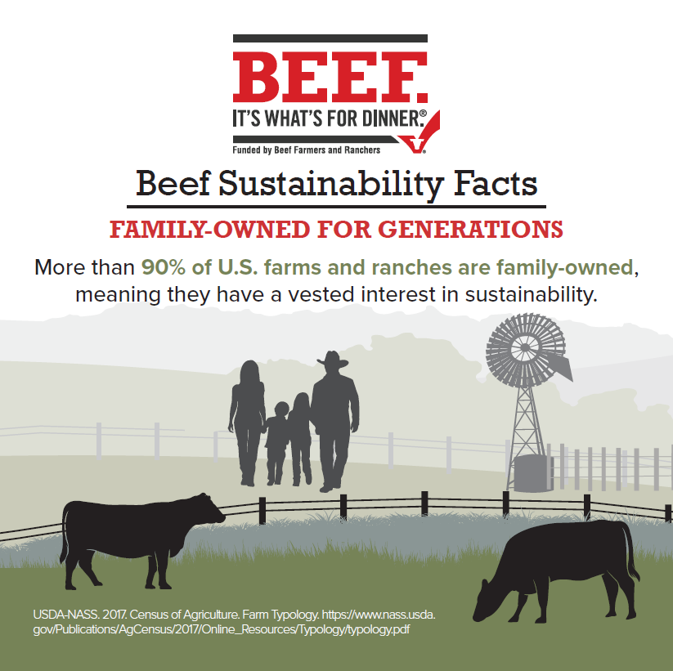
Sustainability
Sustainability =
  Environmental
  Economic
  Social
Like everything we do and eat, beef has a carbon footprint
Cattle coexist with natural wildlife habitats
Cattle upcycle human-inedible plants into high-quality protein
American cattle farmers and ranchers are committed to continuous improvement
Beef University
Notes:
As you have learned, the beef community is full of conscientious farmers, ranchers and others raising cattle in a sustainable manner. First, it’s important to explain that sustainability means a lot of things. While it’s traditionally thought of from an environmental perspective, sustainability also incorporates economic and social pillars as well. For example, beef production must remain financially viable, safe for workers, safe for public health, and safe for animals for the industry to continue.
Every food has a carbon footprint, so it’s imperative to consider diets holistically, looking at all costs and benefits of a food source. Cattle utilize land that is unsuitable for crop production, expanding the area for human food production and do so while coexisting with and maintaining natural wildlife habitats. 1/3 of land use in the U.S. is pasture and rangelands that are unsuitable for growing crops, but perfect for cattle production. Cattle upcycle human-inedible plants into high-quality protein. Simply put, cattle generate more protein for the human food supply than would exist without them, and the U.S. has shown that cattle can be raised sustainability. U.S. cattle farmers and ranchers are committed to continuous improvement, including producing high-quality beef even more sustainably for generations to come.
USDA-ERS.2021. Economic Research Service using data from the Major Land Use data series. Available at https://www.ers.usda.gov/data-products/major-land-uses.aspx
Brooks, Ashley et al. 2017a. Carbon Footprint Comparison between Grass and Grain finished beef OSU Extension, AFS-3292

Slide 25
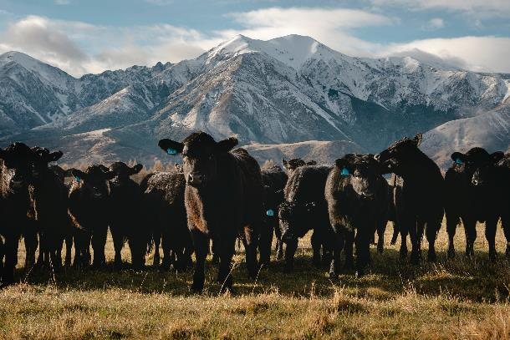
Sustainability
Many misconceptions about beef’s environmental impact, but the facts are:
  Cow farts methane; actually “burps”
  Integral part of the carbon cycle
  Beef cattle emissions = 2.4% of U.S. GHG emissions
  All agriculture direct emissions (crops + livestock) = 10.3% of U.S. GHG emissions
  Transportation = 28%; electricity = 25%
Sources: https://www.epa.gov/system/files/documents/2023-04/US-GHG-Inventory-2023-Main-Text.pdf; https://www.epa.gov/system/files/documents/2023-04/US-GHG-Inventory-2023-Main-Text.pdf
Beef University
Notes:
There are a lot of misconceptions about beef’s environmental impact. For example, you’ve probably heard people talk about cow farts and methane emissions. While it makes for an entertaining story, 85-90% of the methane gas emitted by cattle actually comes from eructation, or belching. Cattle are characterized as ruminant animals which refers to their complex digestive systems that require a symbiotic relationship with microbes to help break down highly structured plant material as a result of this natural microbial process methane is created and released through burps. This biogenic methane plays an integral role in the carbon cycle. Plants, such as grasses, take in CO2, helping the plants grow & creating more food for cattle. The cattle then eat the grass, and convert some of the carbon into methane, which they then emit into the atmosphere by burping. In the atmosphere, methane has a short lifetime and it is broken down into CO2 & H2O. The CO2 is then reabsorbed by plants, completing the cycle. It is important to note that all greenhouse gas emissions from beef production makes up 2.4% of U.S. greenhouse gas emissions. To put that in context, all agriculture direct emissions (crops + livestock) make up 10.3% of U.S. greenhouse gas emissions, while transportation makes up 28% and the generation of electricity makes up 25%.
https://www.epa.gov/system/files/documents/2023-04/US-GHG-Inventory-2023-Main-Text.pdf; https://www.epa.gov/system/files/documents/2023-04/US-GHG-Inventory-2023-Main-Text.pdf

Slide 26
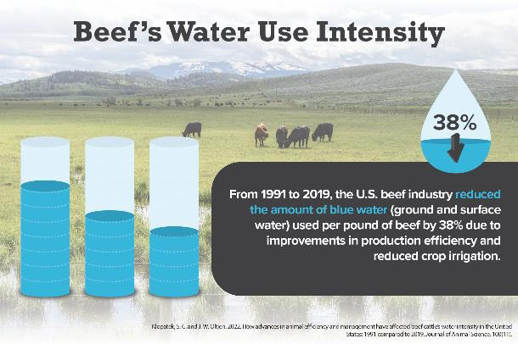
Sustainability
Thousands of gallons of water to produce a pound of beef?
Only 275 gallons per pound
Beef’s water usage is around 5% of U.S. water withdrawals
Much of this water is recycled back into the environment
Source: https://pubmed.ncbi.nlm.nih.gov/36063042/ ; Klopatek, S.C., Oltjen, J.W., 2022. How advances in animal efficiency and management have affected beef cattle’s water intensity in the United States: 1991 compared to 2019. Journal of Animal Science. doi.org/10.1093/jas/skac297
Beef University
Notes:
You’ve also probably heard that it takes thousands of gallons of water to produce a pound of boneless beef, making beef a major drain on water resources. However, it only takes 275 gallons of water to produce a pound of boneless beef, which includes all water used to produce feed, grass and hay for cattle. Water usage has decreased 38% in the last 28 years from 1991 to 2019. It is important to note that water isn’t “lost,” but rather "used" as part of a cycle. Just like humans, water is used to produce the things cattle eat, such as grass and grain. When consumed, most of this water cycles out of the cattle, returning nutrients and water back to the earth. Water used by beef is around 5% of U.S. water withdrawals.
https://pubmed.ncbi.nlm.nih.gov/36063042/
Klopatek, S.C., Oltjen, J.W., 2022. How advances in animal efficiency and management have affected beef cattle’s water intensity in the United States: 1991 compared to 2019. Journal of Animal Science. doi.org/10.1093/jas/skac297

Slide 27

Sustainability
Lifecycle assessments help us understand the environmental impact of beef production
When including the production of animal feed, beef is responsible for 3.8% of U.S. GHG emissions
Much lower than the global livestock figure of 11.2% of GHG emissions
Source: https://www.beefresearch.org/programs/beef-sustainability/sustainability-quick-stats/emission; https://foodandagricultureorganization.shinyapps.io/GLEAMV3_Public/
Beef University
Notes:
A recently conducted lifecycle assessment by the USDA’s Agriculture Research Service and The Beef Checkoff conducted a comprehensive environmental assessment of beef production in the U.S. This study constructed a baseline environmental profile examining 160 different cattle production systems spread across all 50 states along all lines of the supply chain (pasture to plate). This information helps us better understand the environmental impact of beef production. The study found that beef production, inclusive of the production of animal feed, is responsible for only 3.38 of greenhouse gas emissions in the US, which is dramatically lower than the often-misapplied global livestock figure of 11.2%.
Putman, B., Rotz, C.A., Thoma, G., 2023. A comprehensive environmental assessment of beef production and consumption in the United States. Journal of Cleaner Production. doi.org/10.1016/j.jclepro.2023.136766

Slide 28

Sustainability
U.S. cattle production systems are a model for worldwide beef production
U.S. beef industry has one of the lowest carbon footprints in the world; 10 - 50 times lower than some nations
The U.S. produces 17% of the world’s beef with 6% of the world’s cattle
Source: https://www.beefresearch.org/programs/beef-sustainability/sustainability-quick-stats/emission; https://foodandagricultureorganization.shinyapps.io/GLEAMV3_Public/
Beef University
Notes:
In fact, as acknowledged by the Food and Agriculture Organization of the United Nations’ report on climate change and livestock, U.S. systems are used as a model for worldwide beef production – the U.S. beef industry has one of the lowest carbon footprints in the world, 10 to 50 times lower than some nations. The U.S. produces 17% of the world’s beef with just 6% of the world’s cattle. Our low carbon footprint can be attributed to cattle genetics, the quality of cattle feeds, excellent care by committed farmers and ranchers, and the way we use technology. Using management techniques and technologies developed through scientific research, such as genetics and diet, is key to achieving improvements in beef production efficiency and further reducing beef's carbon footprint. The beef community is committed to continuing to improve, which is why partners from across the entire beef value chain – from cow/calf operators to grocery retailers and foodservice operators – have joined with academic institutions, non-governmental organizations and other stakeholders to create the U.S. Roundtable for Sustainable Beef, or the USRSB. The USRSB’s mission is to advance, support and communicate continuous improvement of sustainability across the U.S. beef value chain.

Slide 29
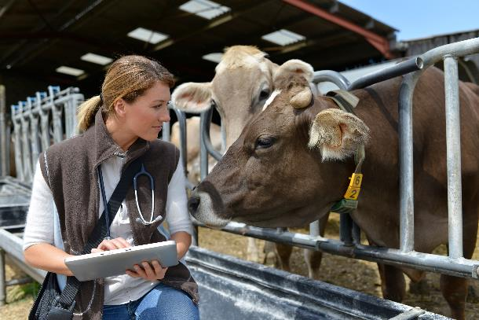
Antibiotics
Antibiotics are just one tool used to treat, prevent or control illness
Prescribed by veterinarians
Precise doses are calculated
Withdrawal times are set by the FDA to ensure no antibiotic residues detectable at time of harvesting
Sick animals will always receive care; beef from cattle treated by antibiotics cannot be marketed as organic
Beef University
Notes:
Before we move on to share specific tips on how you can share the story of beef production, we’d like to briefly touch on the use of antibiotics in raising healthy cattle. Consumers often have questions about this practice and want to know more. Like all living beings, cattle can get sick. Cattlemen and women work to prevent disease through vaccination, proper nutrition, bio-security measures and low stress handling, but despite these efforts, cattle sometimes become sick and require treatment with antibiotics. Cattlemen and women work closely with veterinarians when their animals or herd becomes ill or at times when cattle are susceptible to illness. If antibiotics are used, precise doses of an antibiotic are calculated to prevent, treat or control specific diseases or conditions. Antibiotics are used under the supervision of veterinarians and according to FDA approved labels. Withdrawal times – the amount of time between the last antibiotic dose given to an animal and until it can go to harvest – are set by the FDA and are strictly adhered to so that antibiotic residues are not a concern. All farmers and ranchers, including those who raise organic beef, want to help sick animals get better as it is the humane thing to do. If an animal being raised in an organic system becomes ill and is treated with antibiotics, it cannot be marketed as organic. It is important to note that antibiotics are expensive, so there is no added incentive for cattle farmers and ranchers to use them except as outlined by a veterinarian as part of their animal care plan.

Slide 30
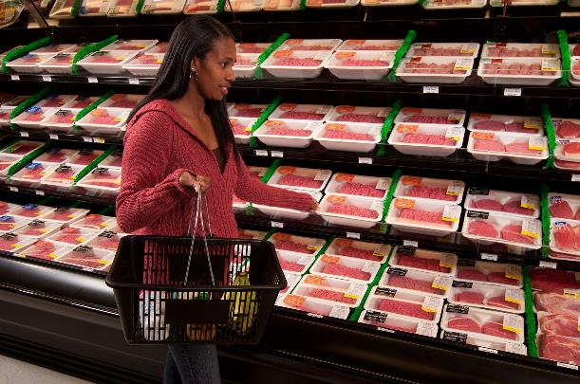
Antibiotics
“Organic” and “Raised Without Antibiotics” labels indicate beef is sourced from an animal not treated with antibiotics
Antibiotic-free does NOT indicate a difference in:
  Nutritional value
  Animal care standards
  Food safety
Beef University
Notes:
If a consumer prefers not to consume beef from an animal that has been treated with antibiotics, they need only look for beef labeled “organic,” or “raised without antibiotics.” This is one way to provide options for consumers to buy beef for themselves and for their families. It does not, however, indicate a difference in nutritional value, animal care standards or food safety in products without that label.

Slide 31
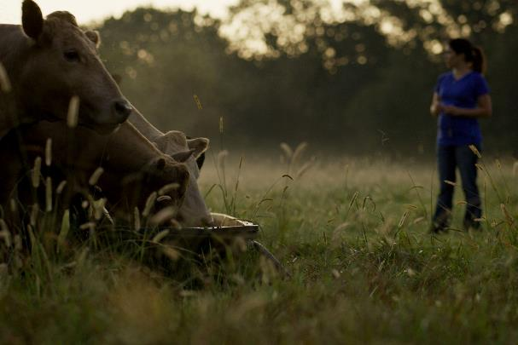
Hormones
Hormones are naturally occurring compounds in different animals and organisms that promote healthy growth
Found in:
  Beef (1.3 -1.9 nanograms of estrogen per 3 oz serving)
  Eggs (993 nanograms of estrogen)
  Peas (542 nanograms of estrogen per ½ cup)
Source: Tabler, T., Wells, J. and Zhai, W. 2013. Chickens do not receive growth hormones: so why all the confusion? Mississippi State Univ. Extension Serv. http://extension.msstate.edu/sites/default/files/publications/publications/p2767.pdf
Beef University
Notes:
Let’s also talk about hormones and hormone supplements. Hormones are naturally occurring compounds in different animals and organisms that promote healthy growth. For example, estrogen is found in beef at a level between 1.3 and 1.9 nanograms per 3 ounce serving, in eggs at a level of 993 nanograms per egg, and in peas at a level of 542 nanograms per half cup.
[Tabler, T., Wells, J. and Zhai, W. 2013. Chickens do not receive growth hormones: so why all the confusion? Mississippi State Univ. Extension Serv. http://extension.msstate.edu/sites/default/files/publications/publications/p2767.pdf]

Slide 32
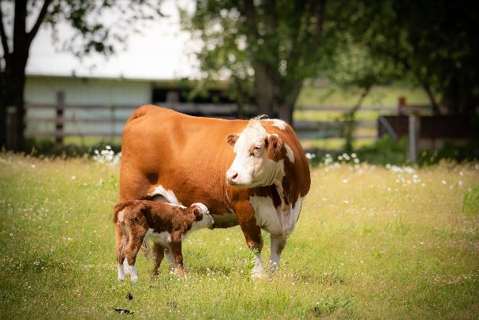
Hormones
Hormone supplements can be
  A feed ingredient
  Implanted, smaller than a pea
Hormone usage approved by the U.S. Food and Drug Administration
Decades of research have not found any human health impact
Using supplemental growth promoting hormones helps the beef community raise beef with fewer natural resources like land and water
Sources: Stewart, L. 2013. Implanting beef cattle. Univ. of Georgia. Bulletin 1302; Tabler, T., Wells, J. and Zhai, W. 2013. Chickens do not receive growth hormones: so why all the confusion? Mississippi State Univ. Extension Serv. http://extension.msstate.edu/sites/default/files/publications/publications/p2767.pdf; Capper, J.L. and D.J. Hayes. 2012. The environmental and economic impact of removing growth-enhancing technologies from U.S. beef production. J. Anim. Sci. 90:3527-3537
Beef University
Notes:
Supplemental hormones can be added to an animal’s feed rations as part of a healthy, balanced diet or via an implant smaller than a pea located under the skin behind the ear to stimulate the gland that produces natural hormones. All hormones used in beef production must be approved by the U.S. Food and Drug administration, which includes a comprehensive, multi-step scientific review process. Decades of research have looked at the effect of using hormones in livestock production, but none have found any human health impact. Using supplemental growth promoting hormones helps the beef community raise beef with fewer natural resources like land and water. Studies have shown that if farmers and ranchers could no longer use supplemental hormones, it would require 141 billion gallons more water to raise the same amount of beef.
[Stewart, L. 2013. Implanting beef cattle. Univ. of Georgia. Bulletin 1302.
Tabler, T., Wells, J. and Zhai, W. 2013. Chickens do not receive growth hormones: so why all the confusion? Mississippi State Univ. Extension Serv. http://extension.msstate.edu/sites/default/files/publications/publications/p2767.pdf
Capper, J.L. and D.J. Hayes. 2012. The environmental and economic impact of removing growth-enhancing technologies from U.S. beef production. J. Anim. Sci. 90:3527-3537.]

Slide 33
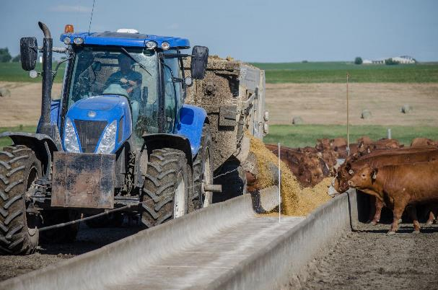
Conventional Beef
Majority of life on pasture
Finished in feedyard
Feedyard diet of:
  Grains (corn, wheat or soybeans)
  Hay/Forages
  Local feedstuffs (potato hulls or sugar beets)
May be given FDA-approved:
  Antibiotics
  Growth-promoting hormones
May be given vitamins and mineral supplements
Beef University
Notes:
It may be helpful to discuss the definitions of some key marketing claims:
Grain-finished or “conventional” beef means that cattle spend most of their lives grazing on pasture, finishing with 4 to 6 months in a feedyard. At the feedyard, cattle are fed a scientifically balanced diet of grains, such as corn, wheat or soybeans and other local feedstuffs, such as upcycled agricultural products like potato hulls or sugar beets and hay or forages. If needed, cattle may be given FDA-approved antibiotics including ionophores (antibiotics not medically important to humans). Cattle may be given FDA-approved growth-promoting hormones, which enables beef to be raised more efficiently and sustainably, by taking less time to get to finishing weight, therefore not using as many resources. Cattle also may be given vitamin and mineral supplements.

Slide 34
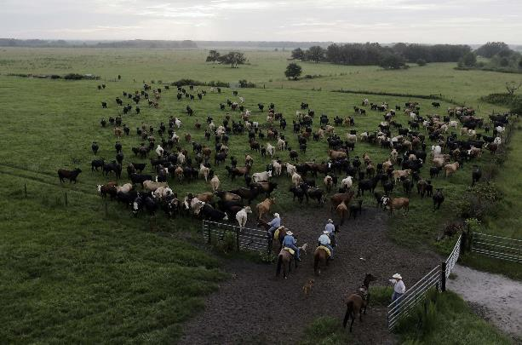
Grass-Finished or Grass-Fed
Exclusively eat grass or forage
May happen via grazing or in a feedyard
May be fed corn silage (10-20% grain)
May be given FDA-approved:
  Antibiotics
  Growth-promoting hormones
May be given vitamins and mineral supplements
Beef University
Notes:
Grass-finished or “grass-fed” beef means that…Cattle exclusively eat grass or forage throughout its lifetime, other than prior to weaning. Cattle may be fed grass or forage in a feedyard setting. They can also be fed silage, such as corn silage, which averages 10-20 percent grain. If needed, cattle may be given FDA-approved antibiotics including ionophores which are antibiotics not medically important to humans. Cattle may be given FDA-approved growth-promoting hormones. And, cattle may be given vitamin and mineral supplements.

Slide 35
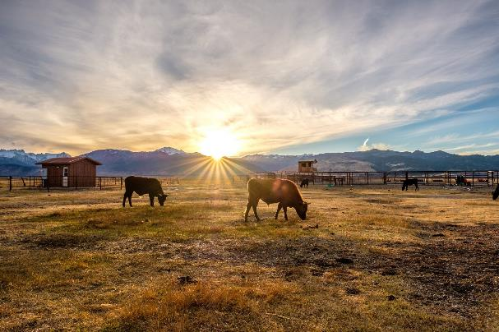
Naturally Raised or “Never Ever”
Grain or grass-finished
May happen via grazing or in a feedyard
Not given antibiotics
Not given growth-promoting hormones
May be given vitamins and mineral supplements
Beef University
Notes:
Naturally raised or “never-ever” beef means that…
Cattle can be grain-finished or grass-finished.
Cattle may be finished in a feedyard setting.
Cattle have never received antibiotics, including ionophores.
Cattle have never received growth-promoting hormones.
And, cattle may be given vitamin and mineral supplements.

Slide 36
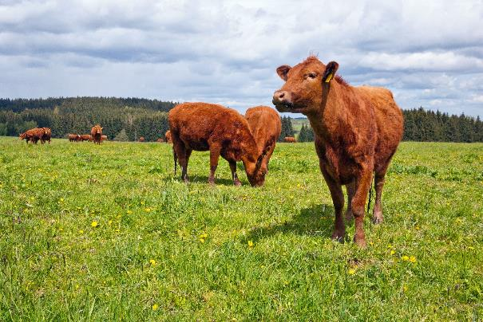
Certified Organic
Follows USDA’s Organic Standards
May be fed in a feedyard with grazing access
No antibiotics
No growth-promoting hormones
May be given vitamins and supplements
Beef University
Notes:
Organic is a labeling term that indicates that the food or other agricultural product has been produced through approved methods. The organic standards describe the specific requirements that must be verified by a USDA-accredited certifying agent before products can be labeled USDA organic:
Cattle can be grain-finished or grass-finished, as long as the feed is certified 100 percent organically grown.
Cattle must graze on pasture at least 120 days per year.
Cattle may be finished in a feed yard setting but must be provided access to graze.
Cattle may have never received any antibiotics, including ionophores, which are antibiotics not medically important to humans.
Cattle may have never received growth-promoting hormones.
And, cattle may be given vitamin and mineral supplements.

Slide 37

Common Consumer Questions
Who raised the beef?
Where does the beef come from?
How was the beef raised?
Beef University
Notes:
Every ingredient has a story, and consumers continue to be interested in the story behind the beef you sell. When it comes to beef, operators’ sourcing stories can be a conveyor of product quality.
Retailers and foodservice operators may choose to include information on the menu or in grocery retail marketing materials on who raised the beef, where it comes from and how it was raised.

Slide 38


Consumer Knowledge
Only 28% of consumers self-identify as being familiar with how cattle are raised, yet 68% consider how their food was raised/grown when making purchasing decisions.
Familiarity with How Cattle are Raised
Consider How Food Was Raised/Grown
Source: Consumer Beef Tracker January – *June 2023. CR1r1: Please indicate how knowledgeable you are about each of the following. n=2,996; Q9: How much do you consider each of the following when you are deciding to have a meal at home with beef, chicken, pork, fish, meat alternatives, or some other source of protein. n=1,495; CR3a: What, if any, concerns do you have about how cattle are raised for food. Please be as specific as possible.. ^March – June 2023, n=1,968 Analysis: National Cattlemen’s Beef Association, a contractor to The Beef Checkoff.
Beef University
Notes:
The Beef Checkoff conducted research to understand what consumers know about beef production, and how much the production story plays a role in their meal decisions.
Only 28% of consumers claim to be knowledgeable about how beef is raised, but more than 68% say they consider how and where their food is grown and raised when deciding what to eat.
At the top of their list of concerns is animal welfare.

Slide 39



Consumers Want Information
of consumers agreed that BQA increased their confidence that the beef they eat is safe
of consumers agreed that BQA increased their confidence that beef cattle are treated humanely
Source: 2018 Responsible Beef Exploration
Beef University
Notes:
Our research indicated that there’s an easy way to ease consumers’ concerns: inform them about the Beef Quality Assurance program. At least 50% of consumers said simply knowing about the program was enough to alleviate some of their beef production concerns. And after learning more about the program, 75% of consumers agreed that BQA increased their confidence that the beef they eat is safe and 67% agreed that BQA increased their confidence that beef cattle are treated humanely.
For more information visit the “Raising Beef” section of BeefItsWhatsForDinner.com.

Slide 40

Additional Resources – BeefItsWhatsForDinner.com
Beef University
Notes:
BeefItsWhatsForDinner.com is your resource for more in-depth information on the beef lifecycle, which can be found on the top navigation bar of the website under “Raising Beef.” Read rancher profiles to learn more about the people behind the protein at each phase of the lifecycle. Read more about ranchers’ sustainability efforts and dedication to animal care.

Slide 41
Thank You

