Slide 1




Orientation
(Welcome to Beef University)

Slide 2
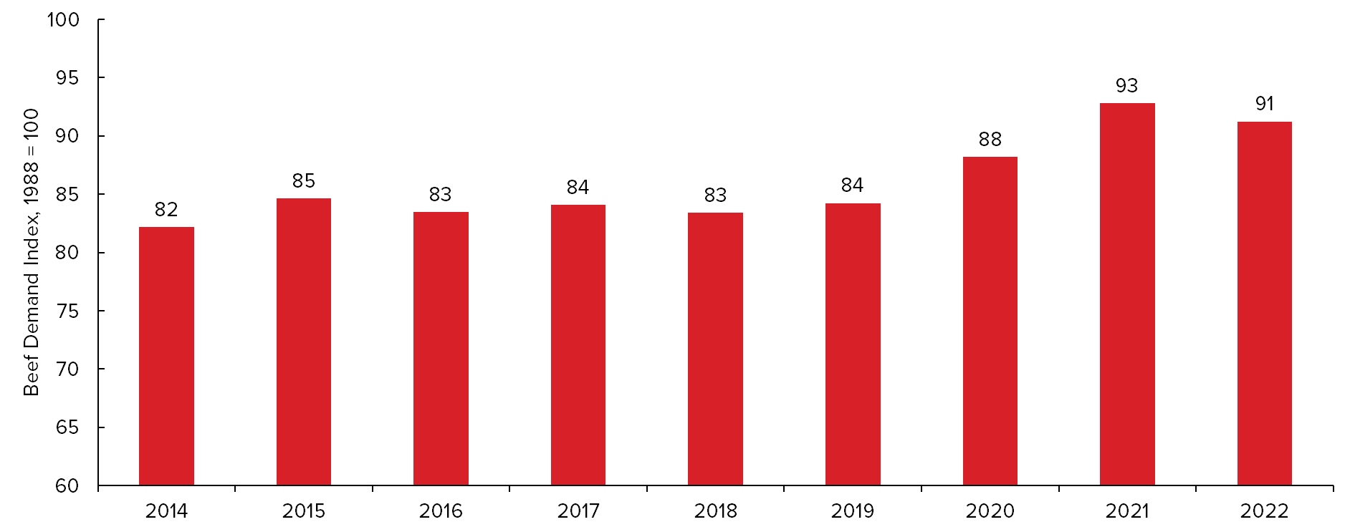
Retail Beef Demand is Steady
Placing various consumption and price data into an index also indicates that beef demand is still strong despite a slight decrease from 2021 – 2022.
Source: USDA, Economic Research Service, US Bureau of Labor Statistics, Bekkerman et al. 2019.
Analysis: National Cattlemen’s Beef Association, on behalf of The Beef Checkoff.
Beef University
Notes:
Beef demand is steady, which signals that consumers continue to crave beef’s great taste, the essential nutrients, and the high-quality protein that comes from consuming it.

Slide 3
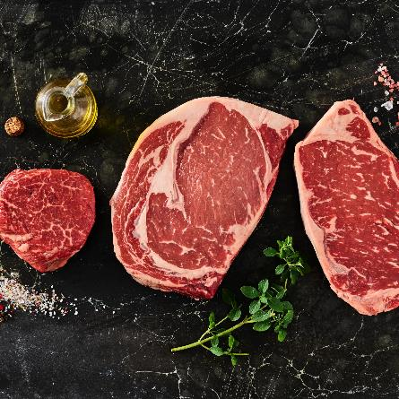
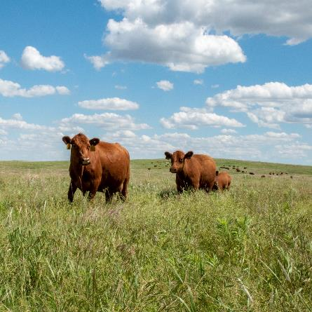
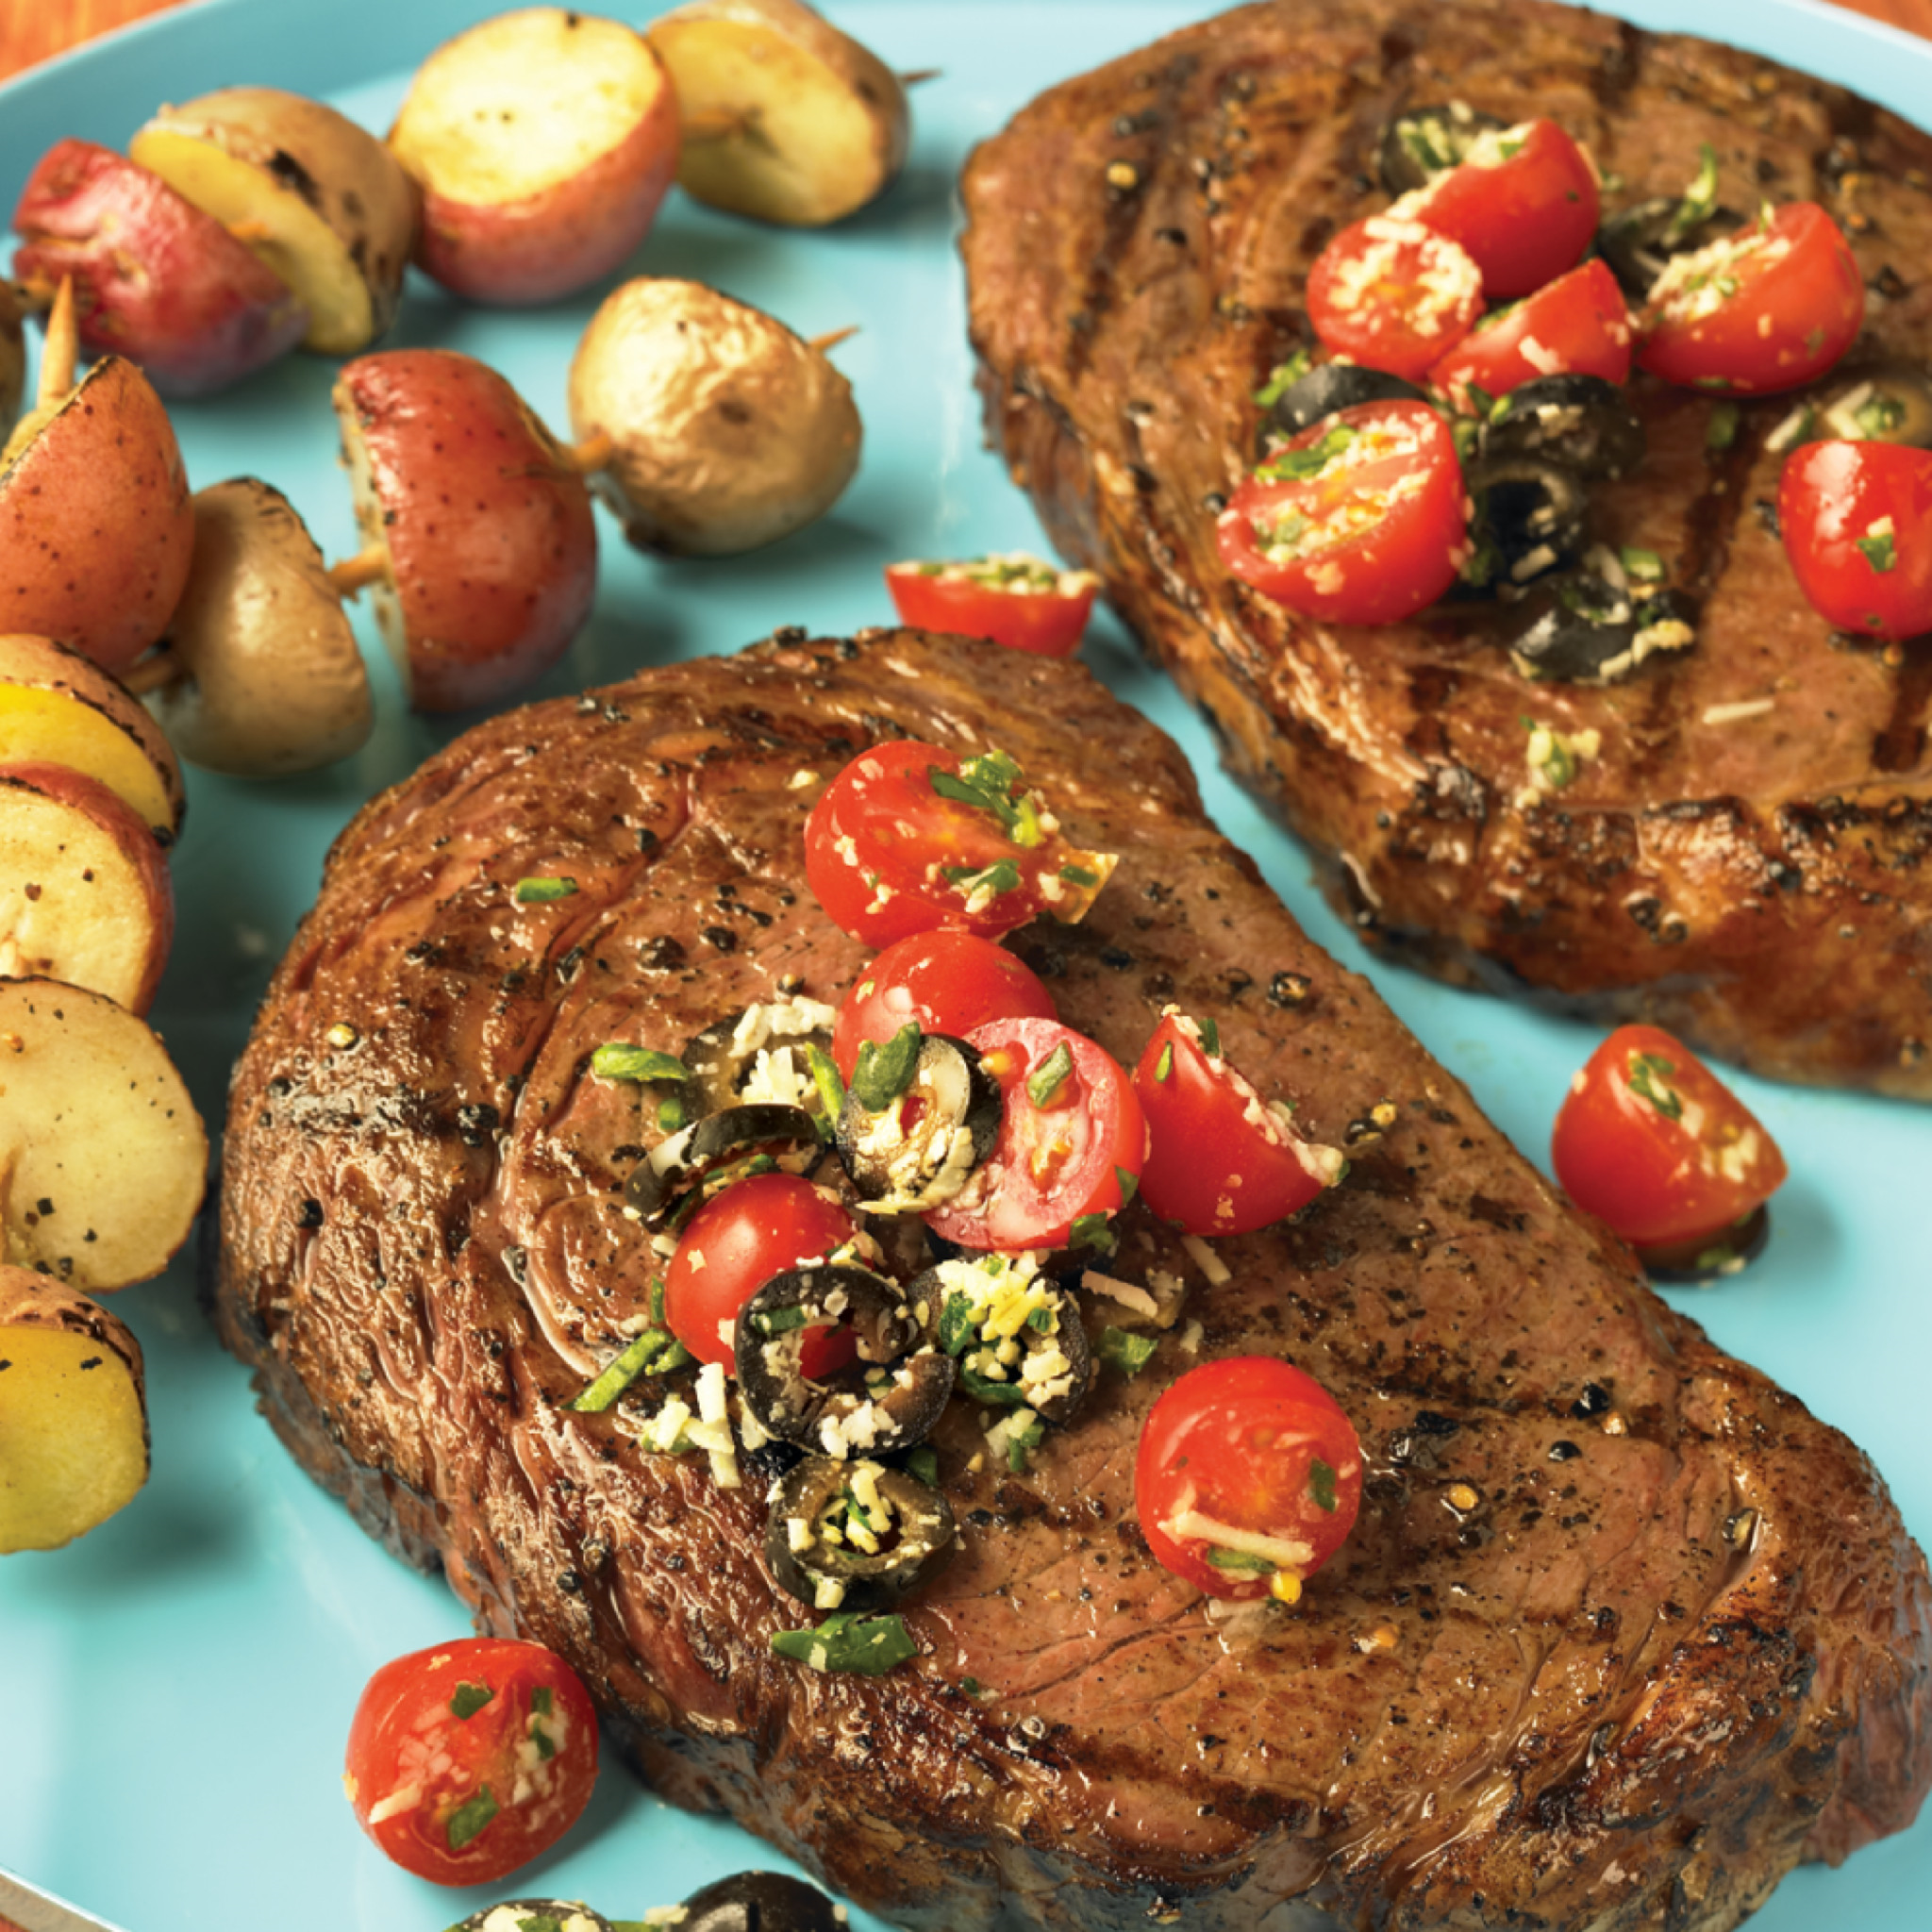
What You’ll Learn in Beef University
Beef cuts and how to prepare them
How beef is raised
Beef’s nutritional value
Beef University
Notes:
Beef University is designed to teach you about the wide array of cuts and how to prepare them, how beef is raised and the journey it takes from pasture to plate, and the nutritional value beef offers.

Slide 4


What is the Beef Checkoff?
Program focused on maintaining and building strong demand for beef
Funds the Beef. It’s What’s For Dinner. brand
Every time a beef animal is sold, $1 is collected to fund education, promotion, and research
Beef University
Notes:
Beef University is a training program funded by cattle farmers, ranchers and importers through the Beef Checkoff program. The Beef Checkoff is focused on maintaining and building strong demand for beef, with the goal of positioning beef as the top protein. This includes supporting supply chain businesses in marketing and selling beef.
Every time a beef animal is sold – which is about two to three times in its lifetime - $1 is collected for the Beef Checkoff Program. This money is used to fund the well-known Beef. It’s What’s For Dinner. brand. And either used on national or state level on programs ranging from education, promotion, to research.

Slide 5
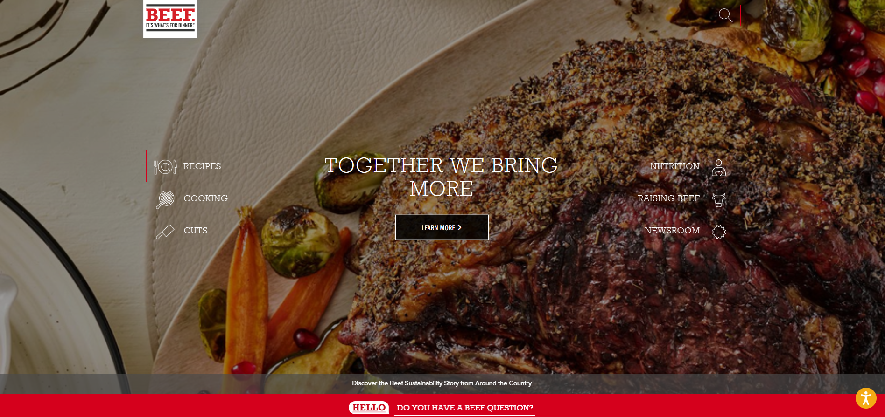
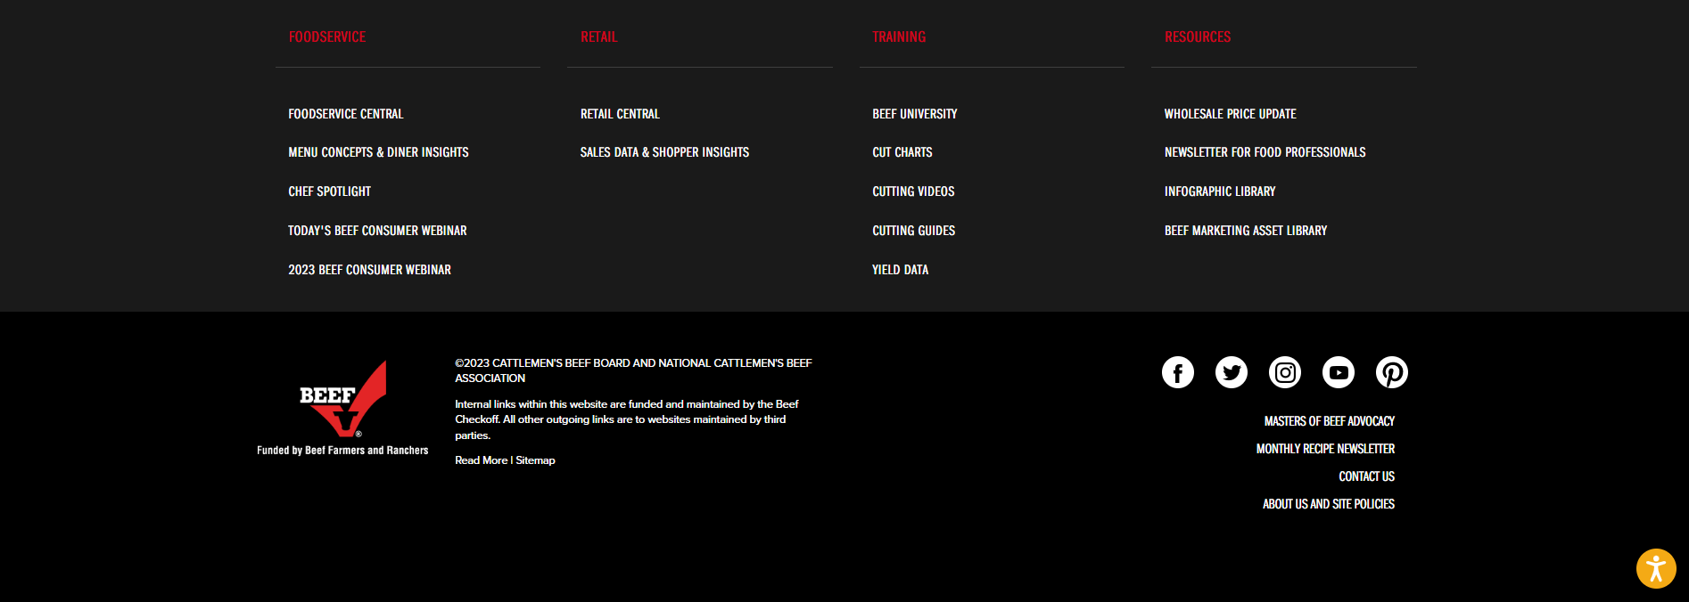
Available Resources – BeefItsWhatsForDinner.com
Beef cut database
Recipe database
Nutritional information
Sales and supply chain intelligence and consumer insights
Complimentary digital marketing assets
Culinary inspiration
Educational programs
Beef University
Notes:
Beef. It’s What’s For Dinner. is your go-to resource. We have the research, tools and resources including a comprehensive cut database, triple-tested recipes, culinary inspiration, sales intelligence and sales trends, shopper insights and consumer trends, and anything you may need to know about beef from farm to fork.
Visit BeefItsWhatsForDinner.com.

Slide 6
Thank You

