Slide 1




Nutrition

Slide 2

What You’ll Learn in This Lesson
An overview of healthy eating patterns
Beef’s nutrient profile
How beef plays a role in your customers’ health & diet
Beef University
Notes:
Welcome to this Beef University lesson on nutrition.
In this lesson on beef nutrition and health, we’ll provide a general overview of healthy dietary patterns and discuss how beef delivers important nutrients, such as protein, iron, zinc and b-vitamins, along with the flavor your customers love. After this lesson, you will be able to share how beef can be part of a healthy diet.

Slide 3
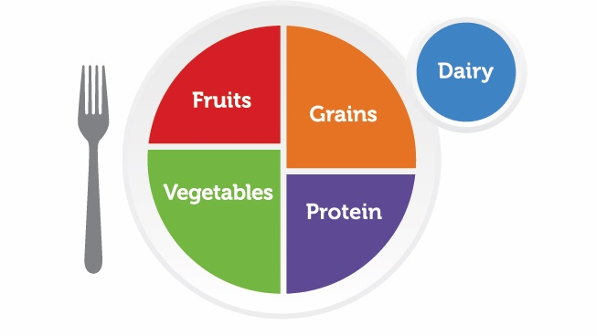

Components of Healthy Eating
Includes:
  A variety of colorful vegetables and fruits, especially whole fruits
  Grains, at least half of which are whole grains
  Fat-free or low-fat dairy
  A variety of protein foods, including seafood, lean meats and poultry, eggs, legumes (beans and peas), and nuts, seeds, and soy products
  Oils
Limits:
  Saturated fats, added sugars, and sodium
Beef University
Notes:
The 2020-2025 Dietary Guidelines for Americans emphasizes the importance of following a healthy dietary pattern across all life stages to maintain good health and reduce the risk of disease.
A healthy dietary pattern focuses on meeting food group needs with nutrient-dense
foods, including a variety of vegetables; fruits, especially whole fruits; grains, at least half of which are whole grains; fat-free or low-fat dairy; a variety of protein foods, including lean meats, poultry and eggs, seafood, legumes (beans and peas), and nuts, seeds, and soy products; and oils.
A healthy eating pattern limits: saturated fats, added sugars, and sodium.
Everything we eat and drink — the food and beverage choices we make day to day and over the course of our lifetime — matters.

Slide 4
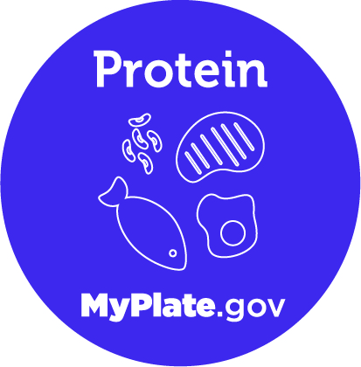
Protein is a Foundational Food for Health
The 2020-2025 Dietary Guidelines for Americans recommend adults consume 5.5-ounce equivalents of protein each day, with about 3.7 ounces per day coming from meats, poultry, and eggs.*
Source: U.S. Department of Agriculture and U.S. Department of Health and Human Services. Dietary Guidelines for Americans, 2020-2025. 9th Edition.
*Based on a Healthy U.S-Style Dietary Pattern at the 2,000-calorie level
Beef University
Notes:
Healthy eating patterns incorporate a variety of nutrient-dense protein foods, including those from both animal and plant sources. The protein foods group encompasses several subgroups including lean meats, poultry and eggs, seafood, nuts, seeds, and soy products.
The recommendation for protein foods in the Healthy U.S.-Style Eating Pattern at the 2,000-calorie level is 5½ ounces of protein foods per day, with about 3.7 ounces coming from animal sources.
Foods in the protein group are an important source of many key nutrients in addition to high-quality protein, including B vitamins (e.g., niacin, vitamin B12, vitamin B6, and riboflavin), iron, selenium, choline, phosphorus, zinc, and vitamin D. The nutrients found in various types of protein foods differ.
For example, meats like beef provide the most zinc, while poultry provides the most niacin per serving. Additionally, meats, poultry, and seafood provide heme iron, which is more bioavailable, meaning it is more readily absorbed by the body, than the non-heme iron found in plant sources of protein. Therefore, each protein food offers a unique nutrient package and can be incorporated into a healthy eating pattern.

Slide 5





Protein’s Role in Human Health
Part of a Healthy Diet¹
Weight Mgmt^{2,3}
Building Muscle³
Increased Energy³
Keeps Me Full Longer³
Sources: 1. HHS and USDA. 2015 – 2020 Dietary Guidelines for Americans. 8th Edition. December 2015. Available at https://health.gov/dietaryguidelines/2015/guidelines/; 2. Leidy HJ, et al. The role of protein in weight loss and maintenance. Am J Clin Nutr 2015;101:1320S-9S; 3. Paddon-Jones D, et al. Protein, weight management, and satiety. Am J Clin Nutr. 2008;87:1558S-61S.
Beef University
Notes:
Proteins, along with carbohydrates and fats, comprise the three macronutrients that supply energy to our bodies in the form of calories. Proteins have several important functions including providing structure to all cells in the human body, particularly for muscle protein synthesis, and functioning as enzymes, transport carriers and hormones.
Protein also plays an important role in supporting our health. Research has found that high-protein diets are effective at promoting weight loss and maintaining lean body/muscle mass. Furthermore, physical activity is more effective when paired with a protein-rich diet. It is well known that protein consumed after exercise provides the amino acids necessary for muscle repair and recovery, which helps stimulate further muscle synthesis.
Evidence also suggests that a protein-rich diet combined with resistance exercise helps adults become more toned by helping them lose fat and maintain muscle mass. Protein has also been shown to help us feel fuller longer, which may help prevent overeating.

Slide 6
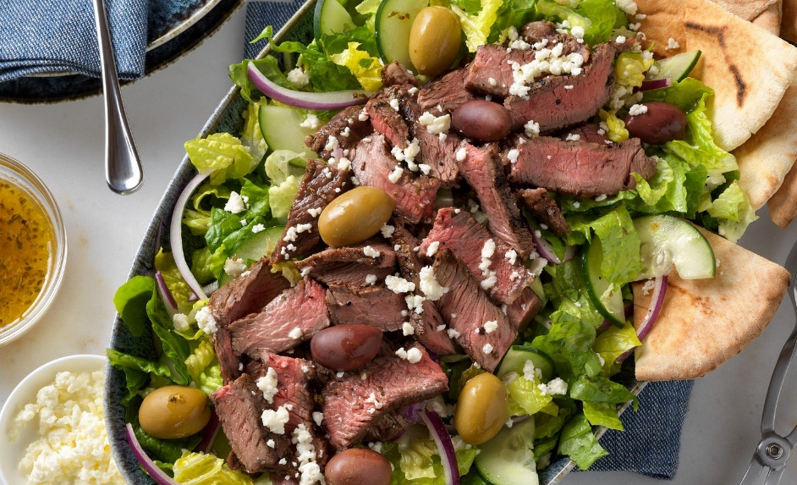
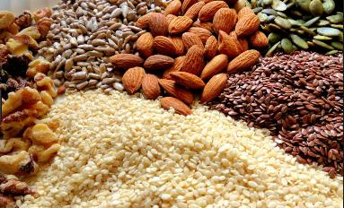
Not All Proteins are Created Equal
Complete proteins include:
  Meat, including beef, pork, chicken and fish
  Eggs
  Dairy, including milk, cheese and yogurt
  Quinoa
  Soy
Incomplete proteins are found in other plant sources:
  Beans and legumes
  Nuts and seeds
  Whole wheat
  Rice
Beef University
Notes:
When it comes to choosing protein, not all food sources are created equal.
Let’s first start with the basics. Protein is made up of amino acids. If amino acids are the letters of the alphabet, proteins are the words they form. There are 20 amino acids, nine of which are essential – meaning the body cannot generate them on its own, so we must consume them in the foods that we eat.
Complete proteins are proteins that contain all nine of those essential amino acids, while incomplete proteins are missing one or more of the essential amino acids.
Generally speaking, proteins that come from animal sources such as beef, poultry, fish, eggs or dairy are complete, or high-quality proteins, whereas most plant sources of protein tend to lack one or more essential amino acids and are thus considered “incomplete” proteins.

Slide 7
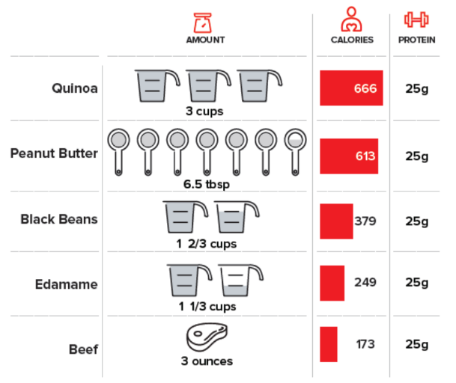
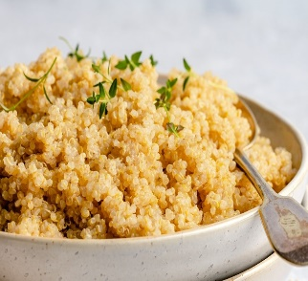
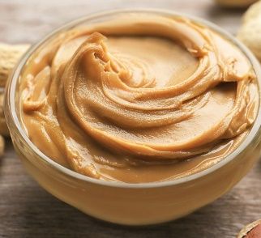
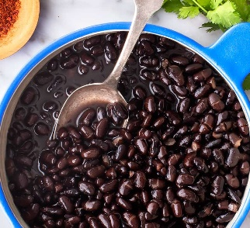

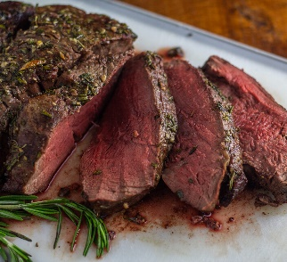
What Does 25 Grams of Protein Look Like?
Source: USDA, Agricultural Research Service, Nutrient Data Laboratory. USDA National Nutrient Database for Standard Reference; NDB#: 13364-composite beef, Legacy. Version Current: April 2018. Available at http://www.ars.usda.gov/ba/bhnrc/ndl
Beef University
Notes:
Animal proteins, such as lean beef, provide complete high-quality protein that contains all the essential amino acids needed for optimal health for fewer calories when compared to other sources. In order to get the same amount of protein found in lean meat from most plant proteins, such as beans, nuts and grains, an individual would end up consuming 1½ to 2 times more calories.
For example, a 3-oz serving of lean beef - about 170 calories on average - provides about the same amount of protein, about 25 grams, as 1 2/3 cups of cooked black beans - 379 calories - in less than half the calories.
There are numerous cuts of beef to choose from to meet protein needs.
Lean beef is also a top source of readily absorbable iron and zinc and an excellent source of vitamin B12, an essential nutrient that is not naturally available in plant protein sources.

Slide 8
Majority of Retail Beef Cuts Qualify as Lean
Lean²
<95 mg cholesterol
≤4.5 g saturated fat
<10 g total fat
More than 38 cuts of beef are lean, as defined by the USDA¹
About 65% of the beef cuts in the fresh meat case are lean. They include:
  Beef cuts with “loin” and “round” in the cut name (Strip/Top Loin Steak, Sirloin, Top Round)
  Tri-Tip (from the Sirloin)
  Flank Steak
  Brisket Flat Half
  93% lean and leaner Ground Beef
*per (85 grams or 3 oz)
of cooked fresh meat
Sources: 1. National Cattlemen’s Beef Association, a Contractor to the Beef Checkoff Program. Lean Matters: Chronicling Beef’s Change from Gate to Plate. 2014. Available at https://embed.widencdn.net/download/beef/iyg5bxcz6u/LeanMatters_Web.pdf?u=q5atpk
2. Nutrient content claims for fat, fatty acids, and cholesterol content. 9 CFR § 317.362. 2018. RACC: Reference Amount Customarily Consumed
Beef University
Notes:
The Dietary Guidelines for Americans encourages consumers to choose “a variety of protein foods” which includes lean meats and poultry. Lean beef is a great option as it delivers more than 10 essential nutrients such as protein, vitamin B12, selenium, zinc, niacin, vitamin B6, phosphorus, choline, iron and riboflavin for only about 170 calories.
“Lean” isn’t a marketing term, but rather a USDA definition for lean qualification based on fat content and composition. To be considered lean, a 3-oz serving of cooked beef must have less than 10 grams of total fat, 4.5 grams or less of saturated fat, and less than 95 milligrams of cholesterol. All beef, whether defined as lean or just outside of lean requirements, provides the same key vitamins, minerals, and protein.
Odds are you’re probably already cooking lean cuts at home or choosing one when dining out because some of the most common beef cuts are USDA lean. A telltale sign that a cut is lean is if the word “Round” or “Loin” is in the name—that’s quite a lot of cuts if you think about it!
A few lean cut examples include 93% lean ground beef or cooked and strained 80% lean ground beef, Flank Steak, Tri-Tip, Tenderloin Steak, Top Loin/NY Strip steak and Top Sirloin.
While there are many lean beef options available, all cuts of beef can be part of a healthy diet. An approachable way to build a healthy plate that includes any cut of beef is to first fill a quarter of your plate with protein, fill at least half of the plate with colorful vegetables and fruits and incorporate fiber-rich carbohydrates.

Slide 9
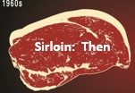
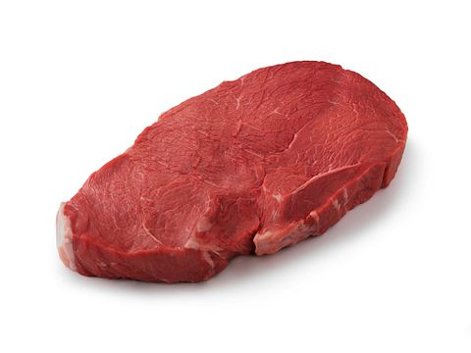
Beef Retail Cuts are Leaner Than Ever Before
-34%
2023
-17%
Sirloin: Now
Source: McNeill, SH, et al. The evolution of lean beef: identifying lean beef in today’s U.S. marketplace. Meat Science. 2011:90: 1-8. Values are for 100 grams of sirloin steak, cooked via broiling (Watt and Merrill, 1963; USDA, 2010)
*SFA 1963 not available
For Sirloin Steak 2019 ( U.S. Department of Agriculture, Agricultural Research Service, FoodData Central. NDB#13455)
Beef University
Notes:
Over the last 50 years, enhancements in trimming practices as well as cattle breeding practices to focus on higher lean-to-fat ratios have yielded a meat case where more than 65 percent of whole muscle cuts found in the supermarket are considered lean when cooked with visible fat trimmed off.
In fact, the number of beef cuts that qualify as “lean” has increased sixfold from 1989 to 2013. This is because of a multi-decade, coordinated effort by beef processors, cattle farmers, and ranchers to meet the growing consumer demand for lean beef. It starts with careful genetic selection for heavier muscled cattle and finishes with updated trimming standards at the processors.
Bringing lean meat to the marketplace involves a coordinated effort among the farmers and ranchers who raise the cattle, the ruminant nutritionists overseeing the diet fed to the cattle, the processors who trim the beef cuts before it’s ready to be sold at retail, and the butchers who may further cut and trim the meat and place it into consumer-ready packaging. They do all of this to provide nutritious, safe and delicious beef for people to eat and enjoy.

Slide 10
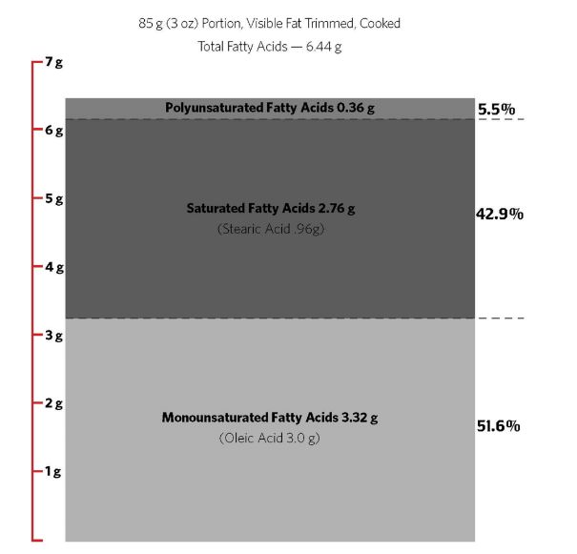
Beef’s Fatty Acid Profile
More than half of beef’s fatty acid content is heart-healthy, monounsaturated fat, the same type of fat found in avocados and olive oil.
More than one-third of beef’s saturated fatty acid content is stearic acid, known to have a neutral effect on human health.
Source: USDA, ARS, Nutrient Data Laboratory. USDA National Nutrient Database for Standard Reference, Release 28. Version Current: September 2015.
Beef University
Notes:
Many people are surprised to learn that half of the fatty acids in beef are monounsaturated – the same heart-healthy type of fat found in olive oil.
Furthermore, approximately one-third of beef’s total saturated fat is stearic acid, which has been shown to be neutral in its effects on blood cholesterol levels in humans.

Slide 11
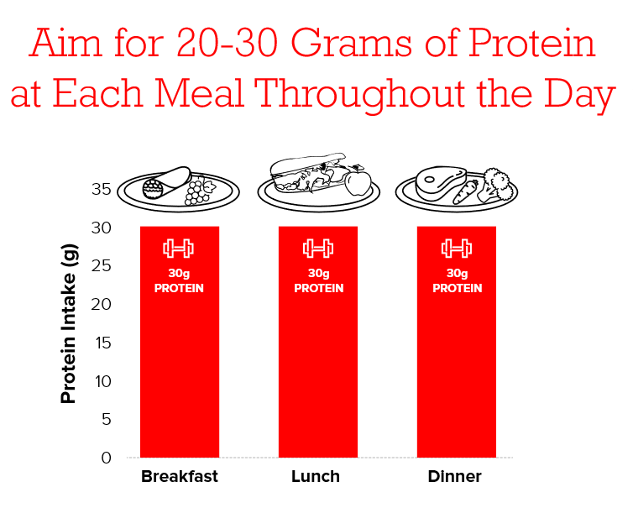
Beef Portion Size & Protein Distribution
A portion of beef is 3 ounces of cooked beef, similar to the size of a deck of cards or a hockey puck
Evenness of protein intake throughout the day is positively associated with lean mass, muscle strength, and muscular endurance, particularly in women¹
Consuming about 30 grams of protein per meal improves satiety and can decrease cravings²
Source: HHS and USDA. 2015 – 2020 Dietary Guidelines for Americans. 8th Edition. December 2015. Available at https://health.gov/dietaryguidelines/2015/guidelines/.
Johnson NR, Kotarsky CJ, Mahoney SJ, et al. Evenness of Dietary Protein Intake Is Positively Associated with Lean Mass and Strength in Healthy Women. Nutr Metab Insights. 2022;15:11786388221101829. Published 2022 Jun 16. doi:10.1177/11786388221101829
Hoertel, H.A., Will, M.J. & Leidy, H.J. A randomized crossover, pilot study examining the effects of a normal protein vs. high protein breakfast on food cravings and reward signals in overweight/obese “breakfast skipping”, late-adolescent girls. Nutr J 13, 80 (2014). https://doi.org/10.1186/1475-2891-13-80
Beef University
Notes:
When it comes to portion sizes, consumers should aim for about 30 grams of protein at each meal, which for beef, equates to about 3 ounces of cooked beef.
Protein distribution through the day, aiming for about 30 grams per meal, is important for satiety, metabolic functions, and blood glucose regulation, yet most adults only consume about 10 grams of protein at breakfast. Rather than only consuming a large portion of protein at dinner, you can encourage your customers and consumers to target a goal of 30 grams of high-quality protein at each meal.
If you’re thinking about visual comparisons that are easy to remember, think of a portion of beef in comparison to a hockey puck or deck of cards. These types of visual clues make it easy for us to remember how much beef is recommended for us to consume in one meal.

Slide 12
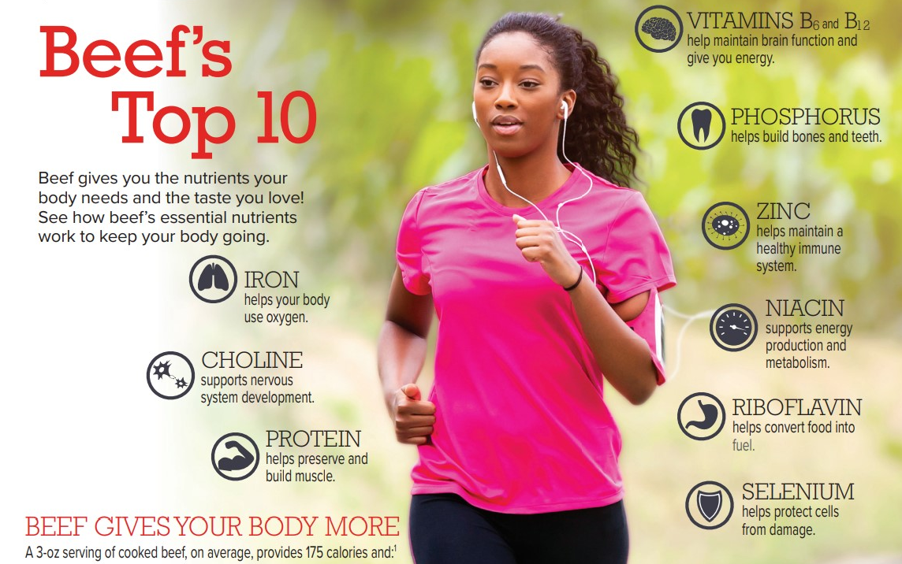
Beef’s Top Ten Nutrients
Beef University
Notes:
By now, you might already be familiar with some of the nutrients that beef supplies. The nutrients that are found in beef promote health throughout life.
For example, protein, iron, zinc, choline, and B-vitamins in beef help ensure young children start life strong, building healthy bodies and brains.
Zinc also supports a strong immune system, which helps to fortify your body to fight infection and disease.
Beef delivers high-quality protein needed to achieve and maintain a healthy weight, preserve and build muscle and support healthy aging.

Slide 13
The Nutritional Value of Beef: Nutrient Density
A 3-oz serving of cooked beef on average provides 173 calories and:
Source: USDA, Agricultural Research Service, Nutrient Data Laboratory. USDA National Nutrient Database for Standard Reference; NDB#: 13364-composite beef, Legacy. Version Current: April 2018. Available at http://www.ars.usda.gov/ba/bhnrc/ndl
-DV refers to Daily Value, the amount of a nutrient needed for a healthy adult on a 2,000-calorie diet. The %DV is the percent of a nutrient’s Daily Value provided by a serving of food.
Beef University
Notes:
Beef supplies essential nutrients and promotes health in a uniquely efficient way. A 3-ounce serving of lean beef provides 10 essential nutrients in about 170 calories, including high-quality protein, zinc, iron and B vitamins. In one serving of beef, you can meet your full daily requirement for vitamin B12, about half of your daily requirement for zinc, protein and selenium, and about 15-30% of your daily requirement for niacin, vitamin B6, riboflavin, phosphorus, iron, and choline. No other protein source offers the same nutrient matrix.
Today, more Americans cite beef as one of their top protein choices and nutritional preferences continue to be positive demand drivers for beef.

Slide 14




How to Build a Balanced Plate with Beef
Beef University
Notes:
Most healthy eating patterns have a lot in common: they incorporate a variety of nutrient-rich foods, emphasize high-quality protein sources, encourage plenty of vegetables and fruit, and are balanced with fiber-rich, quality carbohydrates. Furthermore, a sustainable, healthy eating pattern is one that you enjoy, and beef’s great flavor sets it apart.
Beef’s high-quality protein, iron, and zinc strengthen a healthy plate and strong evidence shows that consuming animal-sourced foods, such as beef, enhances iron and zinc absorption from a plant-based meal, which is known as the meat factor effect. An approachable way to design a foodservice entrée or make meal planning suggestions to customers is to first anchor your plate with high-quality protein, fill at least half of the plate with colorful vegetables and fruits and incorporate fiber-rich or whole grain carbohydrates.
Animal proteins are complete, high-quality proteins, containing all essential amino acids required for normal growth, development, and maintenance of muscle and health functions.
You can feel good knowing that beef is providing so much of what your body needs to perform at its best. And even more good news is how deliciously beef pairs with fruits, vegetables and whole grains—making it even easier to enjoy a balanced diet.

Slide 15

Enjoying Beef in a Heart-Healthy Eating Pattern
Research shows that consuming 4 to 5.5 ounces of lean beef daily, as part of a healthful dietary pattern, including the Mediterranean and DASH diets, supports heart health^{1,2,3,4}
  Sources: 1. Maki KC, Wilcox ML, Dicklin MR, Buggia M, Palacios OM, Maki CE, Kramer M. Substituting Lean Beef for Carbohydrate in a Healthy Dietary Pattern Does Not Adversely Affect the Cardiometabolic Risk Factor Profile in Men and Women at Risk for Type 2 Diabetes. J Nutr 2020; 2. O'Connor LE, Paddon-Jones D, Wright AJ, Campbell WW. A Mediterranean-style eating pattern with lean, unprocessed red meat has cardiometabolic benefits for adults who are overweight or obese in a randomized, crossover, controlled feeding trial. Am J Clin Nutr 2018;108(1):33-40; 3. Roussell MA, Hill AM, Gaugler TL, West SG, Heuvel JP, Alaupovic P, Gillies PJ, Kris-Etherton PM. Beef in an Optimal Lean Diet study: effects on lipids, lipoproteins, and apolipoproteins. Am J Clin Nutr 2012;95(1):9-16; 4. Roussell MA, Hill AM, Gaugler TL, West SG, Ulbrecht JS, Vanden Heuvel JP, Gillies PJ, Kris-Etherton PM. Effects of a DASH-like diet containing lean beef on vascular health. J Hum Hypertens 2014;28(10):600-5. 6. Fleming JA, Kris-Etherton PM, Petersen KS, Baer DJ. Effect of varying quantities of lean beef as part of a Mediterranean-style dietary pattern on lipids and lipoproteins: a randomized crossover controlled feeding trial. Am J Clin Nutr.
Beef University
Notes:
Diet and exercise are the cornerstones for building a strong and healthy heart. A heart-healthy diet is one that includes an abundance of fruits, vegetables, whole grains, healthy fats and lean protein.
One of the biggest misperceptions about beef is that it contains too much saturated fat, which has been thought to contribute to heart disease. The fact is, research shows that consuming 4 to 5.5 ounces of lean beef daily, as part of a healthful dietary pattern, supports heart health.
The Mediterranean Diet and DASH diet (Dietary Approach to Stop Hypertension) are amongst the gold standard diets for heart-health in the US. Decades of research show that beef can be included in these healthy dietary pattern, as well as others, and reduce blood LDL cholesterol, known as the “bad” kind of cholesterol.
That means consumers looking to follow a heart-healthy dietary pattern have the flexibility to choose from among the many lean beef options available today.

Slide 16
Burger Breakdown
Nutrients | Ground Beef (80% lean), 4 oz raw¹ | Ground Beef (93% lean), 4 oz raw² | Ground Beef (96% lean), 4 oz raw³ | Soy-Based (Impossible Burger), 4 oz raw⁴ | Pea-Based (Beyond Meat), 4 oz raw⁵
Calories (kcal) | 290 | 170 | 150 | 230 | 230
Total Fat (g) | 23.0 | 8.0 | 4.5 | 13.0 | 14.0
Saturated Fat (g) | 9.0 | 3.3 | 2.0 | 6.0 | 5.0
Cholesterol (mg) | 80 | 70 | 70 | 0 | 0
Sodium (mg) | 75 | 75 | 75 | 370 | 390
Total Carbohydrates (g) | 0 | 0 | 0 | 9 | 7
Protein (g) | 19 | 24 | 25 | 19 | 20
Sources: 1 U.S. Department of Agriculture, Agricultural Research Service, FoodData Central. NDB# 23572; 2 U.S. Department of Agriculture, Agricultural Research Service, FoodData Central. NDB# 23472.; 3 U.S. Department of Agriculture, Agricultural Research Service, FoodData Central. Ground Beef Calculator. https://ndb.nal.usda.gov/ndb/beef/show .; 4 https://faq.impossiblefoods.com/hc/en-us/articles/360018939274-What-are-the-nutrition-facts-for-Impossible-Beef-Made-From-Plants- 5 https://www.beyondmeat.com/en-US/products/the-beyond-burger
Beef University
Notes:
Meat substitutes are food products that are formulated to compare, nutritionally, to lean ground beef. Notably, over time, meat substitutes have been reformulated to trend toward leaner varieties like 93% lean ground beef.
One of the most notable differences between fresh animal-sourced proteins and plant-based alternatives, is the drastic increase in sodium.
As previously mentioned, beef is an authentic source of high-quality protein and 10 essential nutrients, including Protein, Iron, Zinc, and B-Vitamins that are essential to good health.

Slide 17

Beef Intake Levels
Beef consumption is within recommended intake levels and is helping to offset nutrient inadequacies
Total beef consumed among Americans 2 years and older is on average 1.5 oz/day.¹
According to recent NHANES, beef consumption contributes only 5.4% of daily calories, and just 8.7% of total fat intake and 11% of saturated fat intake, yet more than 5% of 8 essential nutrients to American diets.²
¹Lau CS, Fulgoni VL III, Van Elswyk ME, McNeill SH. Trends in Beef Intake in the United States: Analysis of the National Health and Nutrition Examination Survey, 2001–2018. Nutrients. 2023; 15(11):2475. https://doi.org/10.3390/nu15112475; ²Agarwal S, Fulgoni VL 3rd. Contribution of beef to key nutrient intakes in American adults: an updated analysis with NHANES 2011-2018. Nutr Res. 2022;105:105-112. doi:10.1016/j.nutres.2022.06.009
Beef University
Notes:
People have enjoyed beef for centuries, and today, eat beef within the current Dietary Guidelines for Americans recommendations. In fact, Americans are consuming beef at levels consistent with the current recommendations. As mentioned previously, the 2020-2025 Dietary Guidelines recommend 5.5 ounce-equivalents of protein foods daily, with about 3.7 ounces coming from meat, poultry and eggs, and data shows that Americans are currently eating within or below those recommendations with average intake for Americans 2 years and older at 1.5 ounces per day.
Research shows that beef contributes approximately 5 percent of total calories to Americans’ diets while providing more than 5 percent of eight essential nutrients: potassium (5.6%), phosphorus (6.8%), iron (7.6%), vitamin B6 (8.3%), niacin (9.4%), protein (14%), zinc (21%), and vitamin B12 (20%).
Notably, beef contributes just below a quarter of Americans’ B12 intake, a key nutrient that your body needs for normal function of the brain and nervous system.

Slide 18
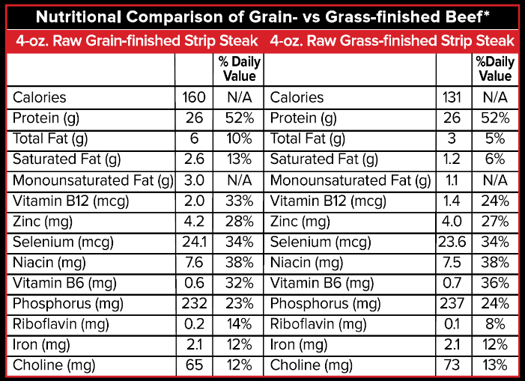
Grass and Grain-Finished Beef
Source: US Department of Agriculture, Agricultural Research Service, Nutrient Data Laboratory. USDA National Nutrient Database for Standard Reference, Release 28. Version Current: September 2015, slightly revised May 2016. Internet: /nea/bhnrc/ndl
Beef University
Notes:
In the Raising Beef lesson, we discuss the variety of beef choices available in both foodservice and retail. While options such as Grass-Fed, Certified Organic and Naturally Raised might be appealing, it is important to note that the only nutritional differences between the various beef choices relate to the fat content of grain-finished beef versus grass-finished beef.
While grass-finished beef tends to be a little leaner (1-2 grams less fat per 3 ounce serving), in general, all varieties of beef are equally nutritious as all are a natural source of more than 10 essential nutrients, like protein, iron, zinc and many B vitamins.
When comparing the two nutrition profiles of both choices, it’s important to note that the differences, including the differences in calories and total fat, are not significant when we think about the context of the total diet.

Slide 19
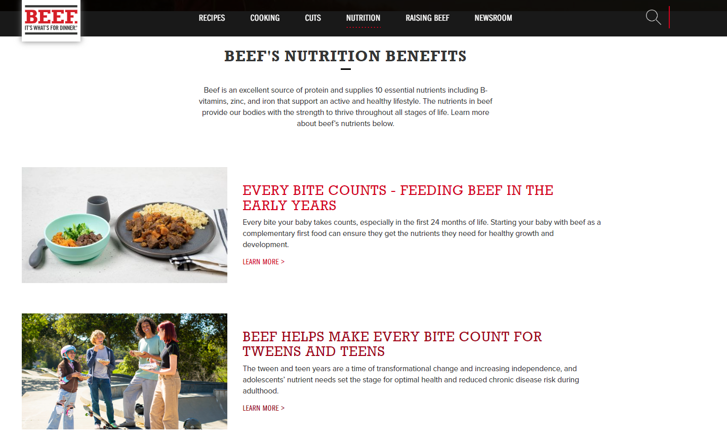
Additional Resources – BeefItsWhatsForDinner.com
Beef University
Notes:
Beef is a protein powerhouse, offers a nutrient-rich package and plays an integral role in healthy diets.
As part of most Americans’ diets, traditions, and celebrations, beef is a foundational food that nourishes and optimizes health at every life stage. When people eat beef, they enjoy a delicious, natural source of high-quality protein, iron, zinc and vitamin B-12, along with other essential nutrients.
BeefItsWhatsForDinner.com features a wealth of beef nutrition and health information, conveniently located in the nutrition section of the website. You have access to educational fact sheets, videos and other resources to enhance your knowledge on beef’s role in healthy diets.

Slide 20
Thank You

