Slide 1




Beef Grades, Cuts, and Preparation

Slide 2



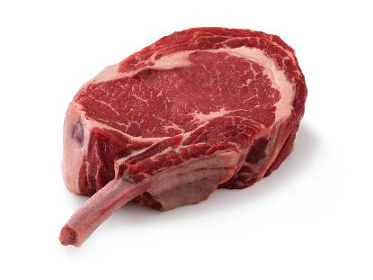




What You’ll Learn in This Lesson
Beef inspection and grading
Beef’s flavor profile and eating experience
Beef cuts and cut-specific cooking methods
Beef University
Notes:
This lesson on Beef Grades, Cuts and Preparation will beef up your knowledge. You will learn about beef inspection and grading, the eating experience of beef, beef cuts and cooking methods for each cut to optimize their overall eating experience.

Slide 3

Beef Inspection
Federally inspected beef processing facilities are required by law to have inspectors from the U.S. Department of Agriculture’s (USDA) Food Safety Inspection Service present
Funded by public funds
Each live animal is inspected
Each carcass is inspected for wholesomeness and stamped
Beef University
Notes:
The United States has one of the safest food supplies in the world. The U.S. Department of Agriculture’s (USDA) Food Safety Inspection Service is required by law to provide inspection for all federally inspected beef processing facilities. Without a USDA inspector present, federal facilities cannot operate. The Beef University program focuses on providing more education about beef sourced from federally inspected processing facilities.
The Federal Meat Inspection Act requires USDA inspectors to provide inspection of all live animals before they enter the processing facility. The inspector evaluates animals to ensure they are healthy and fit for harvest. If an animal is sick or injured, the USDA inspector will deem it unfit for human consumption and the animal will not enter the food supply.
After the animal is harvested, a USDA inspector will perform additional inspections to ensure the wholesomeness of the beef carcass. Once approved, the carcass is stamped with a non-toxic ink stamp to show that the animal has passed USDA inspection. If a carcass does not pass the USDA inspection it is condemned, stamped as such, and does not enter the food supply. The inspection stamp includes an establishment number that uniquely identifies each US processing facility.
All meat products are inspected by USDA inspectors before leaving the federally regulated facility. The inspection process is mandatory and is paid for with public funds.

Slide 4
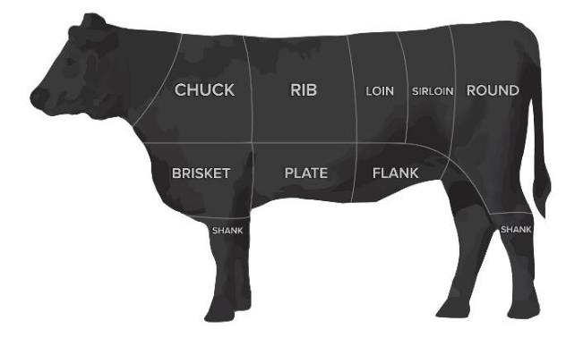
Yield Grading
Predicts the percentage of closely trimmed, boneless retail cuts that can be fabricated from the four major primals (Chuck, Rib, Loin, and Round)
Lower number = less external fat; more lean, edible meat
Intended for packers and further processors; not typically relayed to consumers
Beef University
Notes:
Yield grade predicts the percentage of closely trimmed, boneless retail cuts that can be fabricated from the four major primals in a beef carcass. The primals are the large sections of beef initially separated from the carcass: the Chuck, Rib, Loin and Round.
Yield grades range from 1 to 5. A lower numbered yield grade indicates less external fat and more lean, edible meat in the carcass. Yield grade is assigned in a packing plant prior to carcass fabrication. This information is primarily of interest to beef packers and further processors, as it impacts the profitability of their business. Therefore, yield grade is not typically relayed to an end customer.

Slide 5
Quality Grading
USDA’s Agricultural Marketing Service conducts voluntary beef quality grading
  Funded by beef packers
  Predicts the tenderness, juiciness, and flavor of beef
Marbling is small flecks of fat within muscle (AKA, intramuscular fat) and a predictor of eating quality of beef
USDA quality grades reflect the amount of marbling, which is measured at the 12th rib of the carcass, and the age of the animal
PRIME
CHOICE
SELECT
STANDARD
COMMERCIAL
UTILITY
CUTTER
CANNER
Beef University
Notes:
The USDA’s Agricultural Marketing Service also conducts beef quality grading that is voluntary. It is requested and paid for by beef packers versus taxpayers. Most beef carcasses in the United States are assigned a quality grade prior to fabrication. This underscores how valuable the beef industry believes grading is to provide grocery retailers, foodservice operators and consumers with the information they need to select beef that meets their preferences for quality and palatability or eating satisfaction.
Quality grade predicts the overall eating experience of beef and specifically, anticipated palatability which includes the attributes of tenderness, juiciness and flavor. There are eight USDA quality grades which reflect the amount of marbling (or small flecks of fat within the muscle also called intramuscular fat) at the 12th rib of the beef carcass and the age or maturity of the animal.
For example, younger animals with more marbling produce higher quality grades and more tender, flavorful, juicy beef. The eight available USDA quality grades are Prime, Choice, Select, Standard, Commercial, Utility, Cutter and Canner. The first three are the most common, so we’ll explore those further.

Slide 6

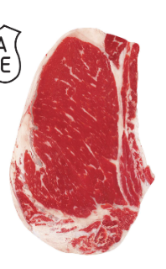
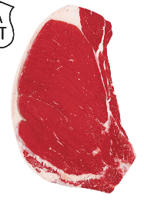
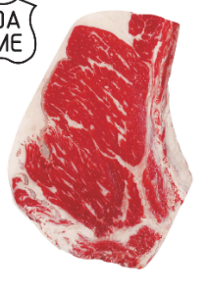
Quality Grading Continued
Prime, Choice, and Select are the most common grades sold in grocery stores and restaurants
Choice is the most significant volume of graded beef
More than 80% of beef graded is Prime and Choice
Beef University
Notes:
The top three USDA quality grades – Prime, Choice and Select – are the most commonly produced and marketed grades in grocery stores and restaurants in the United States. Choice represents the most significant volume of graded beef each year in the US, followed by Prime and Select.
There are also three sub-levels within the Choice grade including low, average and high choice. So, you may hear the term “upper two thirds Choice” which refers to graded beef that falls within the average and high Choice sub-levels but not low Choice.
Thanks to the advances beef farmers and ranchers have made in technology, genetics, and nutrition, as well as increased participation in the Beef Quality Assurance program, which we’ll tell you about in the “Raising Beef” lesson, today more than 80% of beef graded and available in the marketplace is USDA Prime and Choice, which represents a 38% increase since 2004.
You may also hear the term no-roll. No-roll refers to beef that is ungraded with no Prime, Choice or Select designation.

Slide 7

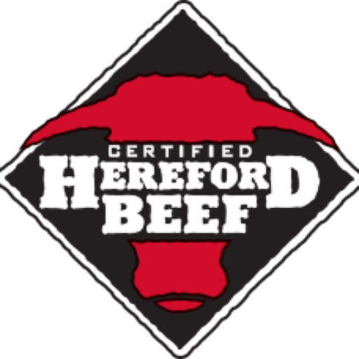
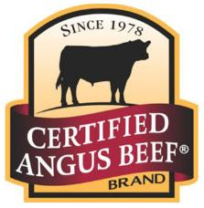
Marketing Programs
USDA’s Agricultural Marketing Service also offers:
  Tenderness certification
  Branded beef program oversight, i.e., Certified Angus Beef or Certified Hereford Beef
Cattle farmers and ranchers receive a premium for cattle that meet a set of quality standards and in turn, consumers may pay more for these products
Highlighting USDA quality grades, brands or other sourcing details on beef labels and menus conveys quality and value to consumers
Beef University
Notes:
The USDA’s Agricultural Marketing Service also offers tenderness certification, as well as oversight of specialty beef branding programs, such as Certified Angus Beef or Certified Hereford Beef. These branded programs indicate that the beef meets particular carcass standards or product specifications established by each program, which are approved and monitored by the USDA and generally intended to help indicate higher quality and palatability of the products being sold. An example of a product specification for a brand would be to only include beef in that brand’s program if it grades a minimum of upper two thirds Choice.
Beef packers and processors often pay cattle farmers and ranchers a premium for raising cattle that meets these standards. Restaurants can purchase branded or specially labeled beef cuts for their menus. And, retailers can do the same for their meat cases. Or, individual retailers may also implement their own branded beef program that they develop in conjunction with their suppliers and may place a price premium for products labeled this way in their stores. Highlighting USDA quality grades, branding or other beef sourcing information on labels in the meat case or on the menu conveys to shoppers and diners that they can expect a high-quality beef eating experience.

Slide 8
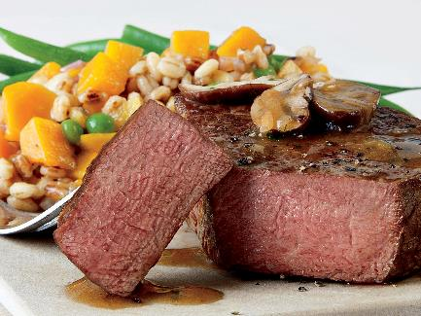
Beef’s Eating Experience
Impacted by:
Pre-harvest
  Age
  Gender
  Genetics
  Temperament
  Diet
  Health
  Animal handling
Post-harvest
  Chilling
  Electrical stimulation of carcass
  Mechanical tenderization
  Aging
  Cooking
Bistro-style filet mignon with champagne pan sauce
Beef University
Notes:
As previously mentioned, the beef eating experience is primarily determined by three factors of palatability: tenderness, juiciness and flavor.
The tenderness of a given cut of beef is influenced by the amount of marbling, or intramuscular fat in the cut and by the age or maturity of the animal which it was sourced from. And, it can be impacted by several factors. Pre-harvest factors affecting tenderness include age of the animal – beef from older animals is less tender than that from younger animals – as well as sex, genetics and even the temperament of the animal. Other pre-harvest factors that affect tenderness include the animal’s diet or nutrition, overall animal health and animal handling.
There are many post-harvest factors that can impact tenderness as well, including carcass chilling, electrical stimulation of the carcass, mechanical tenderization of individual cuts, post-harvest aging of beef products and cooking practices.
Electrical stimulation is a practice where an electric current is transmitted through the carcass just after harvest. Electrical stimulation of carcasses soon after harvest speeds up the normal pH decline in carcasses muscles and can enhance beef tenderization during the carcass chilling process.
Regarding cooking, less tender cuts such as some chuck and round roasts are cooked slowly at low heat with added liquid to break down natural connective tissue or collagen and create a more ideal eating experience.

Slide 9
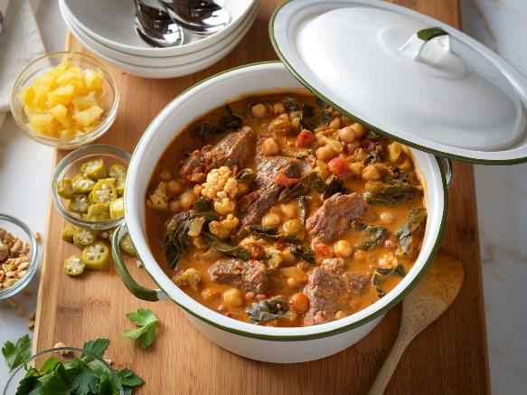
Beef’s Eating Experience – Flavor & Juiciness
Influenced by similar factors as tenderness
Impacted by cooking time, technique, and seasoning
North African harissa-braised beef stew
Beef University
Notes:
Many of the factors that impact beef tenderness also influence juiciness and flavor, especially the amount of marbling present in a cut but also the age of the animal and what the animal is fed in its diet.
In addition, cooking beef cuts using the optimal technique or method and cooking cuts for the correct amount of time helps ensure a juicy, flavorful result. Proper seasoning of beef also comes into play.

Slide 10
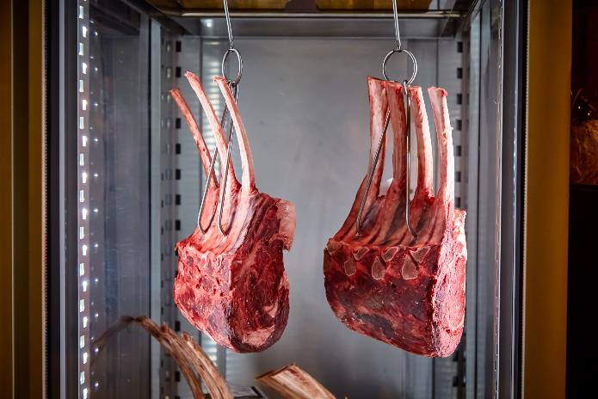
Beef Aging
Wet Aging
  Vacuum-sealed in plastic
  Retains moisture
  Most common in retail and foodservice
Dry Aging
  Exposed to air
  Moisture dissipates, resulting in intense beef flavor
  More expensive and less common
Beef University
Notes:
Similar to foods like wine and cheese, beef gets better with age as it becomes more tender and flavorful. Aging is holding beef for a period of time post-mortem to allow for natural tenderness and flavor to develop.
Wet-aged beef is vacuum-sealed in plastic, oxygen barrier packaging, which retains moisture and protects the product during storage and transportation. Most beef sold in retail and foodservice is wet-aged.
Dry-aged beef is exposed to air, outside of a package, in a controlled environment, which leads to the dissipation of moisture, resulting in beef with a hard crust that must be removed before cooking and an intense beefy flavor. However, this moisture loss decreases the weight of the meat and increases the price per pound making dry aging more expensive and less common.
Minimum recommend aging time for both wet and dry aged beef, which is based on extensive amounts of published research, is 14 days, though many cuts benefit from additional aging time. And, because of beef industry research and education, both the retail and foodservice channels currently exceed this minimum aging recommendation on average helping ensure a more tender, flavorful eating experience for consumers.

Slide 11
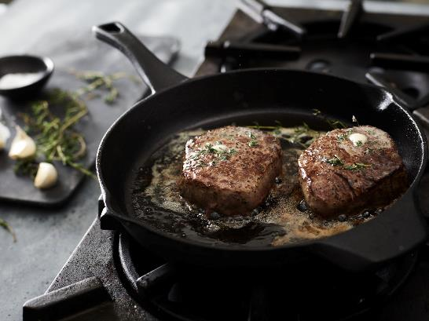
Beef Cookery – The Science of Cooking
Beef = water + protein
Cooking can both toughen or tenderize meat, depending on:
  Time
  Temperature
  Method
  Slicing
Maillard Reaction = caramelization
Beef University
Notes:
Satisfaction with the beef eating experience is also highly impacted by how beef is cooked. Cooking to the optimal level of doneness is also critical to ensuring beef comes out tender, juicy and flavorful. When considering how best to prepare a cut of beef, it is good to know a bit about the science of cooking.
Beef muscle is primarily comprised of water and protein. As proteins cook, toughening and tenderizing changes occur. The extent of each depends on cooking time, temperature, cooking method – whether moist or dry heat – composition of the muscle itself and how and when the beef is sliced after cooking. For example, beef steaks and roasts should be rested for approximately 5 minutes after cooking to allow hot juices in the meat to redistribute and preserve juiciness. And, beef should be sliced across the grain for maximum tenderness.
Beef’s inherent flavor compounds rely on heat to develop. The caramelization that occurs during dry heat cooking, known as the Maillard Reaction, enhances the flavor in beef to result in a desired “browned” flavor and to create umami – the “fifth taste” alongside sweet, sour, bitter and salty characterized as a savory or meaty flavor that results from beef’s amino acids being released during cooking.

Slide 12


Beef Cookery – Dry Heat
Methods
  Broiling
  Grilling
  Oven roasting
  Skillet cooking
  Stir-frying
  Smoking
Higher temps
Best for more tender cuts
Beef University
Notes:
All cooking methods can fit into two categories: dry heat and moist heat.
Dry Heat includes broiling, grilling, oven roasting, skillet cooking, stir-frying and smoking. It is best for tender cuts, primarily from middle of the carcass, although some cuts from the Chuck have been found to be tender, such as Flat Iron Steak, Ranch Steak and Petite Tender.
Dry heat cooking methods are typically at higher temperatures, uncovered, to a desired endpoint temperature or degree of doneness (medium, etc.). These methods are generally shorter in duration than moist heat cooking methods, though smoking could take longer. Oven roasting can be done quickly or take longer depending on the cut. Some less-tender cuts can also be dry-heat cooked if they are marinated first with a tenderizing marinade. End point temperature measured via an instant-read or oven-proof thermometer is the best indicator of doneness for beef prepared using dry heat cooking methods.

Slide 13



Beef Cookery – Moist Heat
Methods
  Braising
  Stewing
Low heat and slow cooking
Best for less tender cuts
Brown beef first for color and flavor
Sous vide
Beef University
Notes:
Moist Heat methods rely on a long, slow cooking process in liquid to help tenderize the beef and add flavor. Examples of moist-heat cooking include braising and stewing. These methods may or may not include the cooking vessel remaining covered during cooking.
Browning the beef first adds color and flavor – the Maillard Reaction we covered earlier. Moist heat cookery’s longer, slower cooking also allows time for any natural connective tissue present in beef cuts to convert to gelatin and tenderize. Beef flavor components also seep into cooking liquid, which can be water, stock, wine or broth, to create delicately flavored meat. Beef cooked using moist-heat techniques is generally cooked to fork-tender.
Sous vide, French for under vacuum, is a cooking method that involves vacuum-sealing beef cuts in a bag and then immersing them in a precisely-controlled, low-temperature water bath for cooking for relatively long periods of time.

Slide 14
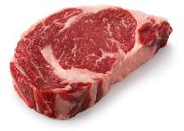
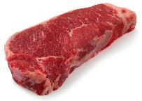
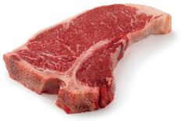
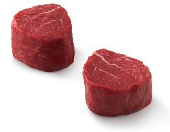
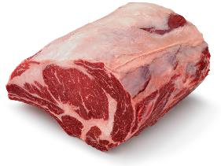
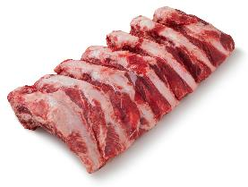
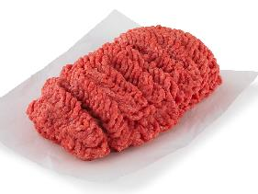
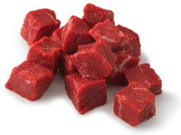
Beef Cuts
Beef University
Notes:
We’ve talked about what goes into beef’s great taste and cookery. Now let’s explore the various cuts of beef, where they are located in a beef carcass and how they should be cut and prepared to ensure an optimal beef eating experience.

Slide 15
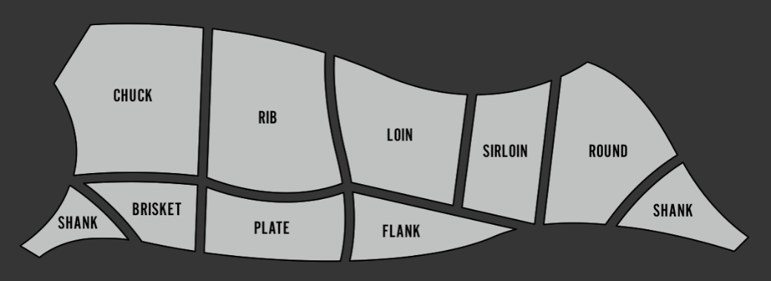
Beef Cuts - Primals
Primal cuts – the first stage of beef carcass fabrication
Major primals: Chuck, Rib, Loin, and Round
Beef University
Notes:
Beef harvest and fabrication occurs at beef packing plants following 24-48 hours of carcass chilling. The first stage of beef carcass fabrication involves splitting the carcass into two sides and then breaking those sides into large primal cuts.
The four major primals include the Chuck, Rib, Loin and Round. The sirloin is also a subsection of the full loin. These primals account for more than 75 percent of the weight of beef produced from each carcass.
The thin meats – Brisket, Plate, Flank and Shank - account for the remaining percentage.

Slide 16
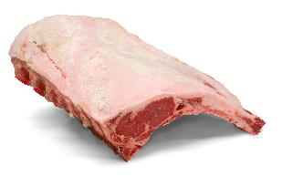
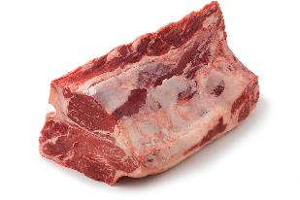
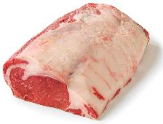
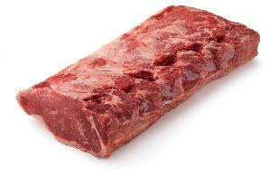
Beef Cuts - Subprimals
Primals are broken down by processors into smaller portions called subprimals
Often purchased by:
  Further processors
  Grocery retailers
  Foodservice operators
PRIMALS
Rib Primal
Loin Primal
SUBPRIMALS
Rib, Lip On
Strip Loin
Beef University
Notes:
Primals are further broken down by packers into smaller portions called subprimals for purchase by further processors, grocery retailers or foodservice operators. Excess fat and bones are generally removed, although some subprimals are offered bone-in.
Examples of subprimals include the Ribeye Roll cut from the Rib primal and Strip Loin cut from the Loin primal.
Like subprimals are placed in cardboard boxes prior to sale, leading to the common industry term “boxed beef.”

Slide 17
Beef Cuts – Final Portion Cuts
SUBPRIMALS
Rib, Lip On
Strip Loin
PORTION CUTS
Ribeye Steak
Strip Steak
Beef University
Notes:
Subprimals are then further cut or broken into final portion cuts which are then sold through retail and foodservice channels.
Examples of final portion cuts from these subprimals are Ribeye Steaks from the Ribeye Roll, and Strip Steaks from the Strip Loin.

Slide 18
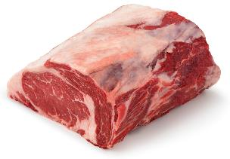

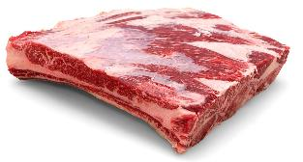
Beef Cuts - Types
Steaks
Roasts
Ribs
Ingredient
Cuts
Beef University
Notes:
When talking final, portioned beef cuts, there are four main categories: Steaks, Roasts, Ribs, and Ingredient Cuts, such as Ground Beef, which are cuts specifically developed for use within a recipe. Let’s take a closer look at each category.

Slide 19
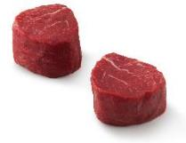
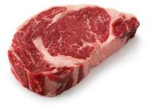

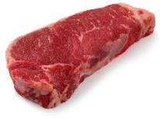
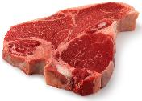
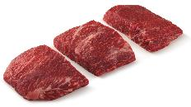
Beef Cuts - Steaks
Flat cuts of beef:
  ¾ - 1 ½ inches thick
Most often cooked using dry heat
Pat dry before cooking
Turn with tongs; not a fork
  Minimize turns
Tenderloin Steak (Filet Mignon)
Ribeye Steak
T-bone Steak
Strip Steak
Porterhouse Steak
Flat Iron Steak
Beef University
Notes:
Steaks are flat cuts of beef generally ranging from three-quarter to one-and-a-half inches thick, though sometimes sliced thin or cut into thicker portions. They are cut from various subprimals and the size of one steak is often enough for one or more portions or servings.
There are many popular preparations for steaks, including grilling, broiling, skillet or skillet-to-oven and sous vide. Many steaks are suitable for dry-heat cookery (grilling, broiling, etc.), including those like Tenderloin Steak/Filet Mignon, Ribeye, Strip, T-Bone, Flat Iron, etc.
Prior to dry-heat cooking, steaks should be patted dry to promote browning and seasoned as desired. Then they can be cooked over medium heat and turned with tongs, not a fork, to avoid piercing the meat, which results in the loss of beef’s delicious juices and can cause a dry steak. And when it comes to turning, less is best. Let the steak cook and avoid touching it as much as possible.

Slide 20

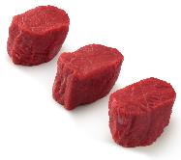

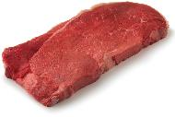
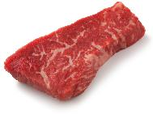
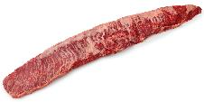
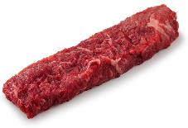

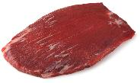
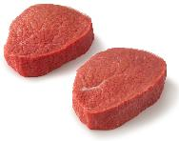

Beef Cuts – Steak Versatility
Middle Meats
tender and flavorful, but pricey
End Meats
great value, benefit from marinating
Opportunity Cuts
great value
Tenderloin Steak (Filet Mignon)
Ribeye Steak
Inside Skirt
Top Round Steak
Petite Tender Medallions
Tri-tip Steak
Sirloin Bavette
(AKA, Flap)
Strip Steak
T-bone Steak
Flank Steak
Eye Of Round Steak
Beef University
Notes:
Steaks are a versatile beef option and there’s a steak for every price point, cooking method and eating occasion. Cuts from the middle of the carcass, such as Ribeye Steak, Tenderloin Steak (also known as Filet Mignon), and T-Bone Steak are referred to as middle meats and command higher prices for their inherent tenderness and flavor.
End cuts, such as Skirt Steak, Top Round Steak, Flank Steak and Eye of Round Steak, offer a good value, but typically benefit from marinating to improve the eating experience.
Lesser-known cuts like the Flat Iron Steak, Tri-Tip Steak and Sirloin Bavette come from the ends of the carcass but offer an exceptional eating experience for a great value.

Slide 21
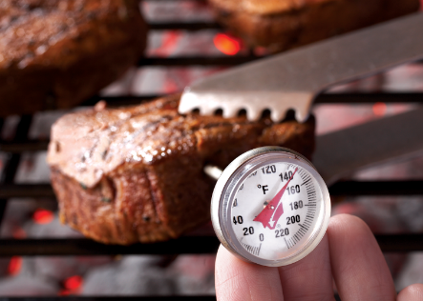
Beef Cuts – Steak Doneness
Insert an instant-read thermometer horizontally from the side
Make sure not to touch bone or fat
USDA Medium Rare = 145°F
USDA Medium = 160°F
USDA Well Done = 170°F
After cooking, let steaks rest before serving
Beef University
Notes:
Cook steaks to medium rare at 145° Fahrenheit, medium at 160° or well done at 170° Fahrenheit to follow USDA minimum internal temperature guidelines.
Insert an instant-read thermometer horizontally from the side, so that it penetrates the thickest part or the center of the steak, not touching bone or fat. It is critical to let beef steaks, roasts and ribs rest at least 5 minutes before slicing, as resting allows beef’s natural juices to redistribute throughout the steak instead of draining out onto the cutting board or plate if sliced immediately after cooking.

Slide 22
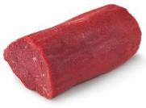
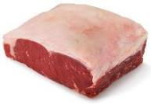
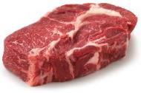
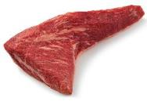
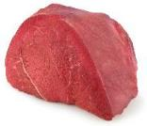
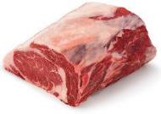
Beef Cuts - Roasts
More than 2 inches thick
Bone-in or boneless
Often contains more than one muscle or muscle group
Cook using dry or moist heat, depending on roast
Tenderloin Roast
Strip Loin Roast
Chuck Roast
Tri-tip Roast
Sirloin Tip Roast
Ribeye Roast
Beef University
Notes:
Roasts are cuts of beef more than two inches thick and larger than a steak. They may contain bones or be boneless and often contain more than one muscle or muscle group. Different roast types call for different types of cooking methods to optimize flavor and tenderness. However, roasts can provide foodservice operators and home cooks flexibility and versatility because roasting is a relatively simple and hand’s-off cooking process.
Example roasts include the Tenderloin Roast, Strip Loin Roast, Chuck Roast, Ribeye Roast, Tri-Tip Roast and Sirloin Tip Roast.

Slide 23

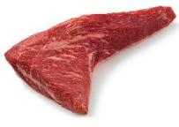


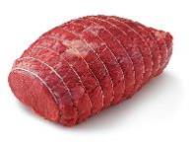
Beef Cuts – Rib and Loin Roasts
Tender
Dry heat
  Oven roasting
  Indirect grill
Ideal for signature dishes
Tenderloin Roast
TRI-TIP Roast
Ribeye Roast
Strip Loin Roast
Top Sirloin
Petite Roast
Beef University
Notes:
Tender roasts from the Rib and Loin are best prepared with dry heat cooking either in the oven or in a covered grill using indirect heat.
Roasts from the Rib and Loin primals are also ideal for signature dishes featuring special rubs, sauces and seasonings and offer the opportunity for a stunning presentation and memorable dining experiences.

Slide 24
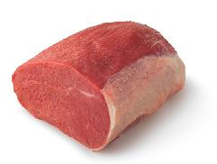
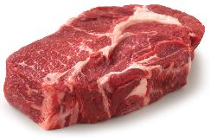

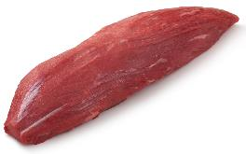
Beef Cuts – Chuck and Round Roasts
Moist heat helps tenderize
  Braising
  Slow-cooker
Often paired with flavorful sauces
Offer value
Larger portions can stretch across more than one meal
Chuck Roast
Eye Of Round Roast
Petite Tender Roast
Sirloin Tip Roast
Beef University
Notes:
Slow, moist heat cooking is required for some roasts to break down naturally present connective tissue and tenderize the cut, and slow roasting also helps introduce complex, intense flavors. Often these cuts are paired with flavorful sauces, which may be created from the cooking liquid produced during slow cooking. Roasts cooked in this manner should be cooked to fork tender.
For example, some of the less tender beef roasts from the Chuck and Round are best when prepared using moist-heat cooking techniques, such as braising or using a slow-cooker. These roasts also offer operators or customers value and can be used to create the foundation for more than one meal because of their inherent volume.

Slide 25

Beef Cuts - Brisket
Sold fresh or cured as Corned Beef
Popular in BBQ and other classic or comfort dishes
Slow cooking methods; moist or dry
  Braising
  Smoking low-and-slow
Adapts well to dry rubs and marinades
Beef University
Notes:
Brisket is a boneless cut from under the first five ribs below the Chuck primal in the beef carcass. It is sold both fresh and cured as Corned Beef.
Brisket is often used in popular barbecue and ethnic comfort dishes. Slow-cooking methods, such as braising or smoking low-and-slow are the best for Brisket. After cooking, it can be sliced for consumption or for use in sandwiches and adapts well to dry rubs or marinades.

Slide 26




Beef Cuts - Ribs
Back Ribs
Country-Style Ribs
Short Ribs
  Traditional Cut
  Flanken-Style
Back Ribs
Country-Style Ribs
Short Ribs
Short Ribs, Flanken-style
Beef University
Notes:
There are three main types of Ribs: Back Ribs, Country-Style Ribs and Short Ribs, which can be cut traditionally between the ribs or cut across the ribs flanken-style. We’ll explore these types of ribs further over the next few minutes.

Slide 27

Beef Cuts – Back Ribs
Bone-in
Relatively inexpensive
Smoke
Indirect grill
Braise
Beef University
Notes:
Back Ribs are sold bone-in and are relatively inexpensive and can be profitable for grocery retailers and foodservice operators. They are often smoked or grilled over indirect heat, but may be braised with wine, vegetables, seasonings and stock to enhance taste and tenderness.

Slide 28

Beef Cuts – Country-Style Ribs
Boneless
From the Chuck Roll subprimal
Meaty, tender, juicy and flavorful
Pre-cut and perfectly portioned
Braise or braise and finish on grill
Beef University
Notes:
Country-Style Ribs come from the Chuck Roll subprimal and are boneless cuts shaped like traditional ribs. They are meaty, tender, juicy and flavorful.
Perfectly portioned and pre-cut, they are just the right size and shape to prepare and serve. Braising works best, or they can be braised and finished on the grill to heighten the natural flavor even more.

Slide 29


Beef Cuts – Short Ribs
Bone-in or boneless
Retail – Chuck Short Ribs
Foodservice – Plate Short Ribs
Slow, moist cooking when cut between ribs
Marinated and grilled when cut Flanken-Style
Short Ribs
From The Chuck
Short Ribs
From The Plate
Short Ribs, Flanken-style
Beef University
Notes:
Short Ribs offer rich, deep flavor and can be purchased bone-in or boneless. Retailers typically carry Chuck Short Ribs, which come from the Chuck primal, while foodservice operators tend to menu Short Ribs from the Plate primal in BBQ applications. They are the ultimate comfort food and require long, slow braising with wine, vegetables, seasonings or stock, or long-smoking, to enhance flavor and tenderness. They are either served whole or served shredded with a sauce.
In addition to chuck and plate short ribs, rib short ribs are also available for retail or foodservice use. And, short ribs can be purchased bone-in or boneless.
Short Ribs can also be cut flanken-style, or across the bone to create thin strips of beef with multiple rib bones present. Flanken-Style Short Ribs are popular in Korean barbecue, where they’re often known as Kalbi Ribs. They can be grilled after marinating with a classic Korean-style marinade such as one made with soy sauce, sesame oil, garlic, green onions, sugar and chili pepper.

Slide 30





Beef Cuts – Ingredient Cuts
Kabobs
Ground Beef
Stew Meat
Beef Strips
Cubed Steak
Beef University
Notes:
Additional beef cut options – referred to as ingredient cuts - exist for use as part of prepared dishes or certain cuisine types.

Slide 31


Beef Cuts – Ground Cuts
Top-selling beef item
Versatile
Made by grinding subprimals or trimmings
Sold according to fat-to-lean ratio
Must be 100% beef
Cannot contain more than 30% fat
Higher fat blends: burgers, meatballs, meatloaf
Leaner blends: crumble recipes, like tacos, meat sauce and chili
Bistro Cheeseburger
Confetti Beef Tacos
Beef University
Notes:
Ground Beef is the top-selling beef item in both retail and foodservice. Its versatility and convenience make it a popular choice in the meat case and on restaurant menus. From hamburgers to lasagna, tacos to meatloaf, pasta sauce to wraps, Ground Beef offers quick, easy and delicious options for any meal and for any occasion.
Ground Beef is most commonly made by grinding beef trimmings, which are smaller pieces of beef that are generated when cutting and trimming steaks, roasts, etc. from across the beef carcass, However, it also can be made by grinding specific primals such as Chuck, Round, Sirloin, etc. and then can be labeled with the primal of origin, such as Ground Chuck. Or, it can be made by grinding specific USDA quality grades of beef or branded beef lines and then labeled as such.
By USDA definition, Ground Beef is sold according to its fat-to-lean ratio, such as 80:20 or 90:10. Ground Beef must be 100% beef and contain no more than 30 percent fat.
Ground beef blends with a higher fat to lean ratio are often used for burgers, meatballs, meatloaf, etc. Leaner blends are often used for crumble-type recipes, such as tacos, meat sauces and chili, etc.

Slide 32



Beef Cuts - Kabobs
Uniform-sized cubes of beef
Marinate from 15 min to 2 hours
When skewering, leave space between cubes
Steak Kabobs with Mushroom Wild Rice
Spicy Portuguese Beef Kabobs
Beef University
Notes:
Kabobs are popular worldwide and rely on uniform size pieces for even cooking. They can be marinated from 15 minutes up to 2 hours.
When skewering, chunk-style kabob cuts should have small spaces between them to allow for even cooking on all sides. Ribbon-style cuts should be woven onto the skewer so that beef is just touching.
Companion ingredients – such as fruit or vegetables – should be skewered separately or grouped according to required cooking time.

Slide 33



Beef Cuts – Stew Meat
Uniform-sized cubes of beef
Coat with flour, brown in a small amount of oil over medium heat, and then add liquid to the pan and cover
Great for stews, chili, pot pie and Stroganoff
Moderately priced
Ideal for high-volume cooking and leftovers
Cowboy Beef Stew
Chunky Beef Chili
Beef University
Notes:
Stew Meat are cubes cut into uniform-sized pieces. They’re best prepared by coating the cubes with flour, browning them in a small amount of oil over medium heat, then adding liquid to the pan and covering tightly.
They should then be simmered gently with any vegetables near the end of cooking. These cuts offer many home-style entrée options including stews, chili, pot pie and stroganoff.
Moderately priced, they are ideal for high-volume cooking, hold well and are easily reheated for leftovers.

Slide 34



Beef Cuts – Beef Strips
Uniform-sized strips of beef
Sliced thinly across the grain to maximize tenderness
Great for stir-fry dishes with vegetables or as fajitas
Asian Beef Stir-Fry
Stir-Fried Beef Gyros in Pita Pockets
Beef University
Notes:
Beef strips, also called stir-fry beef, also rely on uniform sizes for even cooking and are sliced thinly across beef’s natural grain to maximize tenderness. They work well as an ingredient in stir-fry dishes with vegetables or as an ingredient in fajitas.

Slide 35



Beef Cuts – Cubed Steak
Cut thin and mechanically tenderized
Great value
Skillet cooking
Parmesan Crusted Cubed Steak with Zucchini Ribbons
Country Fried Steak with Tomato Basil S
Beef University
Notes:
Cubed Steaks are cut thin and tenderized and are a great value for everyday meals. They are typically cooked in a skillet.
The name comes from the process of mechanical tenderization using a cubing machine that has two sets of sharp pointed discs which cut and shape the beef and pierce it to shorten the natural muscle fibers. This process makes a less tender cut more tender.
Cubed Steaks can be cooked in a skillet and/or battered and pan fried.

Slide 36

Additional Resources – BeefItsWhatsForDinner.com
Beef University
Notes:
Beef. It’s What’s for Dinner. offers numerous cut and cookery education resources to further your knowledge.
For example, the Cuts Section of BeefItsWhatsforDinner.com offers a search function to allow users to view unique pages for each available beef cut that includes cut photos, cut description, cut location, nutritional data, butcher’s tips, ordering information and specifications, recipe ideas and more.

Slide 37
Additional Resources – Cuts Charts
Beef University
Notes:
Our Retail Cut Chart showcases the most popular cuts sold in U.S. grocery stores and includes a cut’s name, it’s primal location or source and suggested cooking method(s).
Our Foodservice Cut Chart includes the same details for the most popular cuts sold on restaurant menus.
Both cuts can be found under the “training section” of the supply chain navigation bar towards the bottom of every page on BeefItsWhatsForDinner.com

Slide 38

Additional Resources – Cooking Lessons
Beef University
Notes:
And, for step-by-step cooking instructions for each popular cooking method, visit the Cooking Section of BeefItsWhatsforDinner.com.

Slide 39


Additional Resources – Cooking Lessons
Beef University
Notes:
For example, the grilling basics page lists all the steps involved in grilling – everything from preparing your beef to letting it rest before enjoying it.

Slide 40

Additional Resources – BeefItsWhatsForDinner.com
Beef University
Notes:
Bottom line, BeefItsWhatsForDinner.com is your resource for more in-depth information on cuts, as well as recipes and cooking methods, which can be found on the top navigation bar of the website. Browse our cuts database to learn which cooking methods pair best with each cut, look up cut-specific nutrition information and much more.

Slide 41
Thank You

