Slide 1
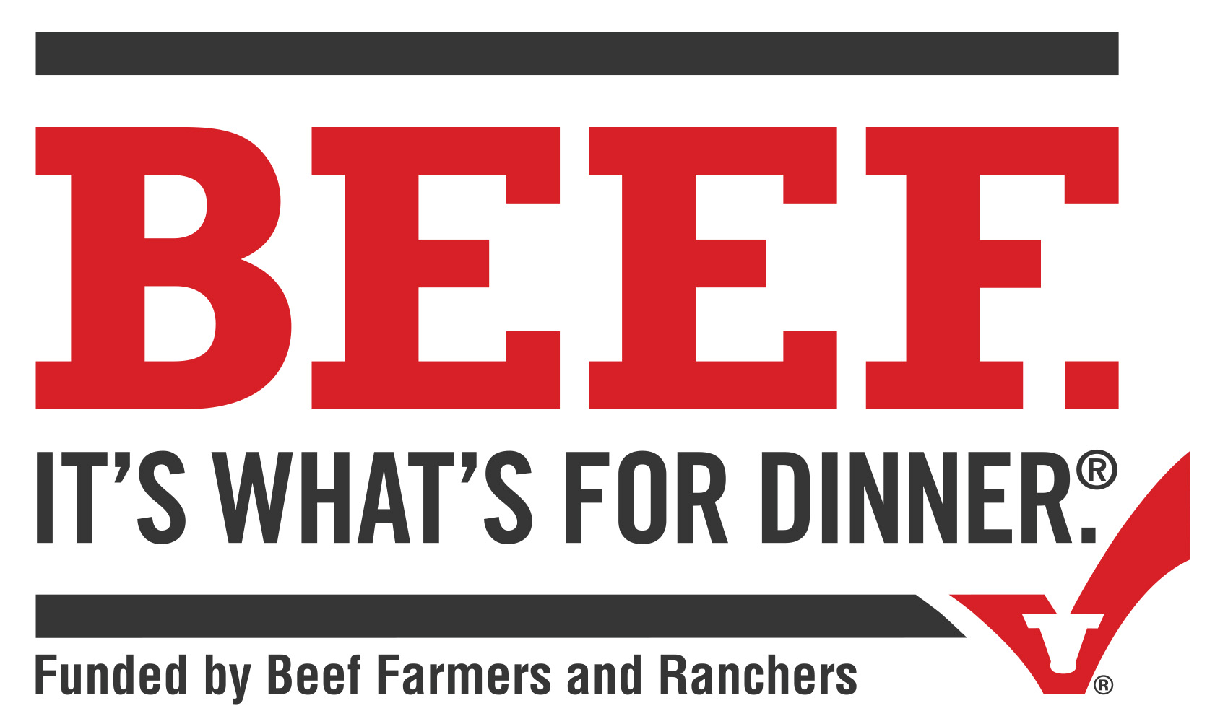
Beef U – Beef Cuts and Prep Quiz
1. All beef products are inspected by U.S. Department of Agriculture inspectors before they leave a federally regulated facility.
True
False
2. Beef quality grades, assigned by the U.S. Department of Agriculture to the vast majority of beef carcasses in the U.S., predict what qualities of beef?
The amount of beef on a carcass
How the beef cattle was raised
What the beef cattle was fed
Anticipated tenderness, juiciness and flavor
3. The three most commonly sold beef grades in grocery stores and restaurants are Choice, Prime, and Select. Please rank the three, starting with the highest quality first.
_______Prime
________Choice
________Select
4. Please select all of the moist heat cooking methods from the list below.
Broiling
Grilling
Oven Roasting
Skillet Cooking
Stir-Frying
Smoking
Braising
Stewing
5. Pre-harvest factors that can affect tenderness include which of the following? Select All that Apply
Age of the animal
Mechanical Tenderization
Sex of cattle
Genetics of cattle
Aging (wet or dry)

Slide 2
6. Please match the beef cut with its type.
Strip Loin
Loin
Strip Steak
Sub Primal
Primal
Final Portion Cut
7. As proteins cook, toughening and tenderizing changes take place in the muscle. The extent of the toughening and tenderizing changes depends on which of the following factors? Select All That Apply
Cooking Time
Cooking Temp
Cooking Method
Composition of the Muscle Itself
8. The best way to cook a steak is typically a dry heat method.
True
False
9. What temperature (in Fahrenheit) does the USDA define as being medium rare? Write In Your Answer
10. To be marketed as Ground Beef, the beef product must meet what specifications? Select All That Apply
Contains 100% beef
Contains no more than 30% fat
Contains no more than 50% fat
Contains at least 80% beef
Only come from the Chuck

