Slide 1

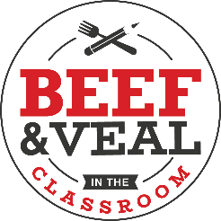

Beef in the classroom
Beef in the classroom
New Oxford High School
Presented in Partnership with the Wisconsin Beef Council
Kaitlyn Carey – PA Beef Council
Notes:
Good Morning/Afternoon Students! Today we will be going through a comprehensive lesson on beef – a high quality, nutrient-dense protein source! Our school has been fortunate enough to receive a grant through the Wisconsin Beef Council to supply the fresh beef product that we will use during our lab/cooking demo/etc. as part of this lesson.
First let’s learn a little bit about the Wisconsin Beef Council and the work they do…

Slide 2
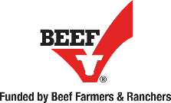

The Beef Checkoff Program
Non-profit organization
Working on behalf of Wisconsin’s beef & dairy farmers
Work in cooperation with the National Beef Checkoff Program
Mission Statement: To build beef demand that is sustainable for future generations.
Notes:
Some background information on the Beef Checkoff Program – to help guide the discussion:
The Beef Checkoff Program is a producer-funded (funded by beef, dairy and veal producers) marketing and research program designed to increase domestic and/or international demand for beef. This is done through promotion, research and new product development, and a variety of other marketing tools.
The Cattlemen’s Beef Board and USDA oversee the collection and spending of checkoff funds.
Checkoff dollars cannot be used for government lobbying efforts or anything policy-oriented.
As any checkoff program it is designed as a “self-help” program – farmers and ranchers are busy producing food for the world, they often don’t have time to promote their products and their livelihoods, this is where the checkoff comes into play
Wisconsin Beef Council specifics:
The Wisconsin Beef Council is a non-profit organization working on behalf of 25,000 beef, dairy and veal. Pennsylvania’s 69,754 farm families continue to be the stewards of more than 14.3 million acres of farmland. With $10.7 billion in cash receipts annually from production agriculture, Wisconsin farmers and agribusinesses are the leading economic driver in our state.
The Wisconsin Beef Council’s Mission Statement is: Be a unified voice for our beef & veal partners by sharing their legacy of commitment with the families enjoying dinner with us.
Beef, dairy and veal producers are busy taking care of and raising their animals – we serve as “boots on the ground” to share their story and promote their products on their behalf.
Please direct any questions on the Beef Checkoff Program to Brooke Roberts - broberts@beeftips.com or 608-833-9944.

Slide 3
Today’s Lesson Goals
Brief Overview of the Beef Industry
  Beef Cuts
  Nutrition
  Cooking with Beef
  Pricing of Beef
  Beef Production
  Questions?
Notes:
You can customize this slide to reflect the goals for your specific lesson.
On the next slide, we will watch a video that gives an overview of the people involved within the beef industry.

Slide 4
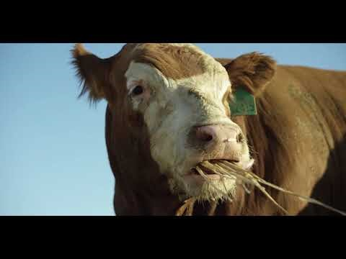
Notes:
Video can be found via YouTube, https://www.youtube.com/watch?v=zdRQm2BHpUs
Questions to ask following the video:
Did you see the care and concern farmers and ranchers have for their animals and the environment? They should answer yes, and note things such as the variety of people involved (nutritionist, veterinarians, etc.)
Were you surprised farmers and ranchers use modern technology, like drones, to manage their cattle?
Ranchers who live in rough terrain and open country use drones to check on water troughs and to gather cattle
Learn more here: https://www.beefitswhatsfordinner.com/raising-beef/rethink-the-ranch

Slide 5
The Basics
Beef: Nutrient-rich meat with 10 essential nutrients produced from bovine animals (cows)
Cow: a mature female bovine – she is bred to have one calf a year
Calf: Young bovine, either male or female
Where are cattle raised?
  Cattle are raised all across the country – most cattle are fed to market weight within the Midwest United States, due to the close proximity to feed resources (the Corn Belt – where a majority of the corn is grown in our country)
How many cows does the average farm have?
  The average herd size across all farms and ranches is 40 head
    There are some farms that have more and some that have less
Notes:
This slide emphasizes some of the concepts that were demonstrated in the short video. Review each term and definition/explanation with your students.
Beef is the final product that is very nutrient-dense, packed with 10 essential nutrients.
A cow is a mature female bovine. She is bred to have only one calf per year.
A calf is the young offspring, either male or female. The males are called bulls and the females heifers.
Cattle are raised all across our great nation, however it’s good to note that a lot of the cattle within our country move west to be fed out to market weight, this is due to the fact that a majority of the nation’s corn is grown within the Midwest United States (the Corn Belt)
The average herd size of cattle is 40 head (or 40 animals) per farm. There are some farms that have more and some that have less – it all depends on the type of operation.
We will walk through the beef lifecycle near the end of the presentation.

Slide 6
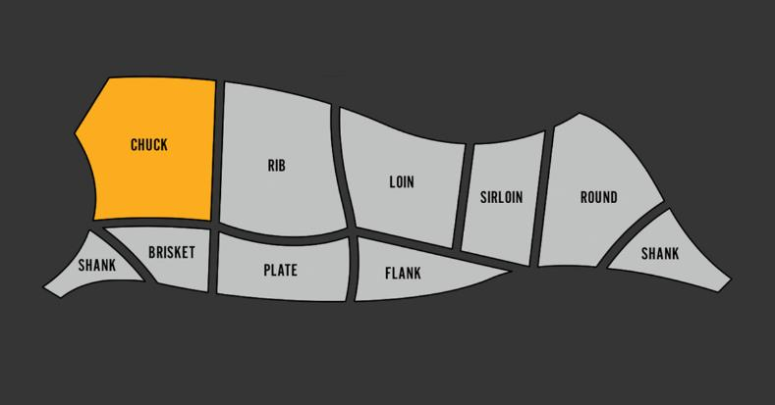
Beef Cuts
Notes:
There is a wide variety of different cuts of beef – whether you are looking for a lean cut for a weeknight family dinner or a large, tender cut for a holiday roast. Selecting the right cut of beef is very important depending on your end goal.
The Beef. It’s What’s for Dinner website has an interactive section that will help you navigate the cuts and choose the perfect cut next time you’re at the grocery store meat case.
On the screen you will see the various primal cuts of beef – are any of these names familiar?
This would also be a great time to hand out the beef cut charts and have students find their favorite cut.

Slide 7
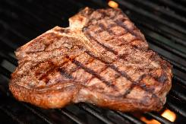
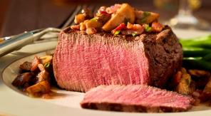
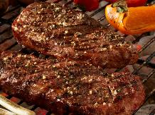
Selecting the Right Cut of Beef
Many of America’s favorite cuts are lean
  Lean = less than 10 grams of total fat, 4.5 grams or less of saturated fat and less than 95 mg of cholesterol per 3.5oz serving
Look for LOIN and ROUND
Examples include: Round Roast (Top Round, Bottom Round), Strip Steak, Tenderloin Roast and Steak, T-Bone Steak
Notes:
Like mentioned previously choosing the right cut of beef is important depending on which cooking method you are using.
Another area of concern for many consumers is ensure that their beef is lean. The good news is that many of America’s favorite cuts are lean.
The definition of lean is as follows: it must have less than 10 grams of total fat, 4.5 grams or less of saturated fat and less than 95 mg of cholesterol per 3.5 oz. serving.
When looking for lean cuts of beef at the grocery store or when ordering at a restaurant look for cuts with Loin and Round in the name. Common examples are listed and pictured on the slide.
Also, on the beef cuts charts that you all have there is a cooking key found at the bottom and then within each specific cut, it gives recommended cooking methods for each cuts. Certain cuts are better for grilling, while other need to be roasted for the optimal eating experience.
Find more information here: https://www.beefitswhatsfordinner.com/cuts

Slide 8
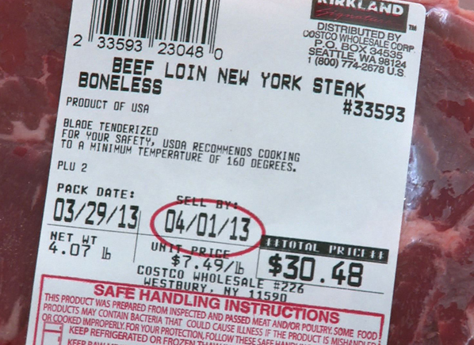
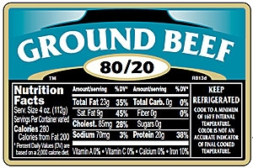
Choosing Beef
Understanding Labels – what does everything mean
Notes:
Point out that meat package labels identify the kind of meat (for example, beef), the wholesale (primal) cut and the cut name. Also included are the weight, price per pound, total price, sell by date and safe handling instructions.
It may also include a grade, nutrition and preparation information and the country of origin
Ground beef labels include the lean to fat percentage (For example 80/20). Ask students again what the 80/20 means on a ground beef label? It is the lean to fat ratio that is formulated when the ground beef is processed. 80/20 is the variety most commonly found in the grocery store.

Slide 9
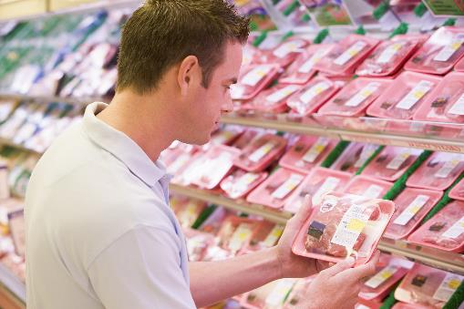
Choosing Beef
Bright cherry-red color
  Darker purplish-red color – exposed to air it will turn a bright red
Firm to the touch
Cold with no holes or tears
Packages without excessive liquid
Sell-by date
When in doubt consult with the store’s butcher – they are your go-to resource
Notes:
Below you will find some general guidelines to follow when buying beef from a grocery store, farmers market, etc.
Select beef with a bright cherry-red color
Beef in a sealed bag is typically going to have a darker purplish-red color – when exposed to air it will turn a bright red
Choose beef that is firm to the touch
Make sure the package is cold with no holes or tears
Choose packages without excessive liquid
Purchase beef on or before the sell-by date
When in doubt consult with the store’s butcher – they are your go-to resource – most all grocery stores have a full-time butcher who should have all of the insight into helping make the best beef choice based on your goal – are you trying to impress your neighbors with a juicy, delicious steak or are you trying to serve your family a beautiful roast for the holidays?

Slide 10
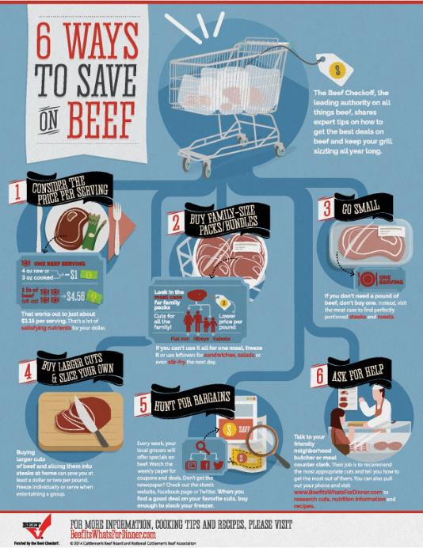
Price of Beef
Pricing of beef largely has to do with supply and demand
Find sales to maximize your value
Buy in bulk from local beef producers
Notes:
The price of beef, as with anything, is largely influenced by supply and demand.
There are some ways that you can get the most bang for you buck when purchasing beef. The infographic on the screen goes through 6 Ways to Save on Beef. (You can read through the ways). Highlight that you can find sales and freeze any beef that you are not going to use right away.
Another option is to buy beef in bulk (whole beef, half a beef, quarter of a beef) from a local beef producer.

Slide 11
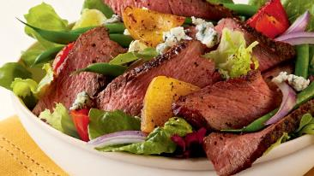
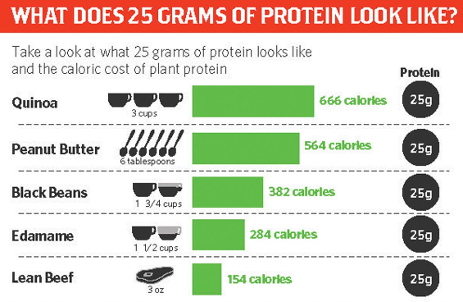
Beef Nutrition
10 Essential Nutrients – support a heart-healthy lifestyle
  Including protein, zinc, iron, B Vitamins
One 3 oz. serving of beef provides you with about half of your Daily Value of protein
Notes:
Beef is a nutrient-dense source of protein, packed with 10 essential nutrients. Essential nutrients are those that must be consumed through our daily diet, as our body does not make them. The 10 essential nutrients in beef support a heart-healthy lifestyle.
One 3 oz. cooked serving of beef provides you with about half of your Daily Value of protein for only 154 calories.
The chart on the screen shows you what 25 grams of protein looks like from commonly consumed sources. It is important to note how much you would have to consume and the caloric cost associated. Ask who could eat 3 cups of quinoa in one day’s time?? For a whopping 666 calories. The point of this infographic is to show that beef wins in portion size and calories to gain 25 grams of protein.
Learn more at: https://www.beefitswhatsfordinner.com/nutrition

Slide 12
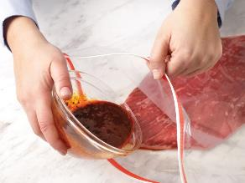
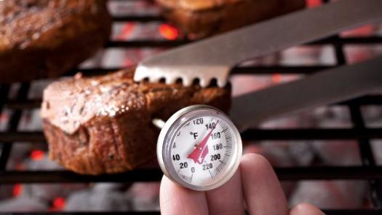
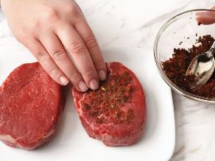
Cooking Beef
Choose the cooking method based on your cut
Marinades vs. Rubs
Determining Doneness
VS
Notes:
There are a wide variety of cooking methods for beef. This would be a good time to talk about the “Simple Steps” Cooking Infographics. It might be helpful to have some copies available for the cooking method that will be used within the classroom.
Some highlights on cooking beef:
It is important to choose the cooking method you use based on your cut
Some cuts are less tender and other are more tender – cuts that are tougher are going to need cooked differently, to ensure you have a positive eating experience.
Note that on the beef cut chart there is a cooking method key that shows the best cooking methods for each cut
Ask your students what is one cut of beef they would grill? Versus what is one cut they would roast?
Marinades vs. Rubs – once again this comes down to which cut you are using. Marinades are designed to help improve the tenderness and flavor of your beef, therefore less tender cuts like chuck and round do well with a marinade. The beef is placed within the marinade for an extended period of time (12-24 hours). A rub is designed for more tender cuts, like steaks – ribeye, strip, etc. A rub is simply placed on the outside surface of the beef directly prior to cooking
Determining the doneness of your beef
Ask you students the best way to determine doneness – is it guess? Time it? Color?
Emphasize that the only true way to know the doneness of your meat is to use a meat thermometer
Ground beef must be cooked to an internal temperature of 160 degrees Fahrenheit – this is due to the fact that it is further process and all mixed together. Steaks and roasts can be cooked to a lower internal temperature, because the inside of the meat is sterile, bacteria would only be on the surface of the steak/roast
For steaks, medium rare the temperature should read 145°F, the temperature for medium steaks should read 160°F, and well done is 170°F
Learn more here, https://www.beefitswhatsfordinner.com/cooking

Slide 13
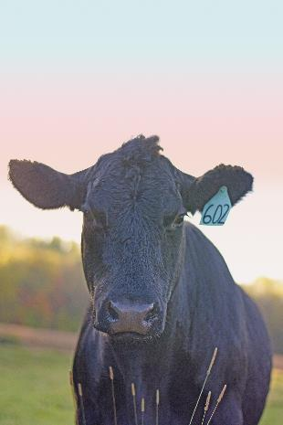
Raising Beef
Complex process, but throughout the entire journey, one thing remains constant – the shared commitment to raising cattle in a safe, humane and environmentally sustainable way by using the latest technology and resources
More than 700,000 cattle farms and ranches in the United States
  In Wisconsin the ratio of people to cattle is 5:3
Average herd size of 40 head
United States producers are responsible for raising 19% of the world’s beef
Notes:
Raising beef is a complex process, but throughout the entire journey from pasture to plate, one thing remains constant – the shared commitment to raising cattle in a safe, humane and environmentally sustainable way, using the latest technology and resources
There are more than 700,000 cattle farms and ranches in the United States. Within WI the human population totals 5,742,713 in comparison to the population of cattle and calves, 3,350,00. In Wisconsin the ratio of people to cattle is 5:3
The average herd size (the number of animals each farmer has) is 40 head. Some farms and ranches have less and some have more. It is largely related to the type of operation.
United States beef producers are responsible for raising 19% of the world’s beef.
Learn more here, https://www.beefitswhatsfordinner.com/raising-beef

Slide 14
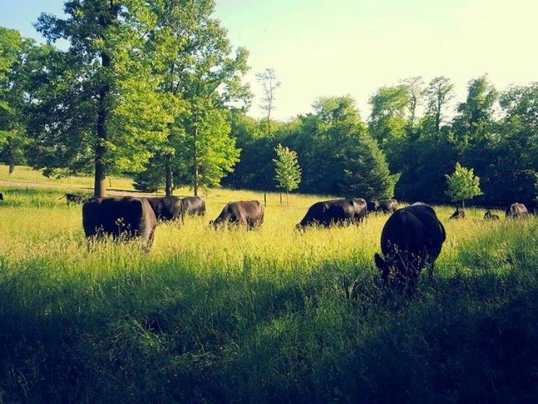
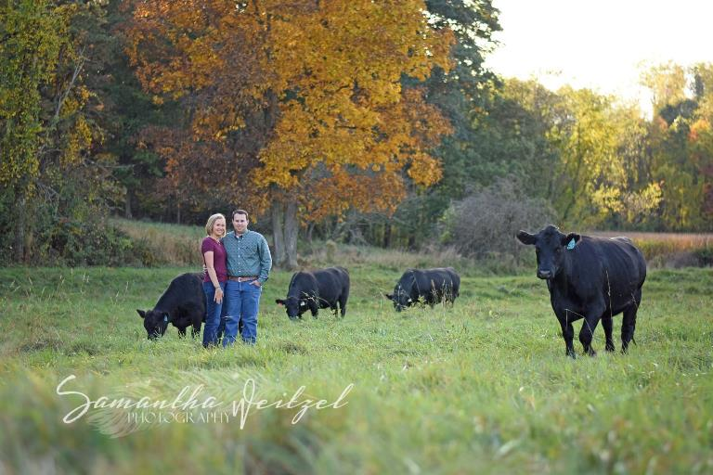
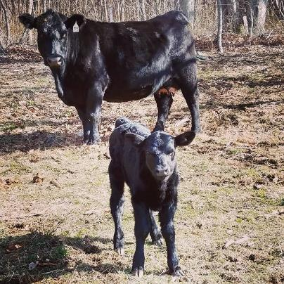
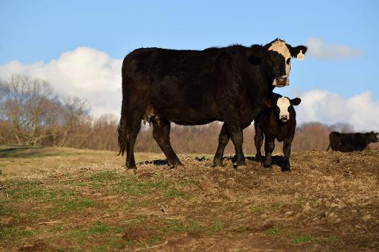
Notes:
Here are some pictures from a Cow/Calf Operation. A cow/calf operation has mama cows that have a calf each year. The calves then go on to either a backgrounding operation or a feedlot. See more about the various stages of the Beef Lifecycle on the next slide.

Slide 15
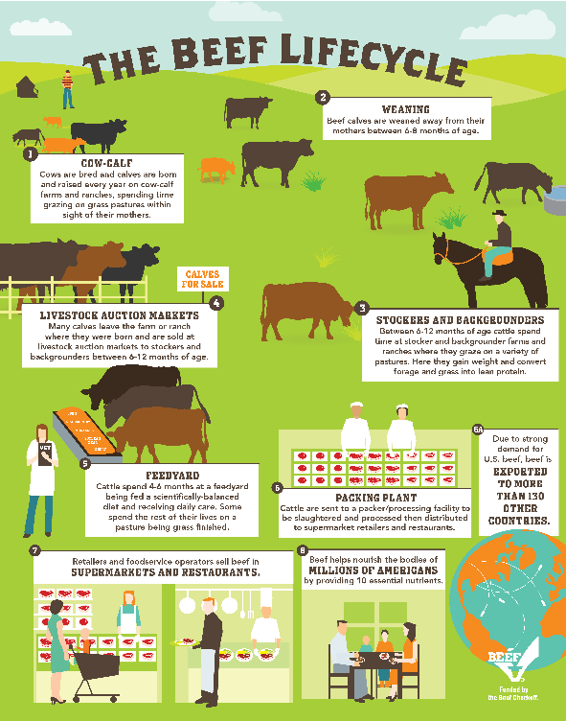
Notes:
This infographic takes you through the various stages of the Beef Lifecycle. You can describe this as a road-map (with a starting point and a finishing point)
You can walk through each stage, if your students would find it valuable. There are descriptions found within each stage.
More information about raising beef can be found here: https://www.beefitswhatsfordinner.com/raising-beef/production-story

Slide 16

Beef Packing Plant
Notes:
This video showcases the safeguards and security measures taken for the safety of the animals, the workers and the final beef product at a beef packing plant.
Questions to ask your students following the video:
Were you surprised by the number of workers it takes to operate the facility?
Did you feel like the cattle were handled with respect and care?
Did this make you confident that your food is safe?
Learn more here: https://www.beefitswhatsfordinner.com/raising-beef/rethink-the-ranch/tyson-packing-plant

Slide 17
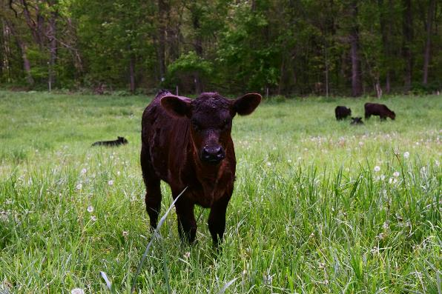

Questions?
???
Notes:
If your students have any questions that you are unable to answer on the spot, please feel free to reach out via email or phone – broberts@beeftips.com or 608-833-9944.
Thank you for taking the time to walk your students through the beef story! We greatly appreciate your commitment to sharing the positive story of agriculture.

